Slide 1


Fifteen Years of Modern C++: My Favorite Features So Far
Prepared and presented by Tom Tesch

Slide 2

About me
Teacher @ Howest University of Applied Sciences within “Digital Arts and Entertainment” bachelor Game Development major
C++ Programming
Algorithms
Computational System Fundamentals
*new* Retro Console Programming
https://www.howest.be/en
https://www.digitalartsandentertainment.be/
tom.tesch@howest.be
https://www.linkedin.com/in/tom-tesch/

Slide 3
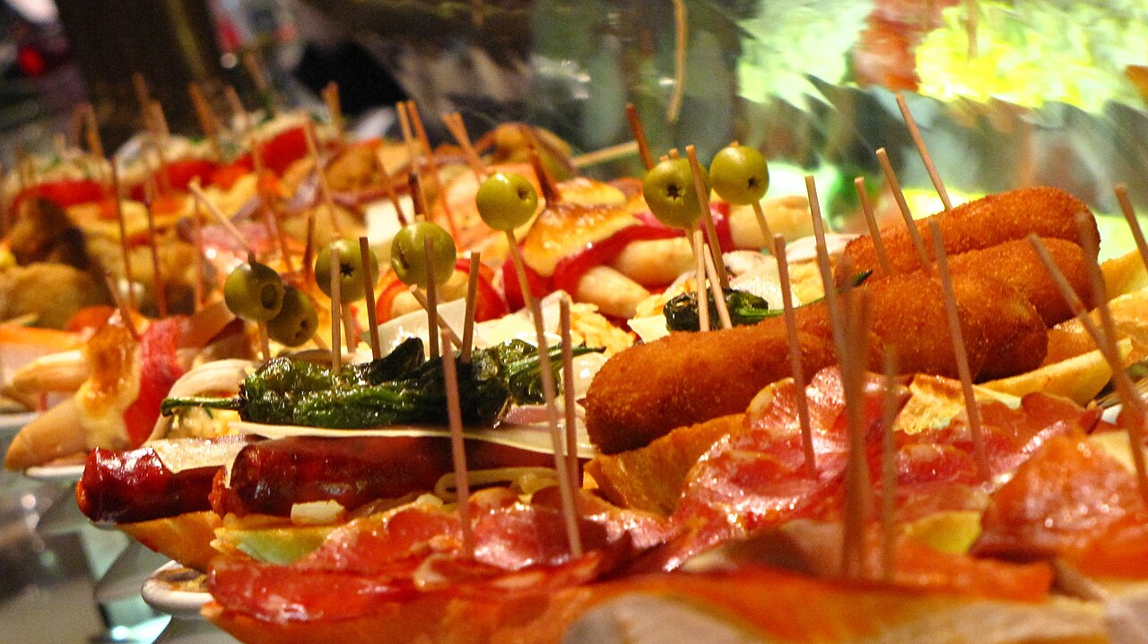

Slide 4

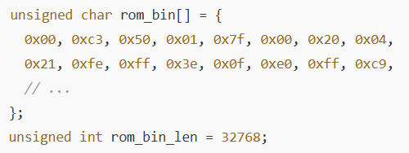
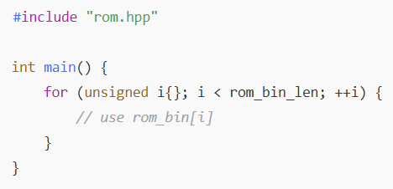
Resource Inclusion
Notes:
https://godbolt.org/z/W3ajfvr4f
https://en.cppreference.com/w/cpp/preprocessor/embed.html

Slide 5
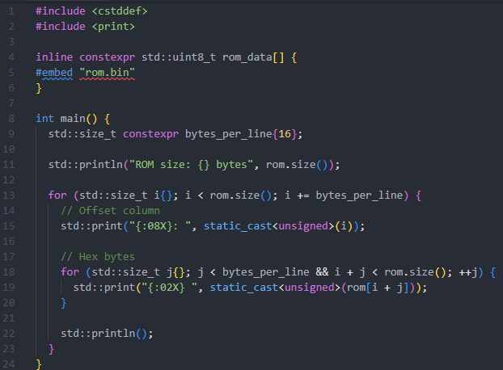
Resource Inclusion
Notes:
https://godbolt.org/z/W3ajfvr4f
https://en.cppreference.com/w/cpp/preprocessor/embed.html

Slide 6
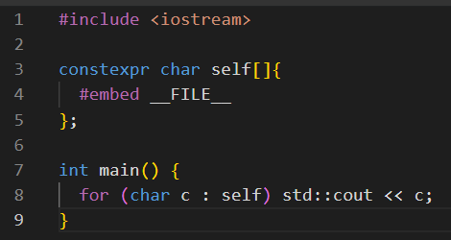
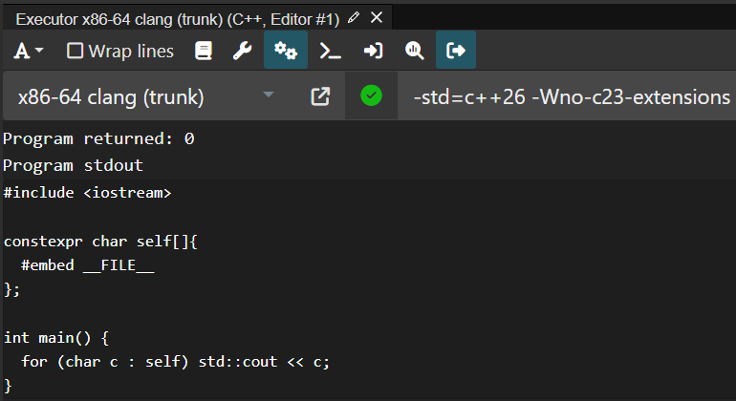
#embed – a Quine
https://godbolt.org/z/b4x3147xz
This means: We can load assets at compile time!
Notes:
https://godbolt.org/z/b4x3147xz
https://en.cppreference.com/w/cpp/preprocessor/embed.html

Slide 7

#embed – a Quine
https://godbolt.org/z/b4x3147xz
26
This means: We can load assets at compile time!
Notes:
https://godbolt.org/z/b4x3147xz

Slide 8
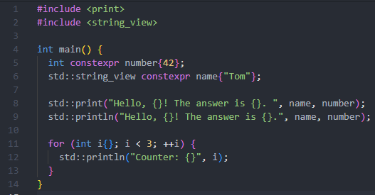
std::print and std::println
Notes:
https://godbolt.org/z/YPMTYMn3z

Slide 9
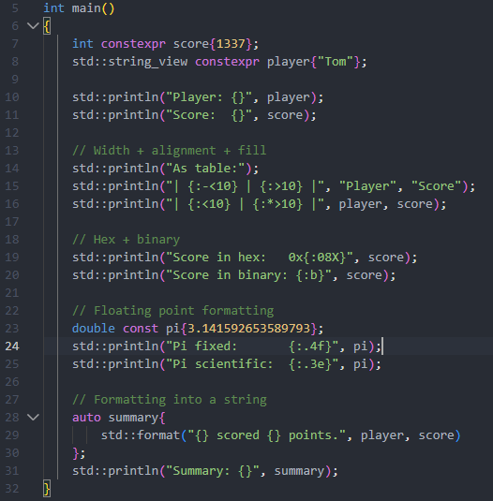
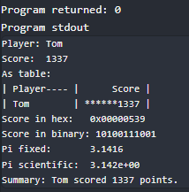
std::print and std::println
Notes:
https://godbolt.org/z/YPMTYMn3z
https://en.cppreference.com/w/cpp/utility/format/spec.html

Slide 10
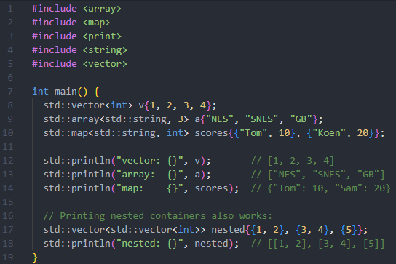
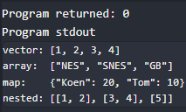
Notes:
https://godbolt.org/z/e7zdYPb7f

Slide 11
23
Notes:
https://godbolt.org/z/e7zdYPb7f

Slide 12
std::println() prints a new line
Notes:
https://godbolt.org/z/e7zdYPb7f

Slide 13
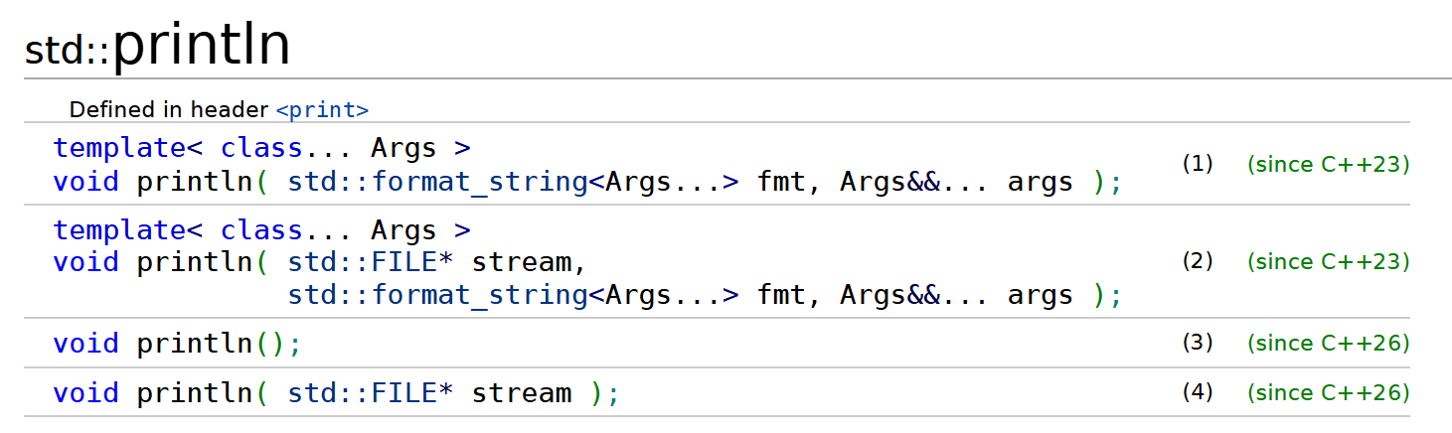
std::println() prints a new line
26
Notes:
https://godbolt.org/z/e7zdYPb7f

Slide 14
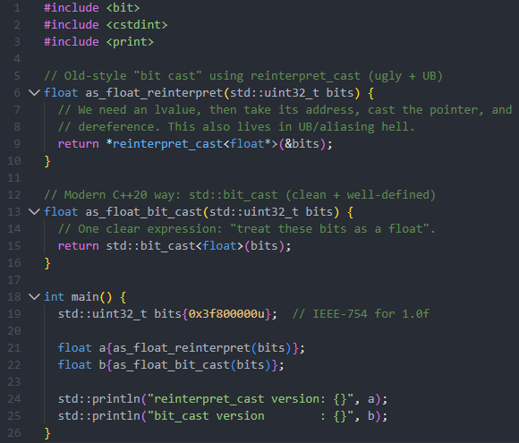
std::bit_cast
Notes:
https://godbolt.org/z/z75v58rPY
https://godbolt.org/z/orYezWo34

Slide 15
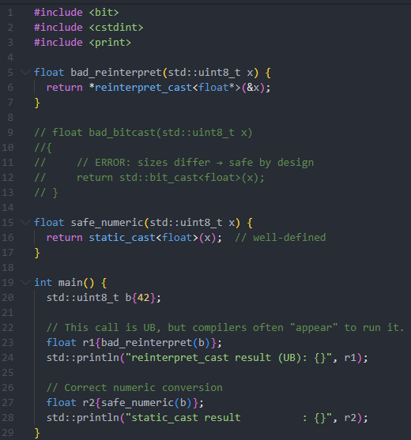
std::bit_cast
Notes:
https://godbolt.org/z/z75v58rPY
https://godbolt.org/z/orYezWo34

Slide 16
std::bit_cast
20
Notes:
https://godbolt.org/z/z75v58rPY
https://godbolt.org/z/orYezWo34

Slide 17

The keyword using with a declarator-list
Notes:
https://godbolt.org/z/jahMedMoT

Slide 18
The keyword using with a declarator-list
17
Notes:
https://godbolt.org/z/jahMedMoT

Slide 19
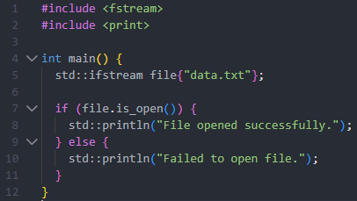
if statement: init-statement
Notes:
https://godbolt.org/z/M98xhhK1j
https://godbolt.org/z/9xnbseGcP

Slide 20
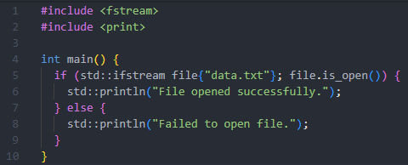
if statement: init-statement
Notes:
https://godbolt.org/z/M98xhhK1j
https://godbolt.org/z/9xnbseGcP

Slide 21
if statement: init-statement
17
Notes:
https://godbolt.org/z/M98xhhK1j
https://godbolt.org/z/9xnbseGcP

Slide 22
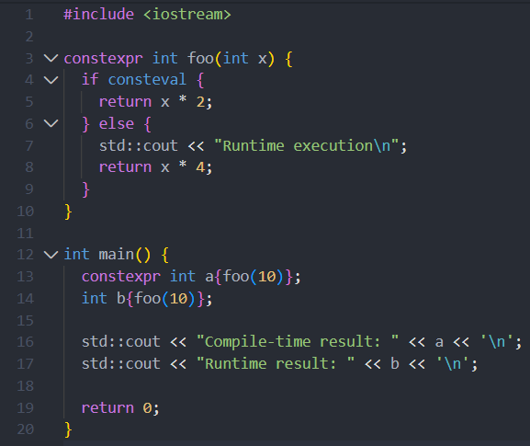
if statement: if consteval
Notes:
https://godbolt.org/z/cczr6WqT7

Slide 23
if statement: if consteval
23
Notes:
https://godbolt.org/z/cczr6WqT7

Slide 24
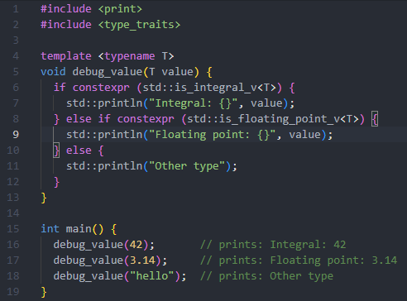
if statement: if constexpr
Notes:
https://godbolt.org/z/hErx9Edd7
https://en.cppreference.com/w/cpp/language/if.html#Constexpr_if

Slide 25
if statement: if constexpr
17
Notes:
https://godbolt.org/z/hErx9Edd7
https://en.cppreference.com/w/cpp/language/if.html#Constexpr_if

Slide 26
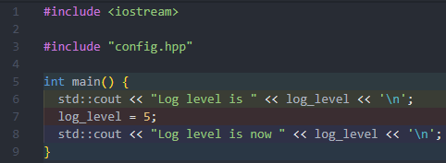
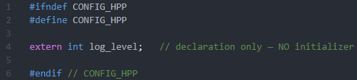
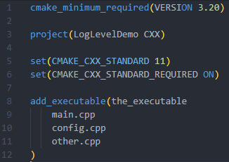
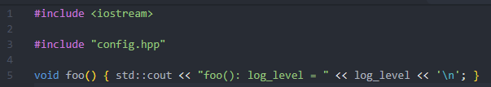

inline variable
main.cpp
config.hpp
other.cpp
config.cpp
CMakeLists.txt
Notes:
https://godbolt.org/z/5Kf7enYx3
https://en.cppreference.com/w/cpp/language/inline.html

Slide 27
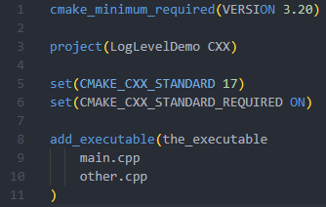
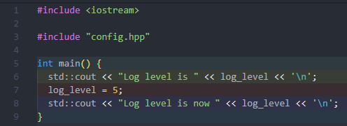
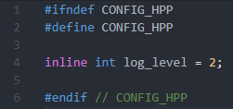
inline variable
main.cpp
CMakeLists.txt
other.cpp
config.hpp
Notes:
https://godbolt.org/z/b3rfK9n99

Slide 28
inline variable
main.cpp
CMakeLists.txt
17
other.cpp
config.hpp
Notes:
https://godbolt.org/z/b3rfK9n99

Slide 29
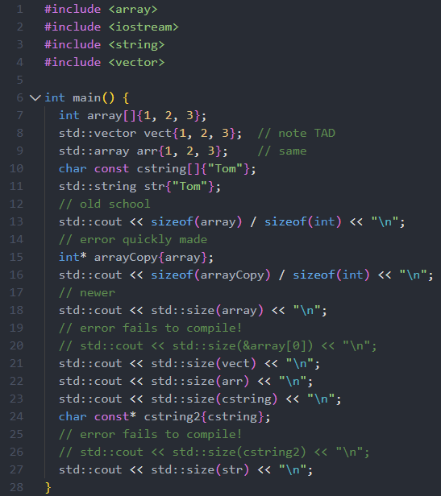
std::size, std::ssize
Notes:
https://godbolt.org/z/evz4rcrYW
https://en.cppreference.com/w/cpp/iterator/size.html

Slide 30
std::size, std::ssize
17
Notes:
https://godbolt.org/z/evz4rcrYW

Slide 31
std::size, std::ssize
20
Notes:
https://godbolt.org/z/evz4rcrYW

Slide 32
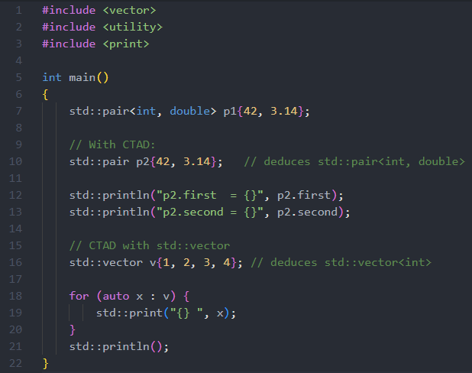
CTAD
Notes:
CTAD = Class Template Argument Deduction.
https://godbolt.org/z/seazaqMKf

Slide 33
CTAD
17
Notes:
CTAD = Class Template Argument Deduction.
https://godbolt.org/z/seazaqMKf
https://en.cppreference.com/w/cpp/language/class_template_argument_deduction.html

Slide 34
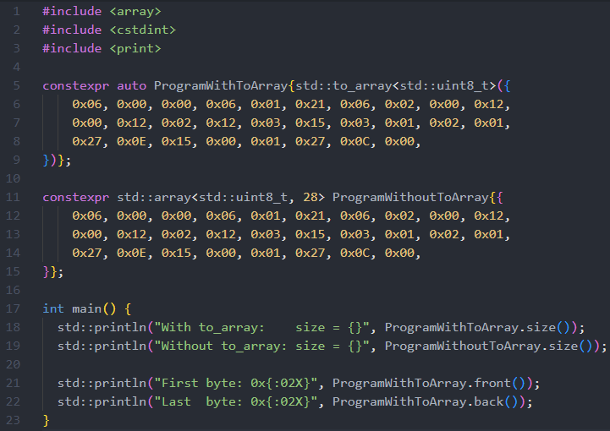
CTAD for std::array size
Notes:
CTAD was disabled for std::array because deducing the size (N) from a braced initializer is ambiguous, unsafe, and violates the rules for template argument deduction in aggregates. C++20’s std::to_array was introduced as the safe alternative.
https://godbolt.org/z/qcqfxsP9r
https://en.cppreference.com/w/cpp/container/array/to_array.html

Slide 35
CTAD for std::array size
20
Notes:
CTAD was disabled for std::array because deducing the size (N) from a braced initializer is ambiguous, unsafe, and violates the rules for template argument deduction in aggregates. C++20’s std::to_array was introduced as the safe alternative.
https://godbolt.org/z/qcqfxsP9r
https://en.cppreference.com/w/cpp/container/array/to_array.html

Slide 36
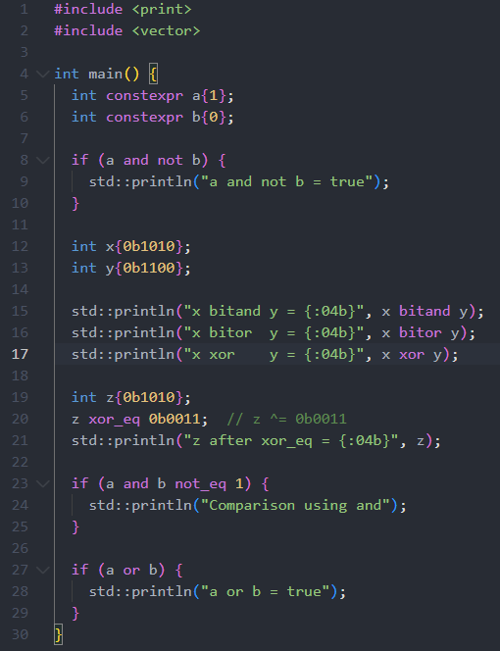
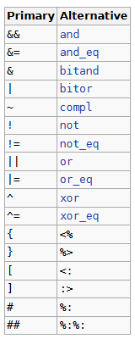
Alternative operator representations
Notes:
https://en.cppreference.com/w/cpp/language/operator_alternative.html

Slide 37
Alternative operator representations
Notes:
https://en.cppreference.com/w/cpp/language/operator_alternative.html

Slide 38
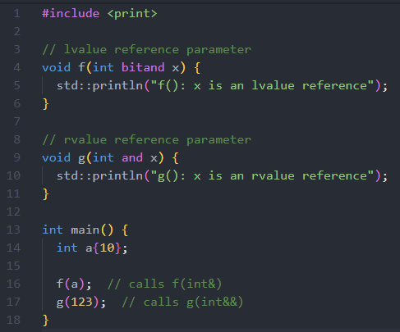
Alternative operator representations *SIGH*
Notes:
https://en.cppreference.com/w/cpp/language/operator_alternative.html

Slide 39
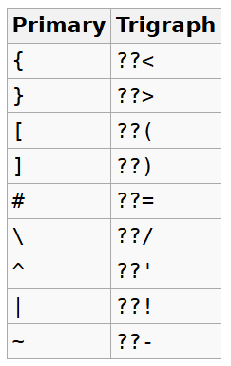
Alternative operator representations

Slide 40
Alternative operator representations

Slide 41
Alternative operator representations
17
Notes:
Besides auto_ptr and Garbace Collection support one of the few things that I know got removed from the standard

Slide 42
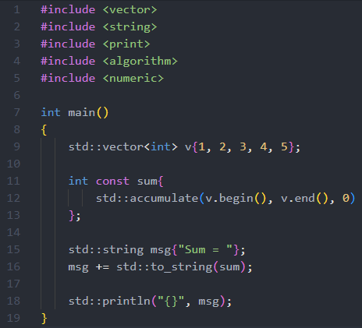
import std;
Notes:
https://godbolt.org/z/ofshKPqv1
https://godbolt.org/z/h9Kn9db6d

Slide 43
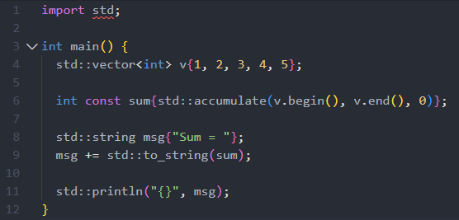
import std;
Notes:
https://godbolt.org/z/ofshKPqv1
https://godbolt.org/z/h9Kn9db6d

Slide 44
import std;
23
Notes:
https://godbolt.org/z/ofshKPqv1
https://godbolt.org/z/h9Kn9db6d

Slide 45
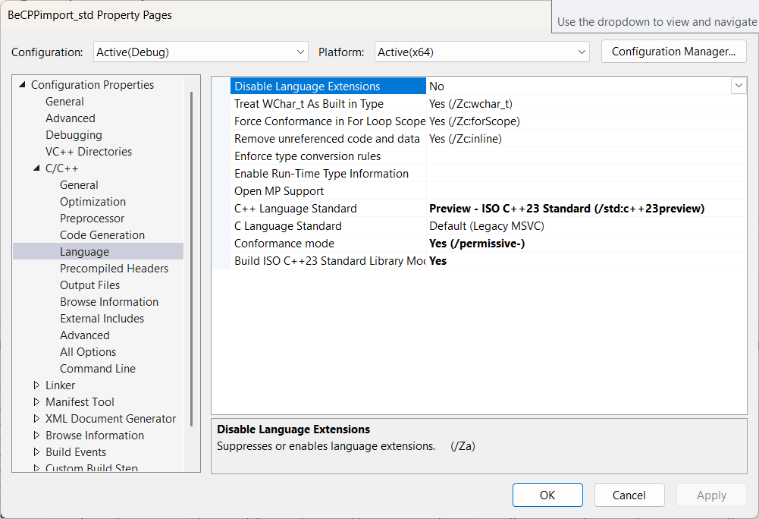
import std;
Notes:
VS26 – for chrono

Slide 46
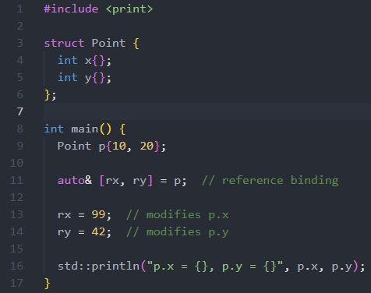
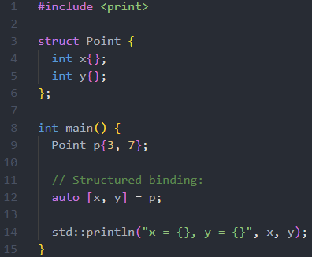
Structured binding
Notes:
https://godbolt.org/z/e7h6666c3
https://godbolt.org/z/WM7zTsrPq
https://en.cppreference.com/w/cpp/language/structured_binding.html

Slide 47
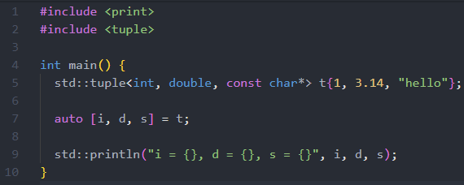
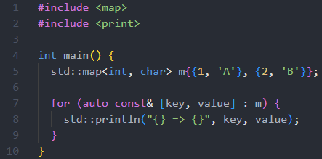
Structured binding
Notes:
https://godbolt.org/z/hT4cWGMEz
https://godbolt.org/z/En9cefsno
https://en.cppreference.com/w/cpp/language/structured_binding.html

Slide 48
Structured binding
17
Notes:
https://godbolt.org/z/hT4cWGMEz
https://godbolt.org/z/En9cefsno
https://en.cppreference.com/w/cpp/language/structured_binding.html

Slide 49
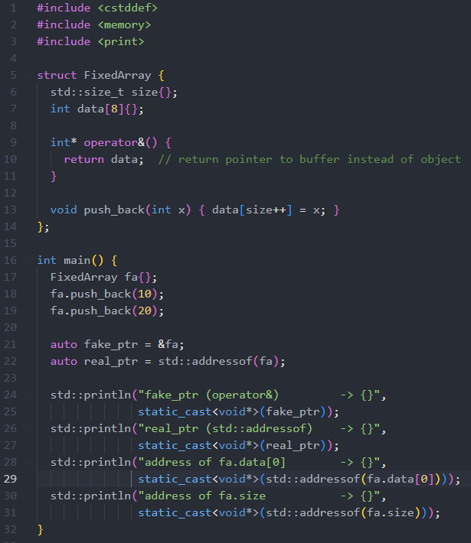
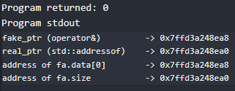
std::addresof
Notes:
https://godbolt.org/z/EP9dKW5r4
https://en.cppreference.com/w/cpp/memory/addressof.html

Slide 50
std::addresof
11
Notes:
https://godbolt.org/z/EP9dKW5r4
https://en.cppreference.com/w/cpp/memory/addressof.html
Constexpr since c++17

Slide 51
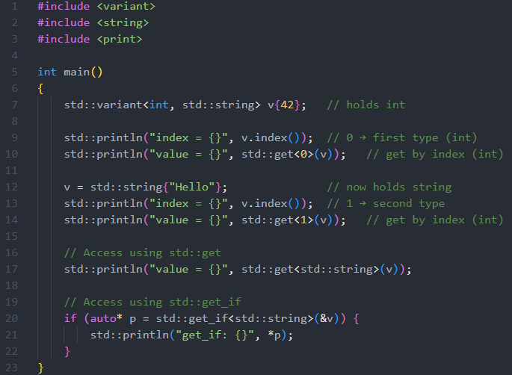
std:: variant
Notes:
std::get<T> → returns reference and throws on wrong type.
std::get_if<T> → returns pointer so it can return nullptr safely.
https://godbolt.org/z/nfK4E1fP9
https://en.cppreference.com/w/cpp/utility/variant.html

Slide 52
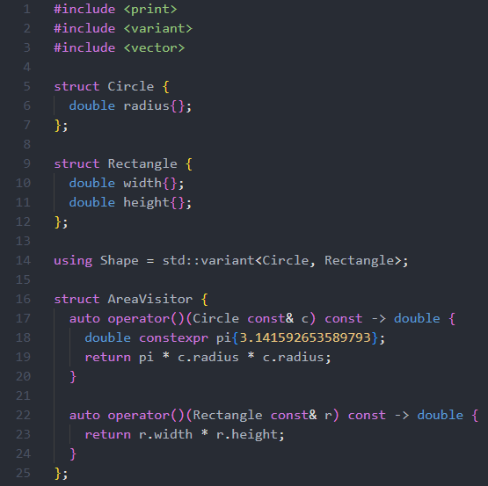
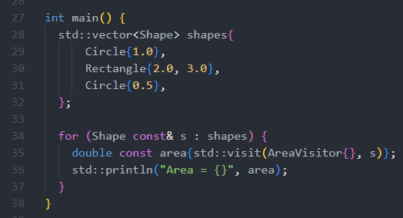
std::variant
Notes:
std::get<T> → returns reference and throws on wrong type.
std::get_if<T> → returns pointer so it can return nullptr safely.
https://godbolt.org/z/KbefbnM64

Slide 53
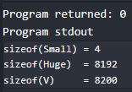
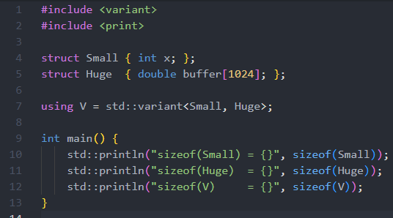
std::variant
Notes:
std::get<T> → returns reference and throws on wrong type.
std::get_if<T> → returns pointer so it can return nullptr safely.
https://godbolt.org/z/KbefbnM64

Slide 54
std::variant
17
Notes:
std::get<T> → returns reference and throws on wrong type.
std::get_if<T> → returns pointer so it can return nullptr safely.
https://godbolt.org/z/KbefbnM64

Slide 55
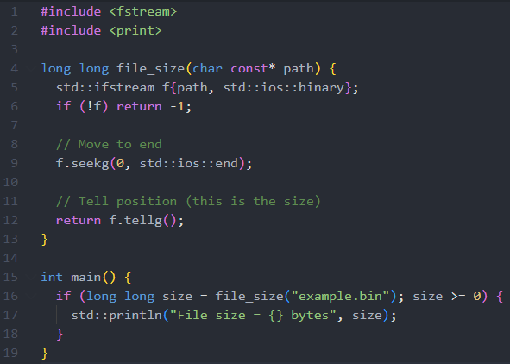
std::filesystem
Notes:
https://godbolt.org/z/fajE5s57x
https://godbolt.org/z/qs7xMon8K
https://en.cppreference.com/w/cpp/filesystem.html

Slide 56
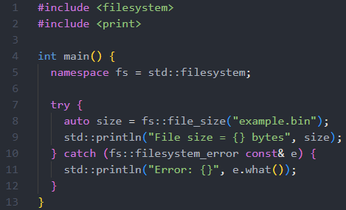
std::filesystem
Notes:
https://godbolt.org/z/fajE5s57x
https://godbolt.org/z/qs7xMon8K
https://en.cppreference.com/w/cpp/filesystem.html

Slide 57
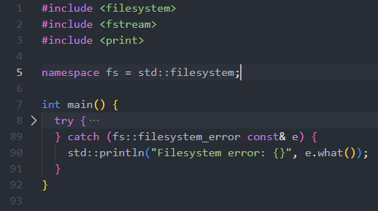
std::filesystem
Notes:
https://godbolt.org/z/dzY1aTvzY
https://en.cppreference.com/w/cpp/filesystem.html

Slide 58
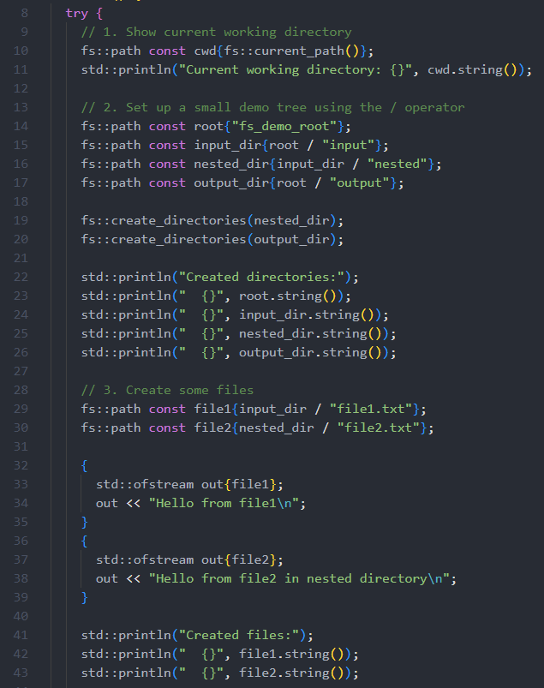
std::filesystem
Notes:
https://godbolt.org/z/dzY1aTvzY
https://en.cppreference.com/w/cpp/filesystem.html

Slide 59

std::filesystem
Notes:
https://godbolt.org/z/dzY1aTvzY
https://en.cppreference.com/w/cpp/filesystem.html

Slide 60

filesystem
Notes:
https://godbolt.org/z/dzY1aTvzY
https://en.cppreference.com/w/cpp/filesystem.html

Slide 61
filesystem
17
Notes:
https://godbolt.org/z/dzY1aTvzY
https://en.cppreference.com/w/cpp/filesystem.html

Slide 62


Slide 63




















































































