Slide 1
Game Development with C++
Digital Arts and Entertainment
Koen Samyn – program coordinator

Slide 2

Game Development study program
Semester 1
Programming 1
Algorithms 1

Slide 3
Game Development study program
Semester 1
Semester 2
Programming 1
Programming 2
Bare bones game engine → No Unreal, Unity, Godot, ….
Algorithms 1
Computations System
Fundamentals

Slide 4
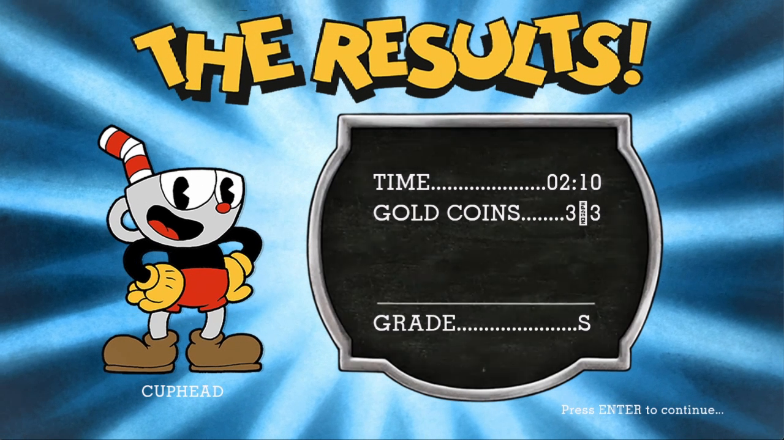
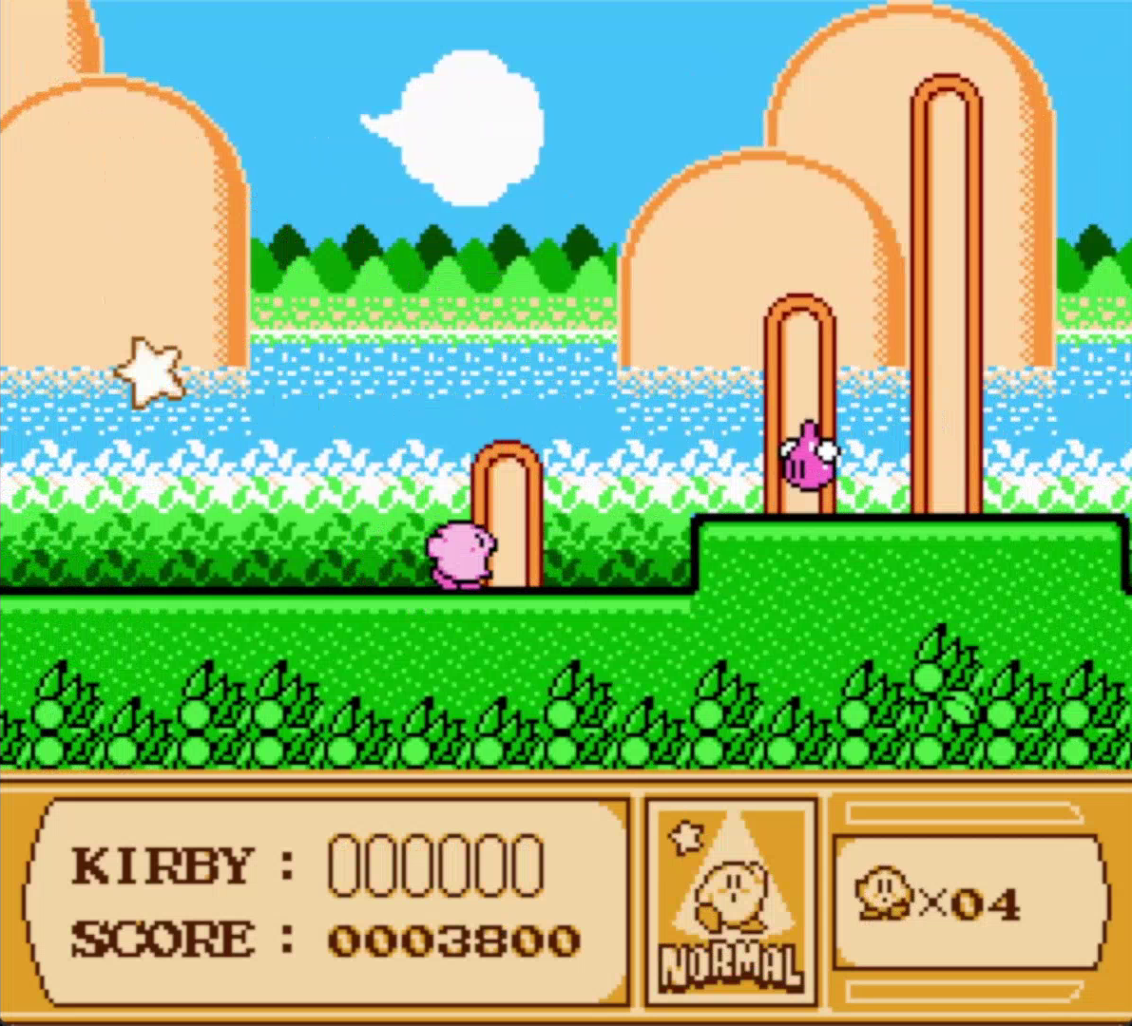
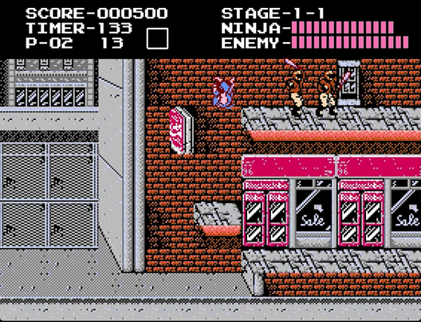
Game Development study program
Semester 1
Semester 2
Programming 1
Programming 2
Algorithms 1
Computations System
Fundamentals

Slide 5
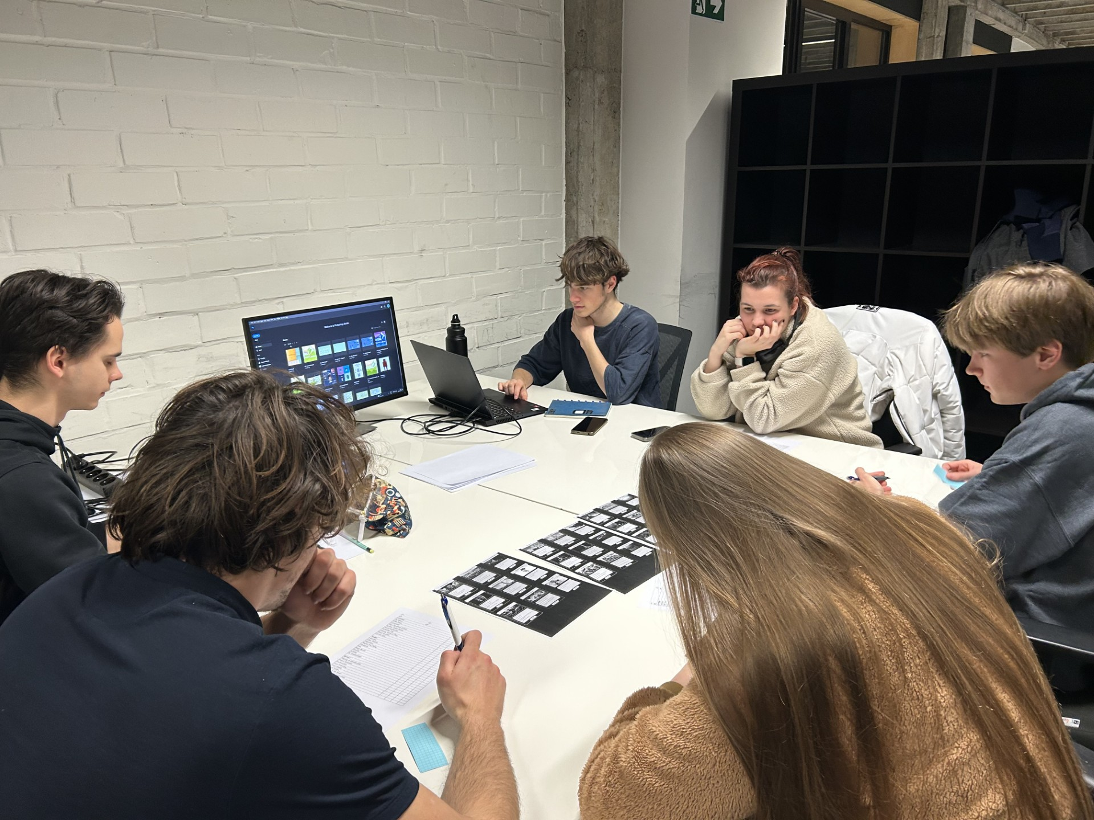
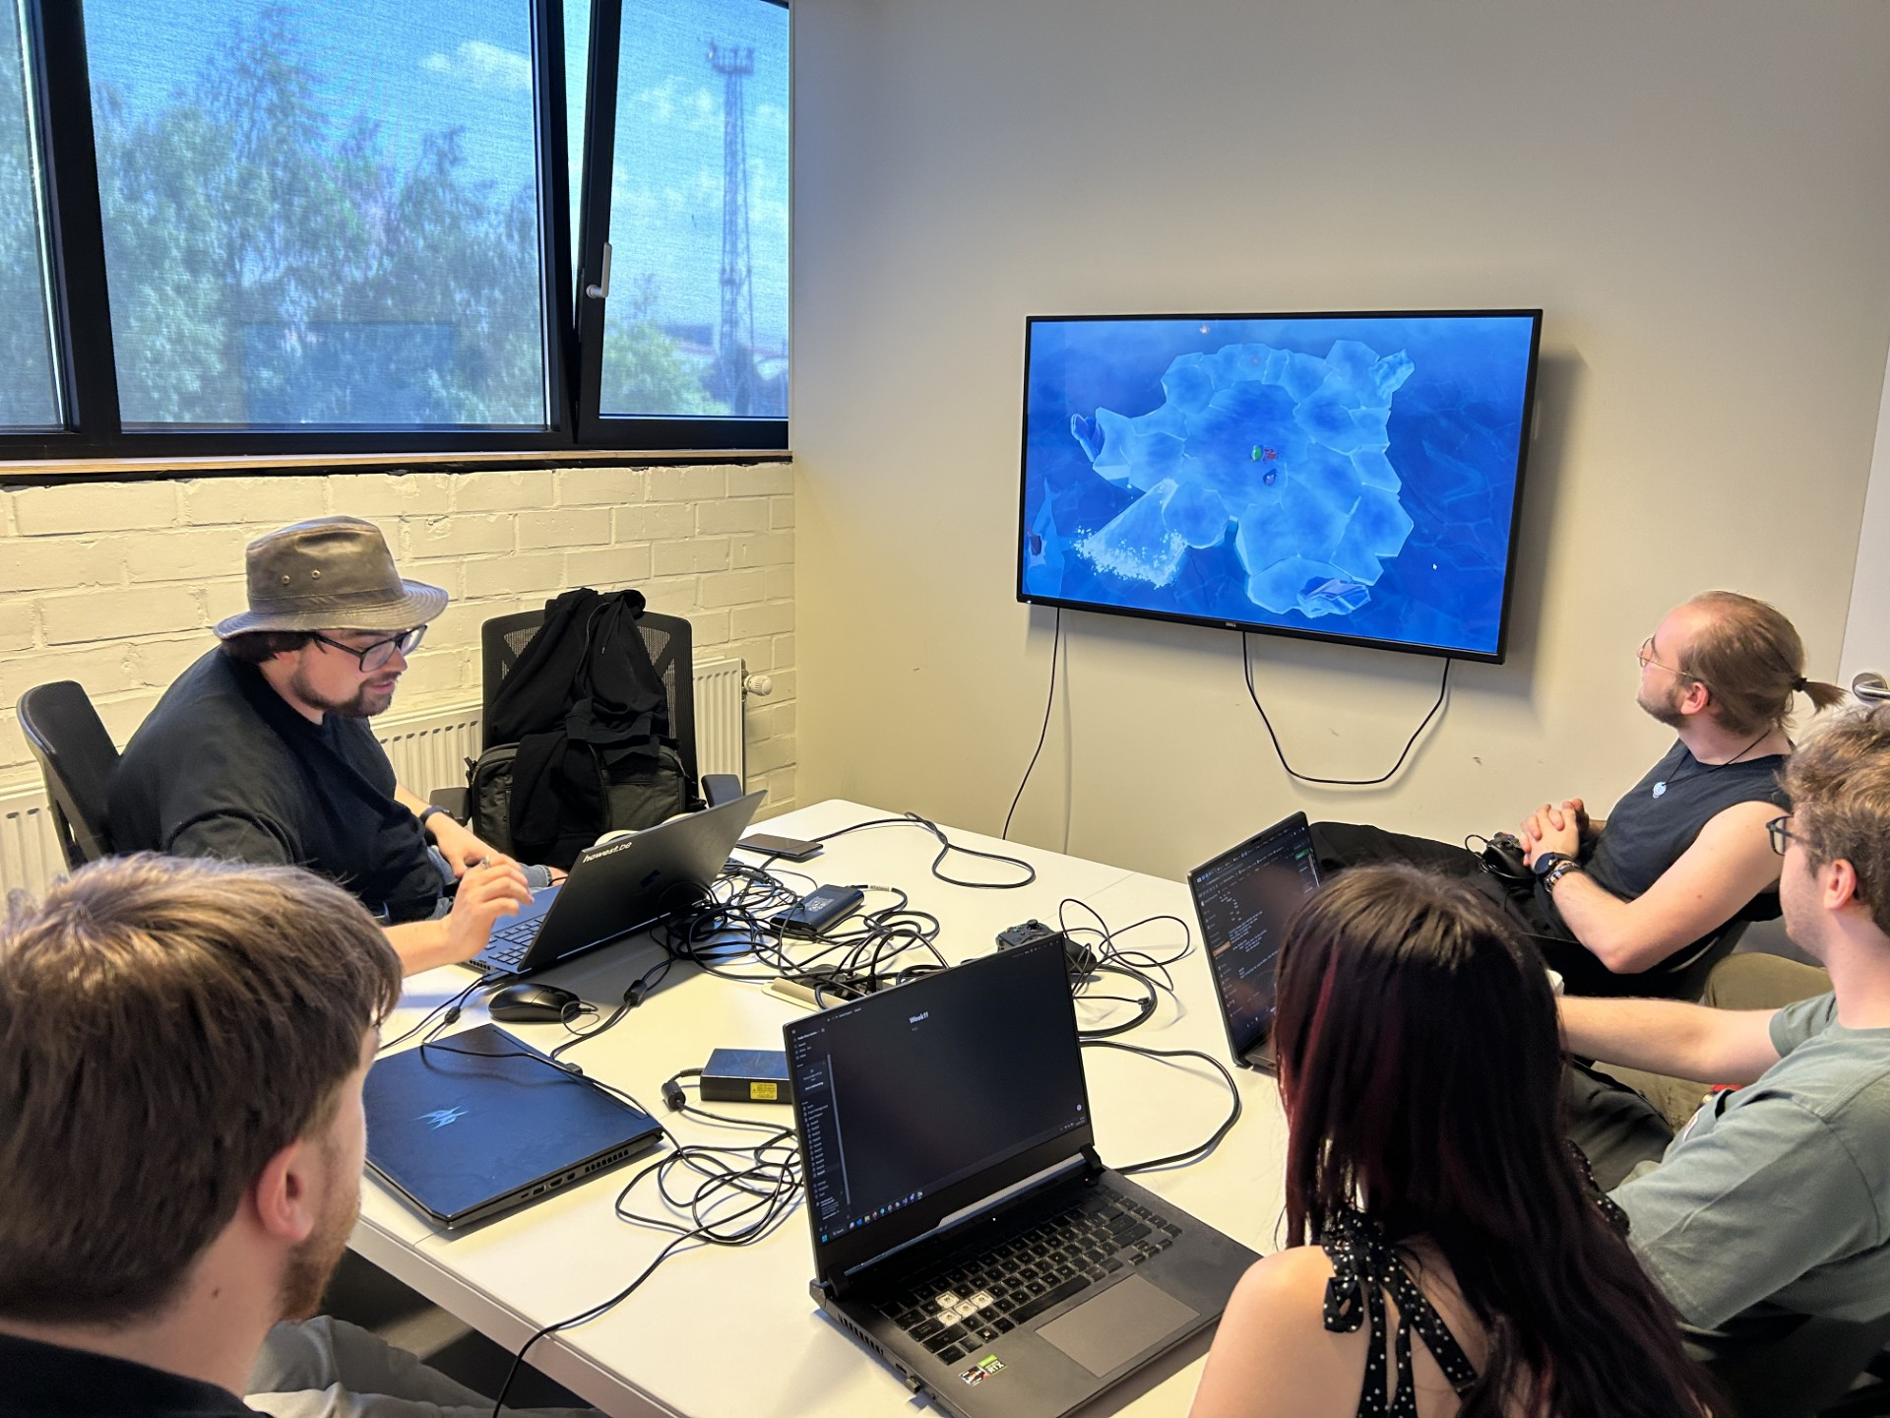
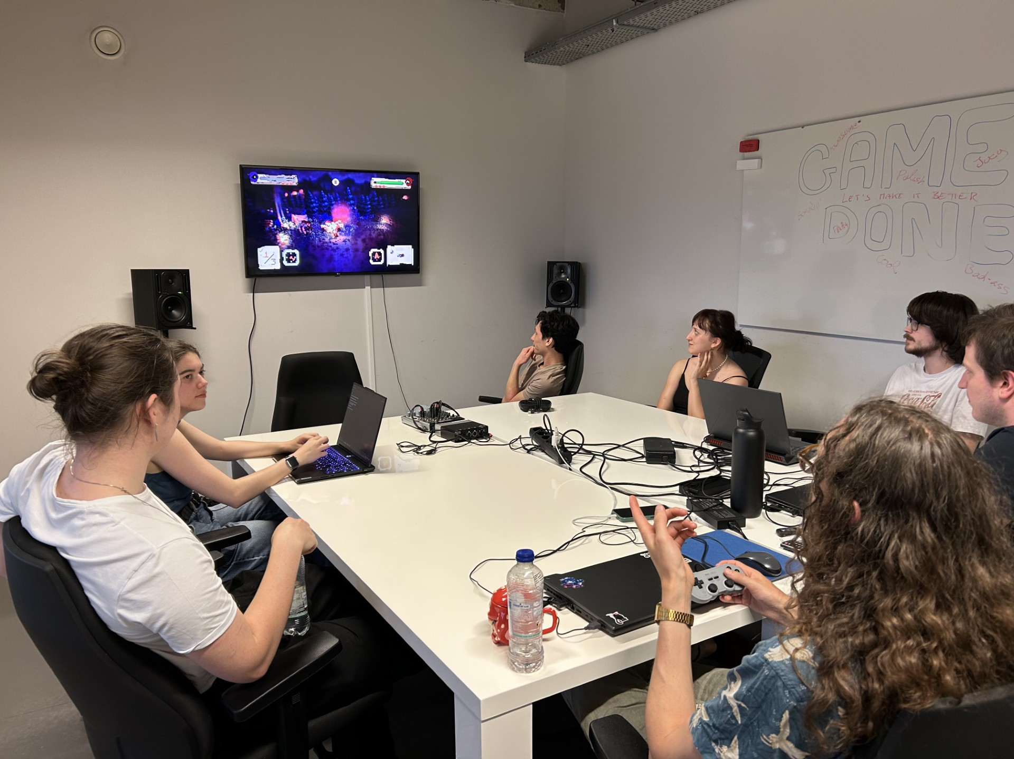
Game Development study program
Semester 1
Semester 2
Programming 1
Programming 2
Algorithms 1
Computations System
Fundamentals
Math and physics, art skills, career skills

Slide 6
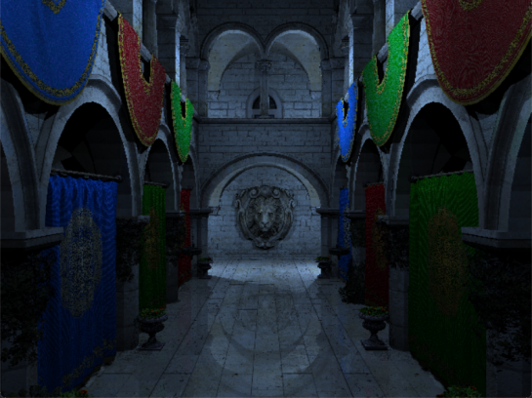
Game Development study program
Semester 3
Programming 3
Software engineering
Graphics Programming 1

Slide 7
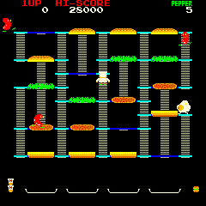
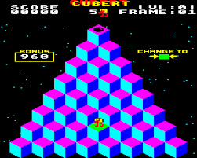
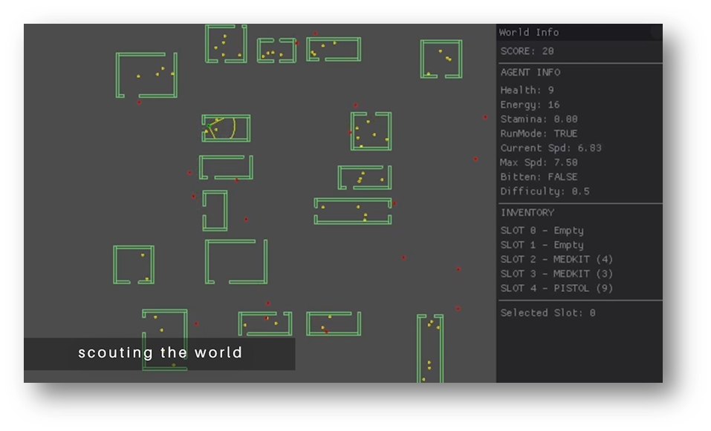
Game Development study program
Semester 3
Semester 4
Programming 3
Programming 4
Software engineering
Tool Development (C#)
Graphics Programming 1
Gameplay Programming

Slide 8
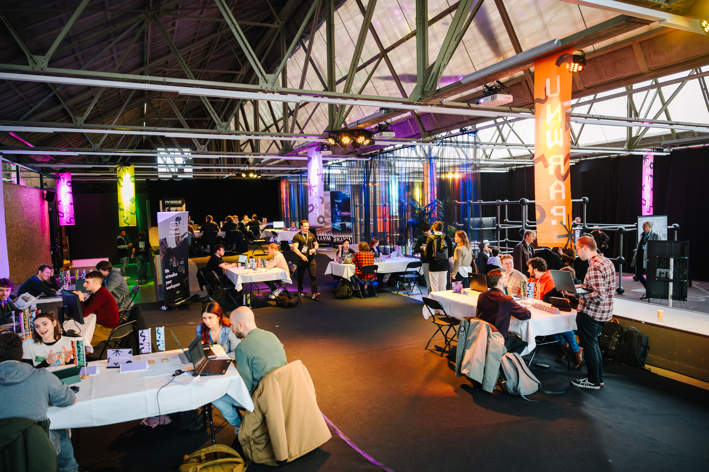
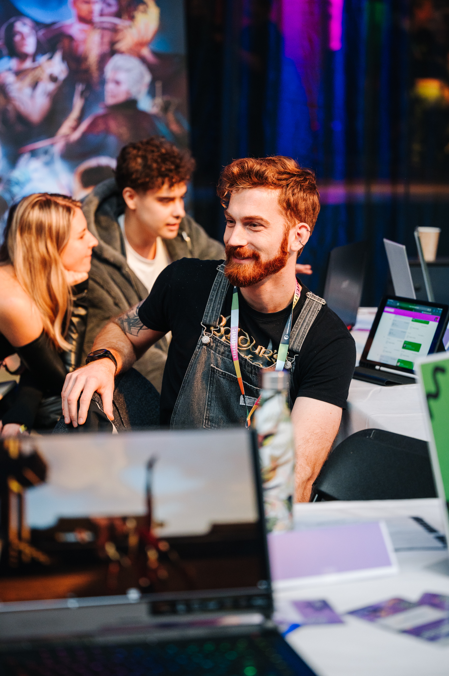
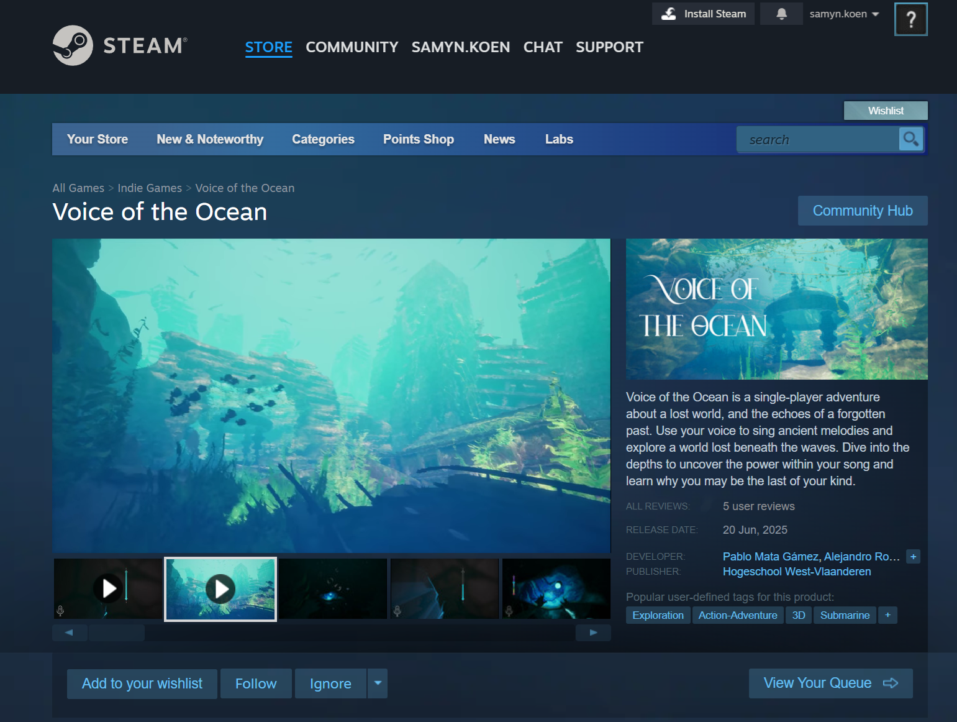
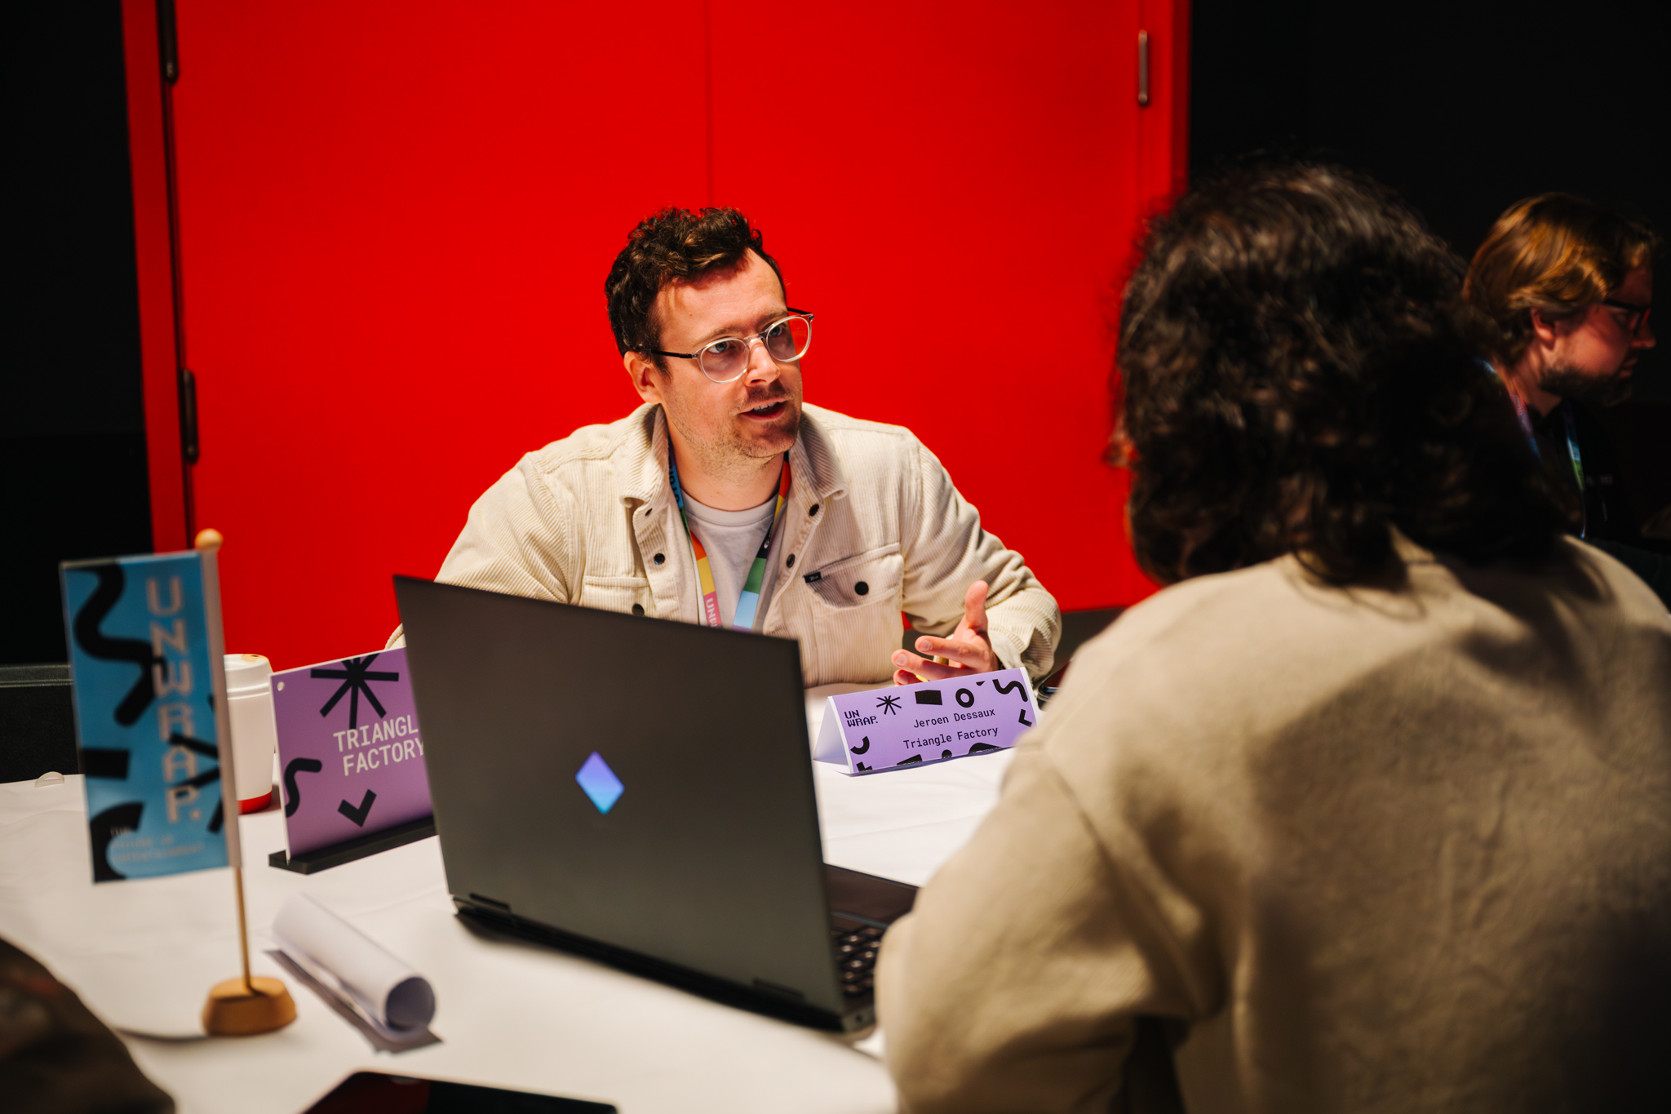
Game Development study program
Final year
Semester 5
Semester 6
Graduation work
Internship
Group project

Slide 9
Game Development at DAE
Contact me for feedback and/or questions
Got C++ jobs / internships?
  Mail them to
    Regis Le Roy (education manager DAE)
    → regis.le.roy@howest.be
    Koen Samyn
    → koen.samyn@howest.be
    → or via linked in.

