Slide 1
Compile-Time Emulation of an 8080-Inspired System in C++
Prepared and presented by Tom Tesch

Slide 2
About me
Teacher @ Howest University of Applied Sciences within “Digital Arts and Entertainment” bachelor Game Development major
C++ Programming
Algorithms
Computational System Fundamentals
*new* Retro Console Programming
https://www.howest.be/en
https://www.digitalartsandentertainment.be/
tom.tesch@howest.be
https://www.linkedin.com/in/tom-tesch/

Slide 4
https://www.youtube.com/watch?v=4lliFwe5_yg

Slide 5
Building the World’s Fastest GameBoy Emulator in Modern C++

Slide 6
Notes:
Chris Evans (Captain America) and Scarlett Johansson (Black Widow)

Slide 7
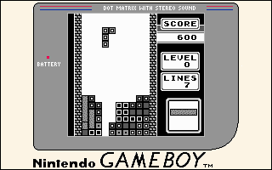
TEGLON?
Tetris for
Gameboy
LOgic
iNnversion
Where does the term
originate from?

Slide 8
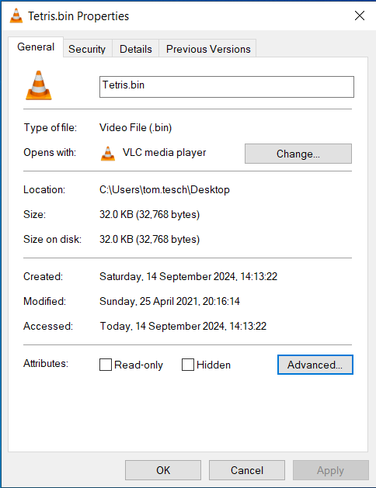
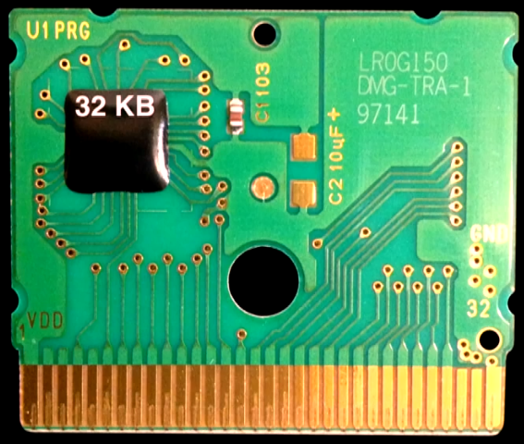
No MBC needed!

Slide 9
Still too much to fully implement in 1 hour

Slide 10
https://schweigi.github.io/assembler-simulator/
Notes:
https://schweigi.github.io/assembler-simulator/

Slide 11
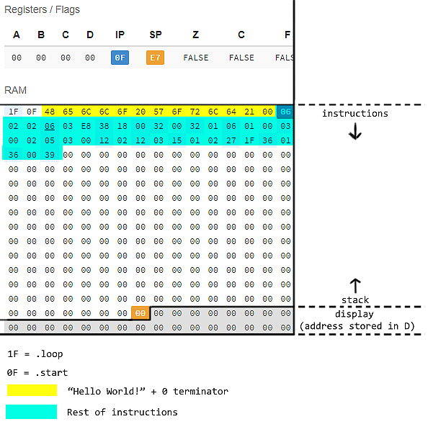

Slide 12
“Hardware”
Eight-bit controller
256 bytes of RAM – 24 bytes used for character display
4 general purpose registers (A, B, C & D)
Stack pointer (SP)
Instruction pointer (IP)
Three flags (Zero, Carry and Fault)
Simulator runs up to a blazing 16Hz

Slide 13
Operators (part 1)
Copying a value
MOV : move
Defining a variable
DB : define bytes
Mathematical operations
ADD : add or subtract
INC : Increment
DEC : Decrement
MUL : Multiply
DIV : Divide
Stack operations
PUSH : push on stack
POP : pop from stack

Slide 14
Operators (part 2)
Logical Operations
AND : Binary and
OR : binary or
XOR : binary xor
NOT : binary not
Shift operations
SHL : shift left
SHR : shift right
Function calling
CALL : function call
RET : return from function
Halting the processor
HLT : stop program

Slide 15
Operators (part 3)
Unconditional jump
JMP : jump
Compare
CMP : compare
Conditional jump
JC : jump if carry
JNC : jump if no carry
JZ : jump if zero
JNZ : jump if not zero
JE : jump if equal
JNE : jump if not equal
JA : jump if above (<)
JNA : jump if not above
JAE : jump if above or equal (>=)
JB : jump if below (<)
JNB : jump if not below
JNBE : jump if not below or equal (<=)

Slide 16
For math (ADD, SUB, INC, DEC)
ADD reg, reg
ADD reg, address
ADD reg, constant
ADD address, reg
ADD address, constant
INC reg
DEC reg
Target operand always a register!
SUB reg, reg
SUB reg, address
SUB reg, constant

Slide 17
Watch out for math instructions MUL and DIV!
MUL reg DIV reg
MUL address DIV address
MUL constant DIV constant
Target of MUL and DIV is always the A register!
Why?

Slide 18
Types of operands for MOV
MOV reg, reg
MOV reg, address
MOV reg, constant
MOV address, reg
MOV address, constant

Slide 19
Types of operands for MOV - aside
MOV A, 128
MOV A, B
MOV [A], 128
MOV A, [128]
MOV [A], [128]
MOV 128, A
MOV 128, [A]
MOV [128], A
MOV [128], [A]

Slide 20
Types of operands for MOV - aside - opcodes
MOV A, 128
MOV A, B
MOV [A], 128
MOV A, [128]
MOV [A], [128]
MOV 128, A Makes no sense!
MOV 128, [A] Makes no sense!
MOV [128], A
MOV [128], [A]

Slide 21
Types of operands for MOV – aside -
MOV A, 128
MOV A, B
MOV [A], 128
MOV A, [128]
MOV [A], [128] Moving from address to address not supported!
MOV 128, A Makes no sense!
MOV 128, [A] Makes no sense!
MOV [128], A
MOV [128], [A] Moving from address to address not supported!

Slide 22
Types of operands for MOV – aside - opcodes
MOV A, 128 0x06 0x00 0x80
MOV A, B 0x01 0x00 0x01
MOV [A], 128 0x08 0x00 0x80
MOV A, [128] 0x02 0x00 0x80
MOV [A], [128] Moving from address to address not supported!
MOV 128, A Makes no sense!
MOV 128, [A] Makes no sense!
MOV [128], A 0x04 0x80 0x00
MOV [128], [A] Moving from address to address not supported!

Slide 23
REGEX 101
Notes:
https://regex101.com/

Slide 24
REGEX 101
Notes:
/([0-9A-F]{2})\n/gm
0x$1,

Slide 25
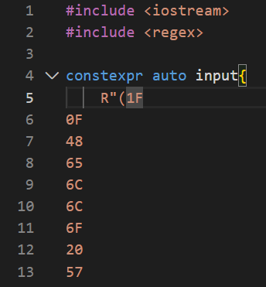
https://godbolt.org/z/MKbadKde6
Notes:
https://godbolt.org/z/MKbadKde6

Slide 26
A first naïve implementation
https://godbolt.org/z/4vobzbvYT
Notes:
https://godbolt.org/z/G77zWvvo8

Slide 29
Write every time!
We Enjoy Typing!
Waste Everyones Time

Slide 30
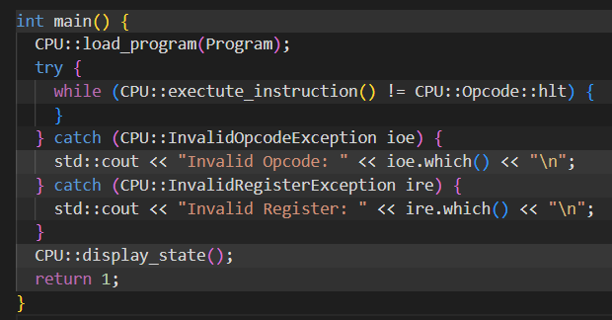
DRY and exceptions
https://godbolt.org/z/WadGrWPKx
Notes:
https://godbolt.org/z/WadGrWPKx

Slide 31
https://quick-bench.com/q/dso6fz4WN2NzBZvv3p_CRxk_iRY
https://www.youtube.com/watch?v=bY2FlayomlE
Notes:
https://quick-bench.com/q/dso6fz4WN2NzBZvv3p_CRxk_iRY

Slide 32
https://www.youtube.com/watch?v=bY2FlayomlE
Notes:
https://quick-bench.com/q/dso6fz4WN2NzBZvv3p_CRxk_iRY

Slide 33
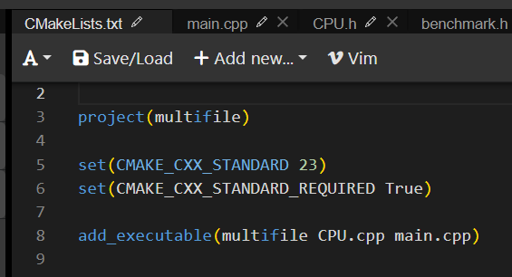
Making a class
Hurray for Godbolt supporting cmake!
This allows for multifile projects
https://godbolt.org/z/Mzdd6n1fW

Slide 34
Aside: avoiding naked for statements
https://isocpp.github.io/CppCoreGuidelines/CppCoreGuidelines#es71-prefer-a-range-for-statement-to-a-for-statement-when-there-is-a-choice

Slide 35
Aside: avoiding naked for statements
Notes:
1. std::span<uint8_t const> program
Accepts a view over a sequence of constant uint8_t values.
Think of it like a non-owning array or vector reference.
2. std::views::enumerate(program)
This is the C++23 feature: std::views::enumerate yields a range of (index, value) pairs for any iterable.
So if program has 5 bytes, you get:
(0, program[0]), (1, program[1]), ..., (4, program[4])
3. for (auto const [idx, c] : ...)
Structured bindings (C++17) are used here to unpack the (index, value) pair.
Each iteration gives you:
idx: the index (as size_t)
c: the byte at that index (as uint8_t)
4. m_memory[idx] = c;
Stores each byte c into m_memory at the corresponding index.

Slide 36
Aside: avoiding naked for statements (C++23)
Notes:
1. std::span<uint8_t const> program
Accepts a view over a sequence of constant uint8_t values.
Think of it like a non-owning array or vector reference.
2. std::views::enumerate(program)
This is the C++23 feature: std::views::enumerate yields a range of (index, value) pairs for any iterable.
So if program has 5 bytes, you get:
(0, program[0]), (1, program[1]), ..., (4, program[4])
3. for (auto const [idx, c] : ...)
Structured bindings (C++17) are used here to unpack the (index, value) pair.
Each iteration gives you:
idx: the index (as size_t)
c: the byte at that index (as uint8_t)
4. m_memory[idx] = c;
Stores each byte c into m_memory at the corresponding index.

Slide 37
https://quick-bench.com/q/4Igc8EFV-7bBkZoORTS1hXWM8Vo

Slide 38
Disaster strikes

Slide 40
benchmark.h to the rescue
https://godbolt.org/z/WarhrqGva

Slide 41
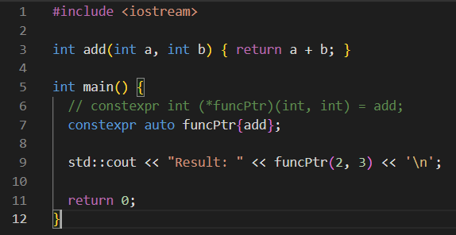
Compile Time Analysis…
Function pointers are constexpr! https://godbolt.org/z/WE7Kz4Y4v

Slide 42
const, constexpr, consteval and constinit
https://godbolt.org/z/fqY7Y1Wof
Notes:
mutable C++98 Allows a member to be modified even in a const method.
volatile C++98 Tells the compiler not to optimize accesses to the variable (e.g. hardware).
inline constexpr C++17 Enables header-only constexpr variable definitions across translation units.
static constexpr C++11 Often used in classes to define compile-time constants.\
const T& C++98 Pass by reference to const: avoids copies and ensures no mutation.
const overloads C++98 Allows multiple method versions depending on const-ness.

Slide 43
Why Can a Function Pointer Be constexpr?
Function identity is known at compile time
Even if the address isn't, the compiler knows which function is being referenced.
constexpr means fixed target, not fixed address
The function being pointed to is constant — not its memory location.
Linker fills in addresses later
The compiler emits relocation info; actual addresses are assigned at link/load time.
Analogy: Reserved seat
You know you're in seat A3 — even if you don’t know where that seat ends up in the venue.

Slide 44
Asside #embed – a Quine
https://godbolt.org/z/b4x3147xz
This means: We can load a file at compile time!
Notes:
https://godbolt.org/z/b4x3147xz

Slide 45
Compile Time Analysis to a map
Goal: make a map containing the location in memory, a pointer to the function to execute, and the parameters to that function
https://godbolt.org/z/YYKdYTGP6

Slide 46
Analyse to map

Slide 47
Need the number of instructions at compile time

Slide 48
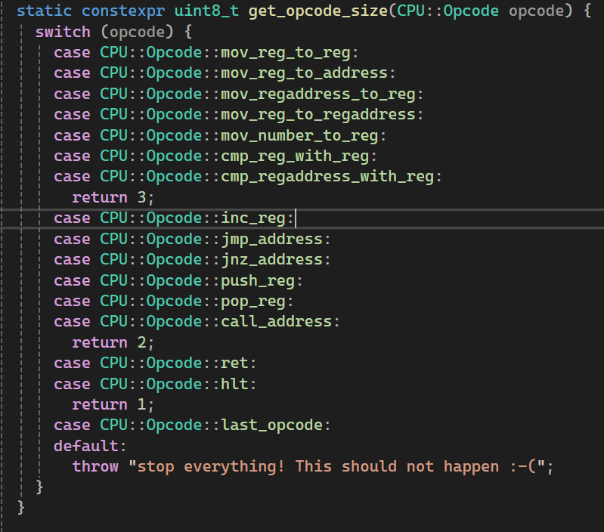

Slide 49
Runtime initialization

Slide 50
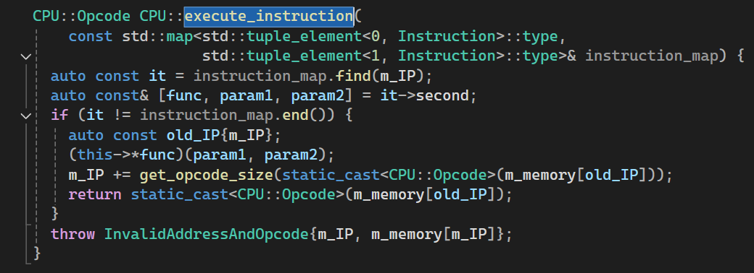

Slide 52
Compile Time Analysis to an array

Slide 53
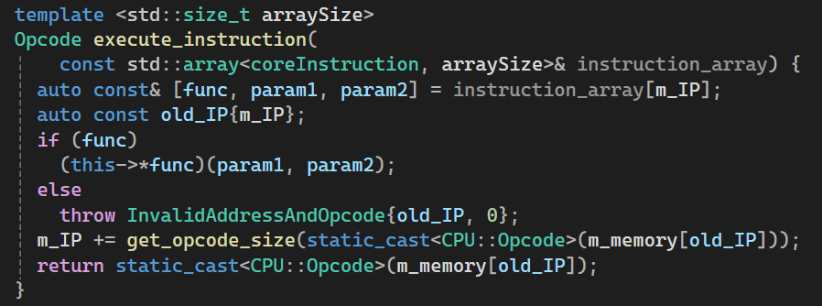
Execution is simple

Slide 54
Aside: CTAD for std::array size (since C++20)

Slide 55
Aside: CTAD for std::array size (since C++20)
Notes:
No #embed in visual studio (yet) sadly

Slide 56
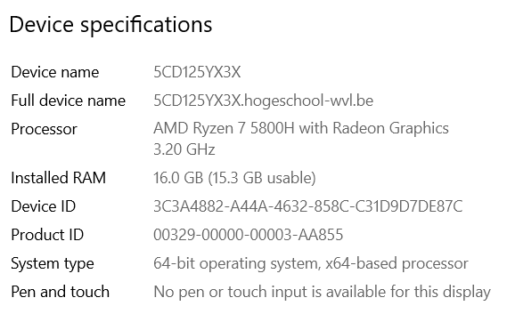
Performance Measurement
The experiment was a failure ☹
Or wasn’t it?

Slide 57
Last version we discussed
https://godbolt.org/z/7Tvb9xfbe

Slide 58
Three nested loops for long execution
On my 3.2 GHz machine:
50529029 in 200ms
-> 250MIPS

