Slide 1
Fibers
Coroutines from the OS
Notes:
Introduce yourself …

Slide 2
Overview
My name is Dave
Lector at the Breda University of Applied Science
Major – Game Development

Slide 3
Overview
Latest projects:
The first renegade
Processing PP

Slide 4
Overview
A quick summary of what topics we will discuss today
What are fibers
Fibers vs coroutines
Things to keep in mind when using fibers
Pros and cons
Support
Memory

Slide 5
Overview
Added a progress bar
This will be the indicator how much content there is left
Or how much you missed
Notes:
To make sure I myself can see how much content I still have to talk about I added a progress bar

Slide 6
Story time
Notes:
So, in my previous company I was building out a volume renderer which was quite nice.
I’ve built this from the ground up and even though I have no idea if they still use it, I thought I could experiment with it on my own.
Whatever was present at the company now or back then is a totally different beast to what I currently have.
But hey not important right now.

Slide 7
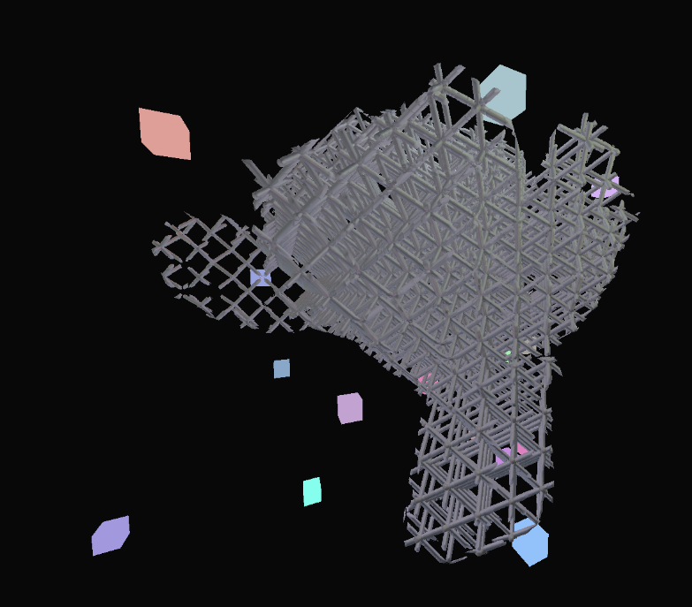
Story time - Limitations of the application
Single threaded application
Notes:
Some work for x logic was offloaded.
Application logic
Physics steps
Render

Slide 8
Story time - Limitations of the application
C API is not the greatest
Max 30 FPS
Notes:
I thought a C api would work better for a small demo, it didn’t
30 fps on average was the max I could reach
Threading did not even work on all supported platforms
Lot of manual management in what was supposed to be a job system
State of the job was confusing
Ran immediately
Deferred to a later stage

Slide 9
Story time - The new design
Jobify the entire framework
Yield in the middle of executing a job
Easy to use API for programmers
One simple way to sync jobs
No manual memory management for users
Performance was secondary to ease of use
Parallelizing the Naughty Dog Engine Using Fibers – Naughty Dog

Slide 10
What is a fiber?
Notes:
So, I saw this talk about fibers that was released quite some time ago ( which is also what this talk was based on ) but it’s still accurate ( aside from some hardware specifications )
And I tried replicating this into my own framework.
And where did I start well by using fibers name is borrowed from the real-world analogy of fibers as fine, lightweight strands that come together to form something larger (like a thread or fabric)
But what is a fiber within the context of computer sciene?

Slide 11
What is a fiber
Partial thread
OS has no idea how to schedule a fiber
Cooperative multithreading
Minimal overhead
Notes:
If you think of a thread …
Thread
Stack space for execution of your code
Space to save registers once the thread goes to sleep
System Requirements: For scheduling, priorities, etc.
Like a partial thread
user provided stack space
space to save register
OS has no idea how to schedule a fiber
Unlike threads
They are always executed by a thread
Cooperative multithreading
Can never be preempted
Acts like a functions
There is no such thing as a fiber interrupting another fiber
Switching between fibers is explicit
You as a user need to manually switch
Switching fibers is switching stack pointers
Minimal overhead
No context switch
Only save/restore registers
Swapping stack pointers etc.
OS does not even know you did it

Slide 12
What is a fiber
Like a partial thread
user provided stack space
space to save register
Notes:
If you think of a thread …
Thread
Stack space for execution of your code
Space to save registers once the thread goes to sleep
System Requirements: For scheduling, priorities, etc.

Slide 13
What is a fiber
OS has no idea how to schedule a fiber
They are always executed by a thread

Slide 14
What is a fiber
Cooperative multithreading
Can never be preempted
Switching between fibers is explicit
Notes:
Acts like a functions
There is no such thing as a fiber interrupting another fiber
You as a user need to manually switch
Switching fibers is switching stack pointers

Slide 15
What is a fiber
Minimal overhead
Notes:
No context switch
Only save/restore registers
Swapping stack pointers etc.
OS does not even know you did it

Slide 16
Fiber vs Coroutine

Slide 17
Fiber vs Coroutine
Coroutines get automatically triggered, the language takes care of this.
When you "wait" for something like a network request, the coroutine automatically pauses itself and lets the rest of your program keep on running.
Fibers must be manually triggered for reactivation by using a system call
You'd have to manage the logic of checking whether the network request is complete, and once it’s ready, you’d manually trigger the fiber to resume.
Notes:
Ok but this sounds a lot like a coroutine, so let’s make something clear here

Slide 18
Fiber vs Coroutine
Coroutines: high-level asynchronous programming for concurrent workflows
Fibers: manual control over multitasking especially useful in performance critical or real-time systems

Slide 19
Fiber vs Coroutine
Use Case | Coroutines | Fibers
I/O-bound tasks (like networking, file access, databases) | ✅ Automatic pausing/resuming makes it ideal for async I/O. | ❌ You’d have to manually handle when the fiber pauses and resumes for I/O tasks.
Fine-grained, manual control over task switching | ❌ Language/runtime controls when to pause/resume. | ✅ You fully control when tasks pause and resume.
Performance-critical, low-level systems | ❌ Runtime management of coroutines adds a slight overhead. | ✅ Extremely lightweight, often better for low-latency systems.
Structured async programming in modern languages | ✅ Integrated into modern languages with async/await, making it easy to write clean, non-blocking code. | ❌ Less common in high-level languages. Requires more manual effort to manage control flow.
Deterministic multitasking | ❌ Coroutines are often resumed based on I/O events or the event loop. | ✅ You decide exactly when tasks switch, ensuring deterministic execution.
Notes:
I asked chat-gpt the same question, you can make whatever you want from this … I’ll stick to my definition

Slide 20
The new design

Slide 21
The new design
X amount of worker threads
Locked with affinity to a CPU core ( details follow later )
A thread is an execution unit, they never move
A fiber is the context of the execution unit
A job always executes in context of a fiber
Job == Function Pointer
Fiber calls the function pointer
Fiber holds stack space ( therefore the execution environment )
Atomic counters are used for synchronization
Allocated Fibers
eg: 160 fibers ( 128 x 64 KiB stack, 32 x 512 KiB stack )
Notes:
Execution unit ( or threads ): are the vehicle in which the jobs actually executes
Thread affinity in computer science refers to the strategy of assigning threads to specific processor cores in order to enhance memory access performance.

Slide 22
The new design
Small Fibers ( 64 KiB stack )
Leaf node type of work
Regular work
Large Fibers ( 512 KiB stack )
Callout to middleware
Control over the stack depth is not optimal
Notes:
Execution unit ( or threads ): are the vehicle in which the jobs actually executes
Thread affinity in computer science refers to the strategy of assigning threads to specific processor cores in order to enhance memory access performance.

Slide 23
The new design
Worker
Thread
X amount of worker threads
Locked with affinity to a CPU core
Worker
Thread
Worker
Thread
Worker
Thread
Worker
Thread
Worker
Thread
Notes:
Execution unit ( or threads ): are the vehicle in which the jobs actually executes
Thread affinity in computer science refers to the strategy of assigning threads to specific processor cores in order to enhance memory access performance.

Slide 24
The new design
A thread is an execution unit
they never switch core
A fiber is the context of the execution unit
they can switch thread
Worker
Thread
Fiber
Notes:
Thread affinity in computer science refers to the strategy of assigning threads to specific processor cores in order to enhance memory access performance.

Slide 25
The new design
Worker
Thread
A job always executes in context of a fiber
job
fiber
thread
Notes:
Job == Function Pointer
Fiber calls the function pointer

Slide 26
The new design
Atomic counters are used for synchronization
Worker
Thread
Wait List
1
Notes:
When there is a dependency that we have to wait for

Slide 27
The new design
3 global job queues
Low
Normal
High
Job Queue
Jobs
3 Job Queues
Low, Normal, High
Notes:
Execution unit ( or threads ): are the vehicle in which the jobs actually executes
Thread affinity in computer science refers to the strategy of assigning threads to specific processor cores in order to enhance memory access performance.

Slide 28
The new design
No stealing!
High-priority jobs are VIP
Prioritize controlled execution over throughput
Notes:
If any thread pushed a high priority job, that should be the next job
Throughput should not be the defining factor, controlled execution should

Slide 29
The new design - Diagram
Jobs
Worker
Thread
Job Queue
Worker
Thread
Fiber
Worker
Thread
Job Queue
Fiber
Worker
Thread
Job Queue
Fiber
Worker
Thread
Fiber
Worker
Thread
Fiber
Fiber
Fiber
Fiber
Fiber
Fiber
Fiber
Fiber
Fiber
Fiber
3 Job Queues
Low, Normal, High
Fiber Pool
Worker Threads

Slide 30
The new design - Diagram
Job Queue
Worker
Thread
Fiber

Slide 31
The new design - Diagram
Job Queue
Worker
Thread
Job always runs in context of a fiber

Slide 32
The new design - Diagram
Job Queue
Worker
Thread
Can push new jobs on the queue

Slide 33
The new design - Diagram
Job Queue
Worker
Thread
Wait List
1
A waiting job is put in a wait list with the counter waited on
Sort of like a fence

Slide 34
The new design - Diagram
Job Queue
Worker
Thread
Wait List
A new fiber is used to allow another job to begin executing
The stack of the waiting job is preserved in the fiber
Fiber
1
Fiber
Fiber
Fiber
Fiber
Fiber Pool
Fiber
Fiber

Slide 35
The new design - Diagram
Job Queue
Worker
Thread
Wait List
0
A job can decrement the counter of a fiber in the wait list.
A new job is scheduled, taken from the queue

Slide 36
The new design - Diagram
Job Queue
Worker
Thread
Wait List
Fiber
0
When a job is resumed.
We first free the current fiber
Fiber
Fiber
Fiber
Fiber
Fiber Pool
Fiber
Fiber

Slide 37
The new design - Diagram
Job Queue
Worker
Thread
Wait List
0
Switch stack pointer and some registers and resume execution

Slide 38
Keep this in mind
Notes:
First: fibers do not provide advantages over a well-designed multithreaded application. However, using fibers can make it easier to port applications that were designed to schedule their own threads.
Second: well if you are using fibers ( next slide )

Slide 39
Things to keep in mind
Worker threads are locked to a core!
Notes:
Avoid context switches and unwanted core switching
Kernel threads could cause ripple effects

Slide 40
Things to keep in mind
Computation cores run for a very long time …
Spawn Thread
Run Logic
Application
Boot
Spawn Thread
Run Logic
Spawn Thread
Run Logic
Notes:
3 cores allocated and used for computation
They run for a very long time …

Slide 41
Things to keep in mind
Core 0
Thread
Run Logic
What happens when the kernel evicts us?
Core 1
Thread
Run Logic
Evicted
Core 2
Thread
Spawn
Kernel Thread
Kernel
Notes:
When the kernel thread evicts us ( which happens all the time )

Slide 42
Things to keep in mind
Core 0
Thread
Run Logic
The thing must run somewhere else …
Core 1
Thread
Run Logic
Core 2
Kernel Thread
Run Logic
Core 2 Thread
Spawn
Kernel Thread
I need to run somewhere else!
Kernel
Notes:
The thread says: I’ve been evicted but I need to run somewhere else …
What is evicting:
In a multithreading environment, the operating system or thread scheduler may evict a thread from the CPU when it has used up its time slice or when the scheduler determines that another thread has a higher priority. This is common in preemptive multitasking, where a running thread is forcibly removed (or evicted) from the CPU, allowing another thread to run.

Slide 43
Things to keep in mind
Well, I’ve been running for a long time
Core 0
Thread
Run Logic
Some thread must be running for a long time already?
Core 1
Thread
Run Logic
Core 2
Kernel Thread
Run Logic
Core 2 Thread
Spawn
Kernel Thread
Kernel
Notes:
Well, I’ve been running for a long time why don’t you take my spot.
And this happens for every running thread.

Slide 44
Things to keep in mind
…
Core 2
Thread
Run Logic
Now this one must run somewhere else …
Core 1
Thread
Run Logic
Core 2
Kernel Thread
Run Logic
Core 0 Thread
Spawn
Kernel Thread
I need to run somewhere else!
Kernel
Notes:
So you end up with ( well in this case ) 3 context switches ( at a minimum) instead of 1 from the kernel thread …

Slide 45
Jobify everything!

Slide 46
Jobify everything!
Application logic
Physics steps
Math equations
Command buffer generation
Data processing

Slide 47
Jobify everything!
Except “I/O threads” ( sockets, file I/O, system calls )
Life of an I/O thread seems peaceful
OS
Wake up
I/O Thread
Perform
System Call
Go back to sleep
Post a job
Notes:
After first bullet point These are system threads
Implemented like interrupt handlers ( read data, post job )
Always wait, never do expensive processing of data

Slide 48
The code

Slide 49
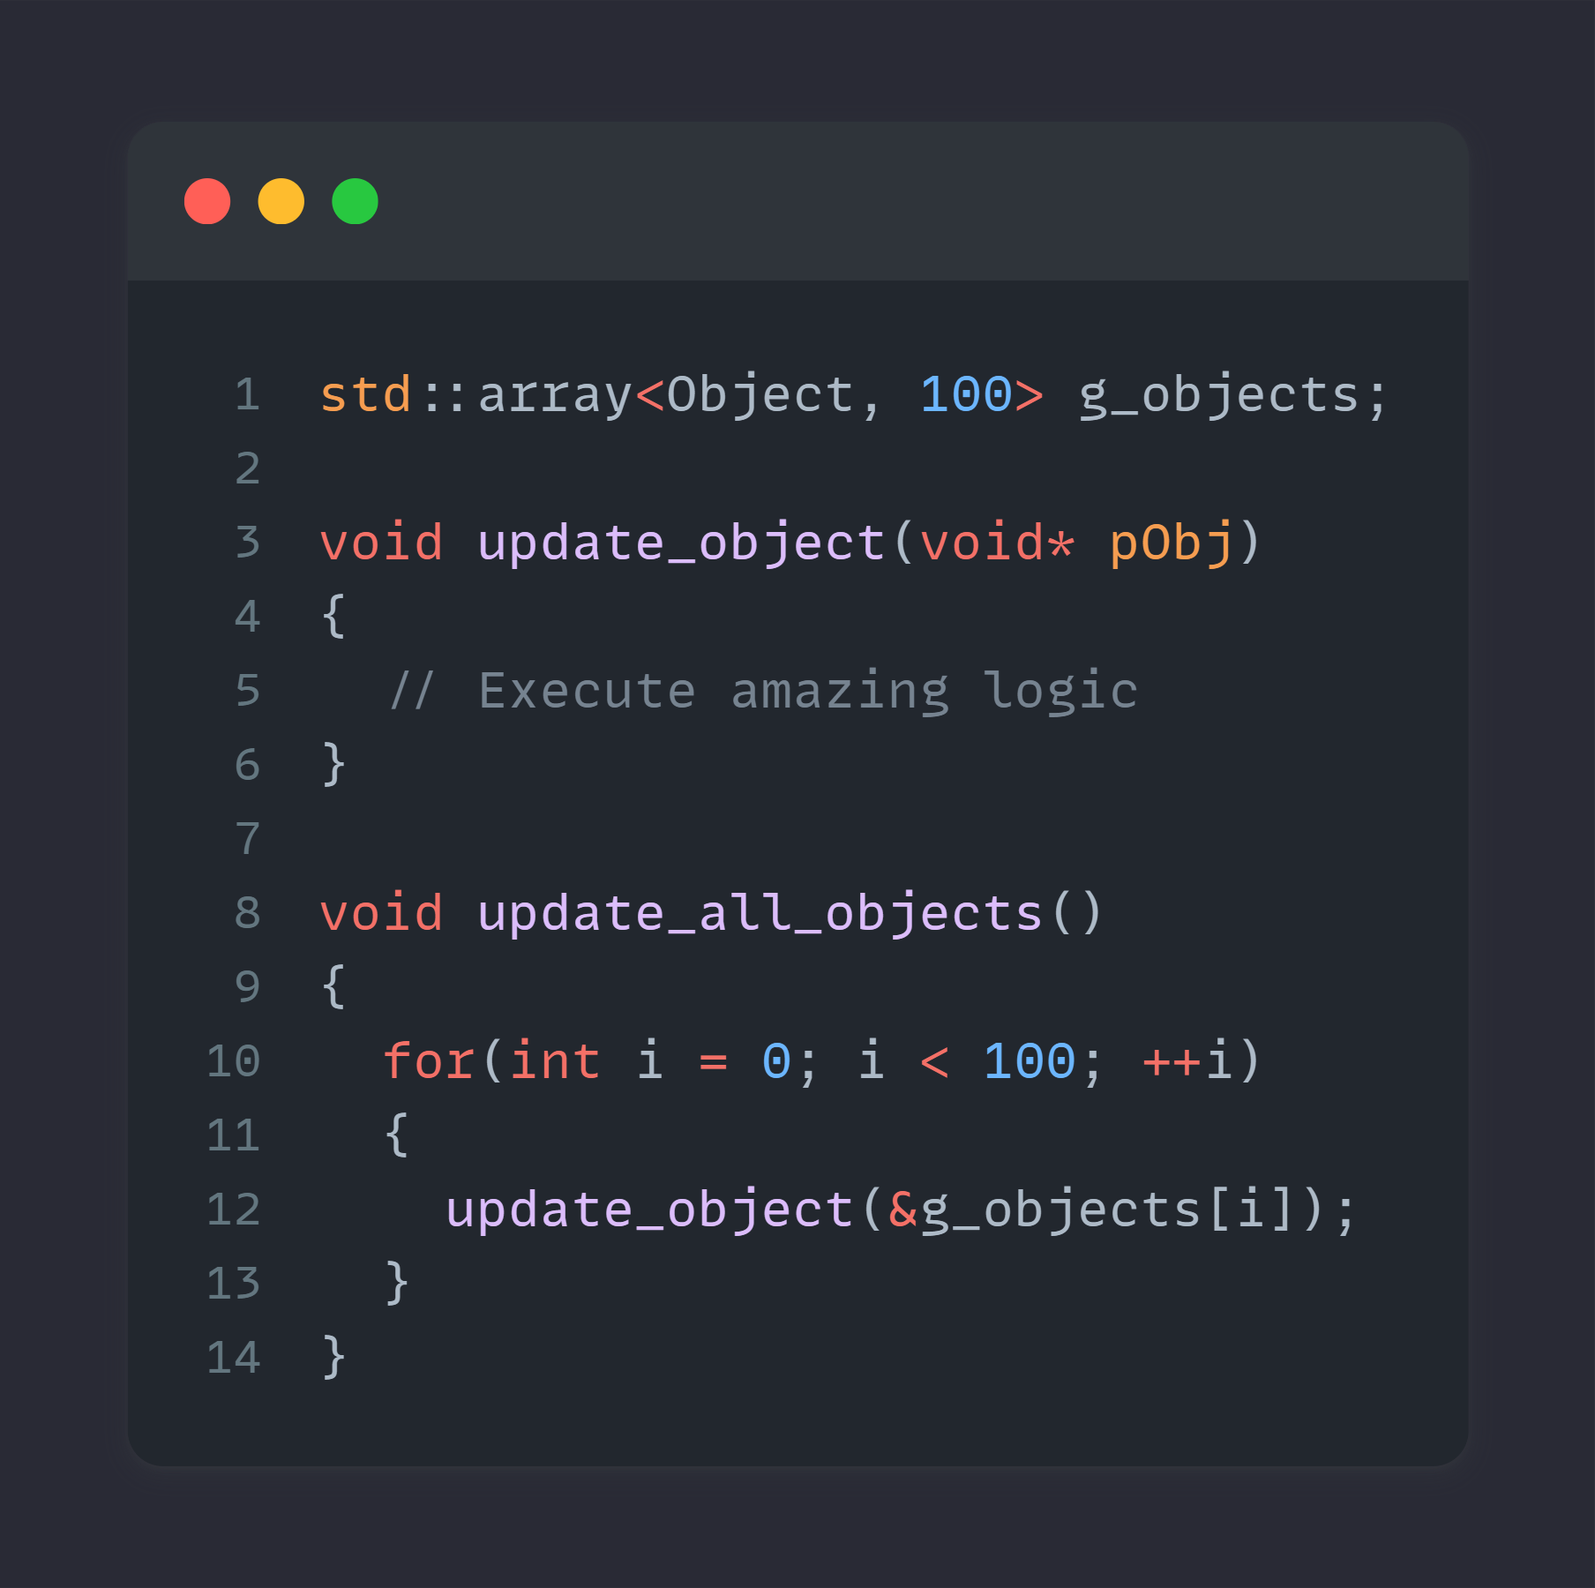
The code
Regular update for 100 objects

Slide 50
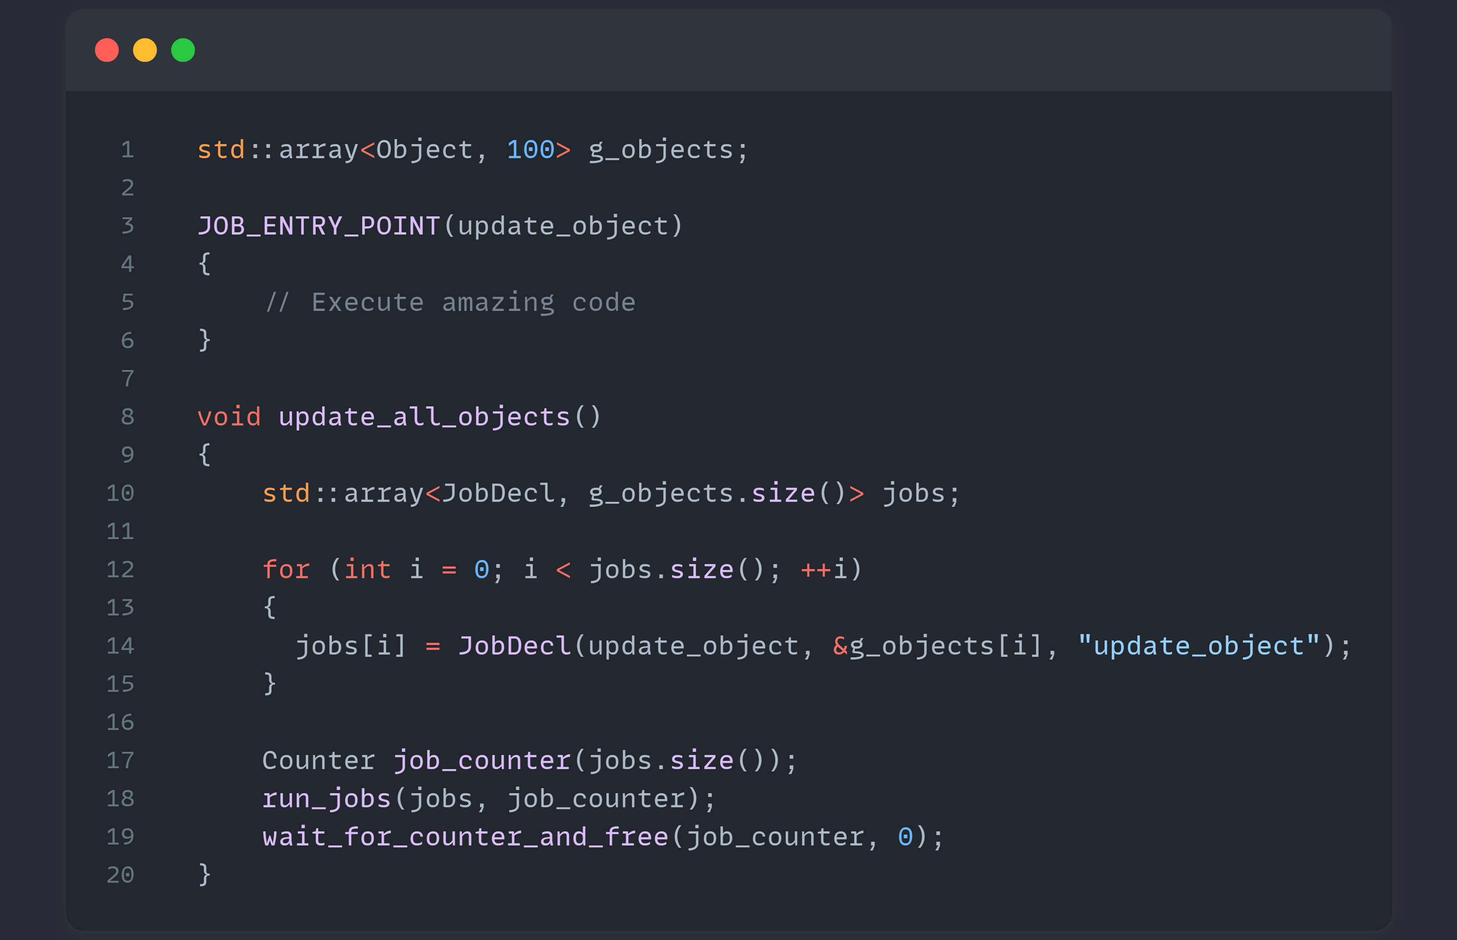
Notes:
How to jobify …

Slide 51
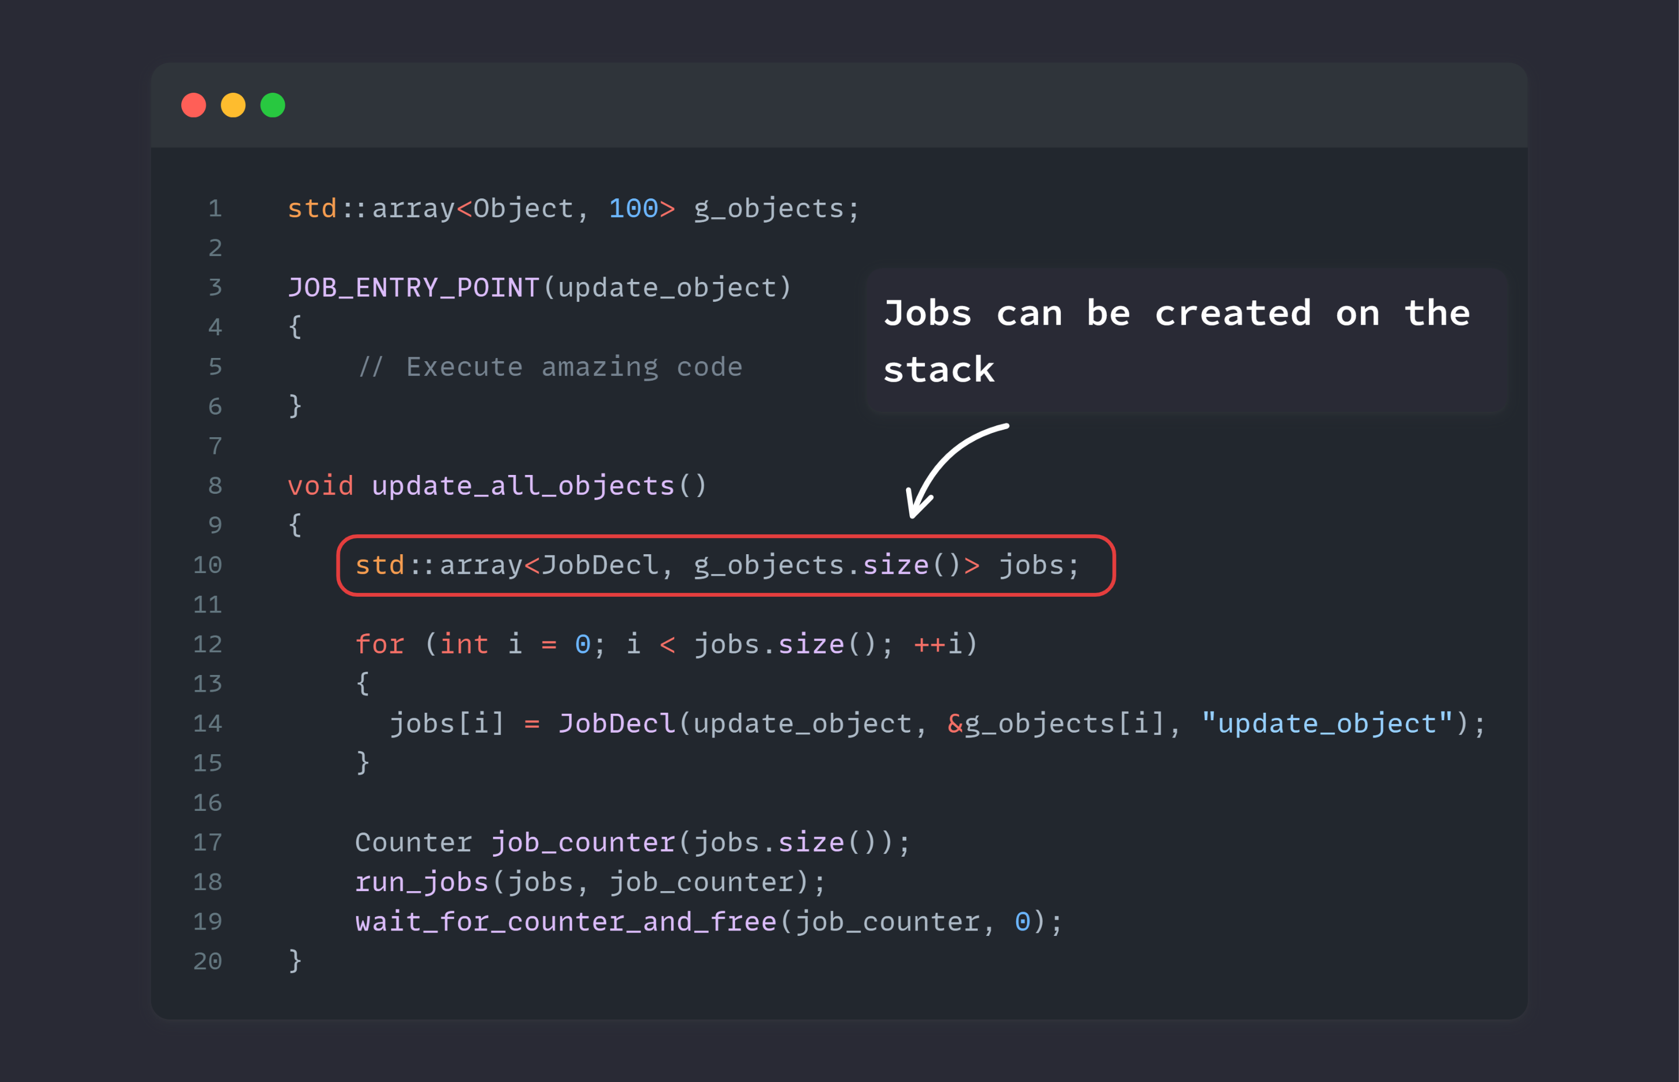

Slide 52
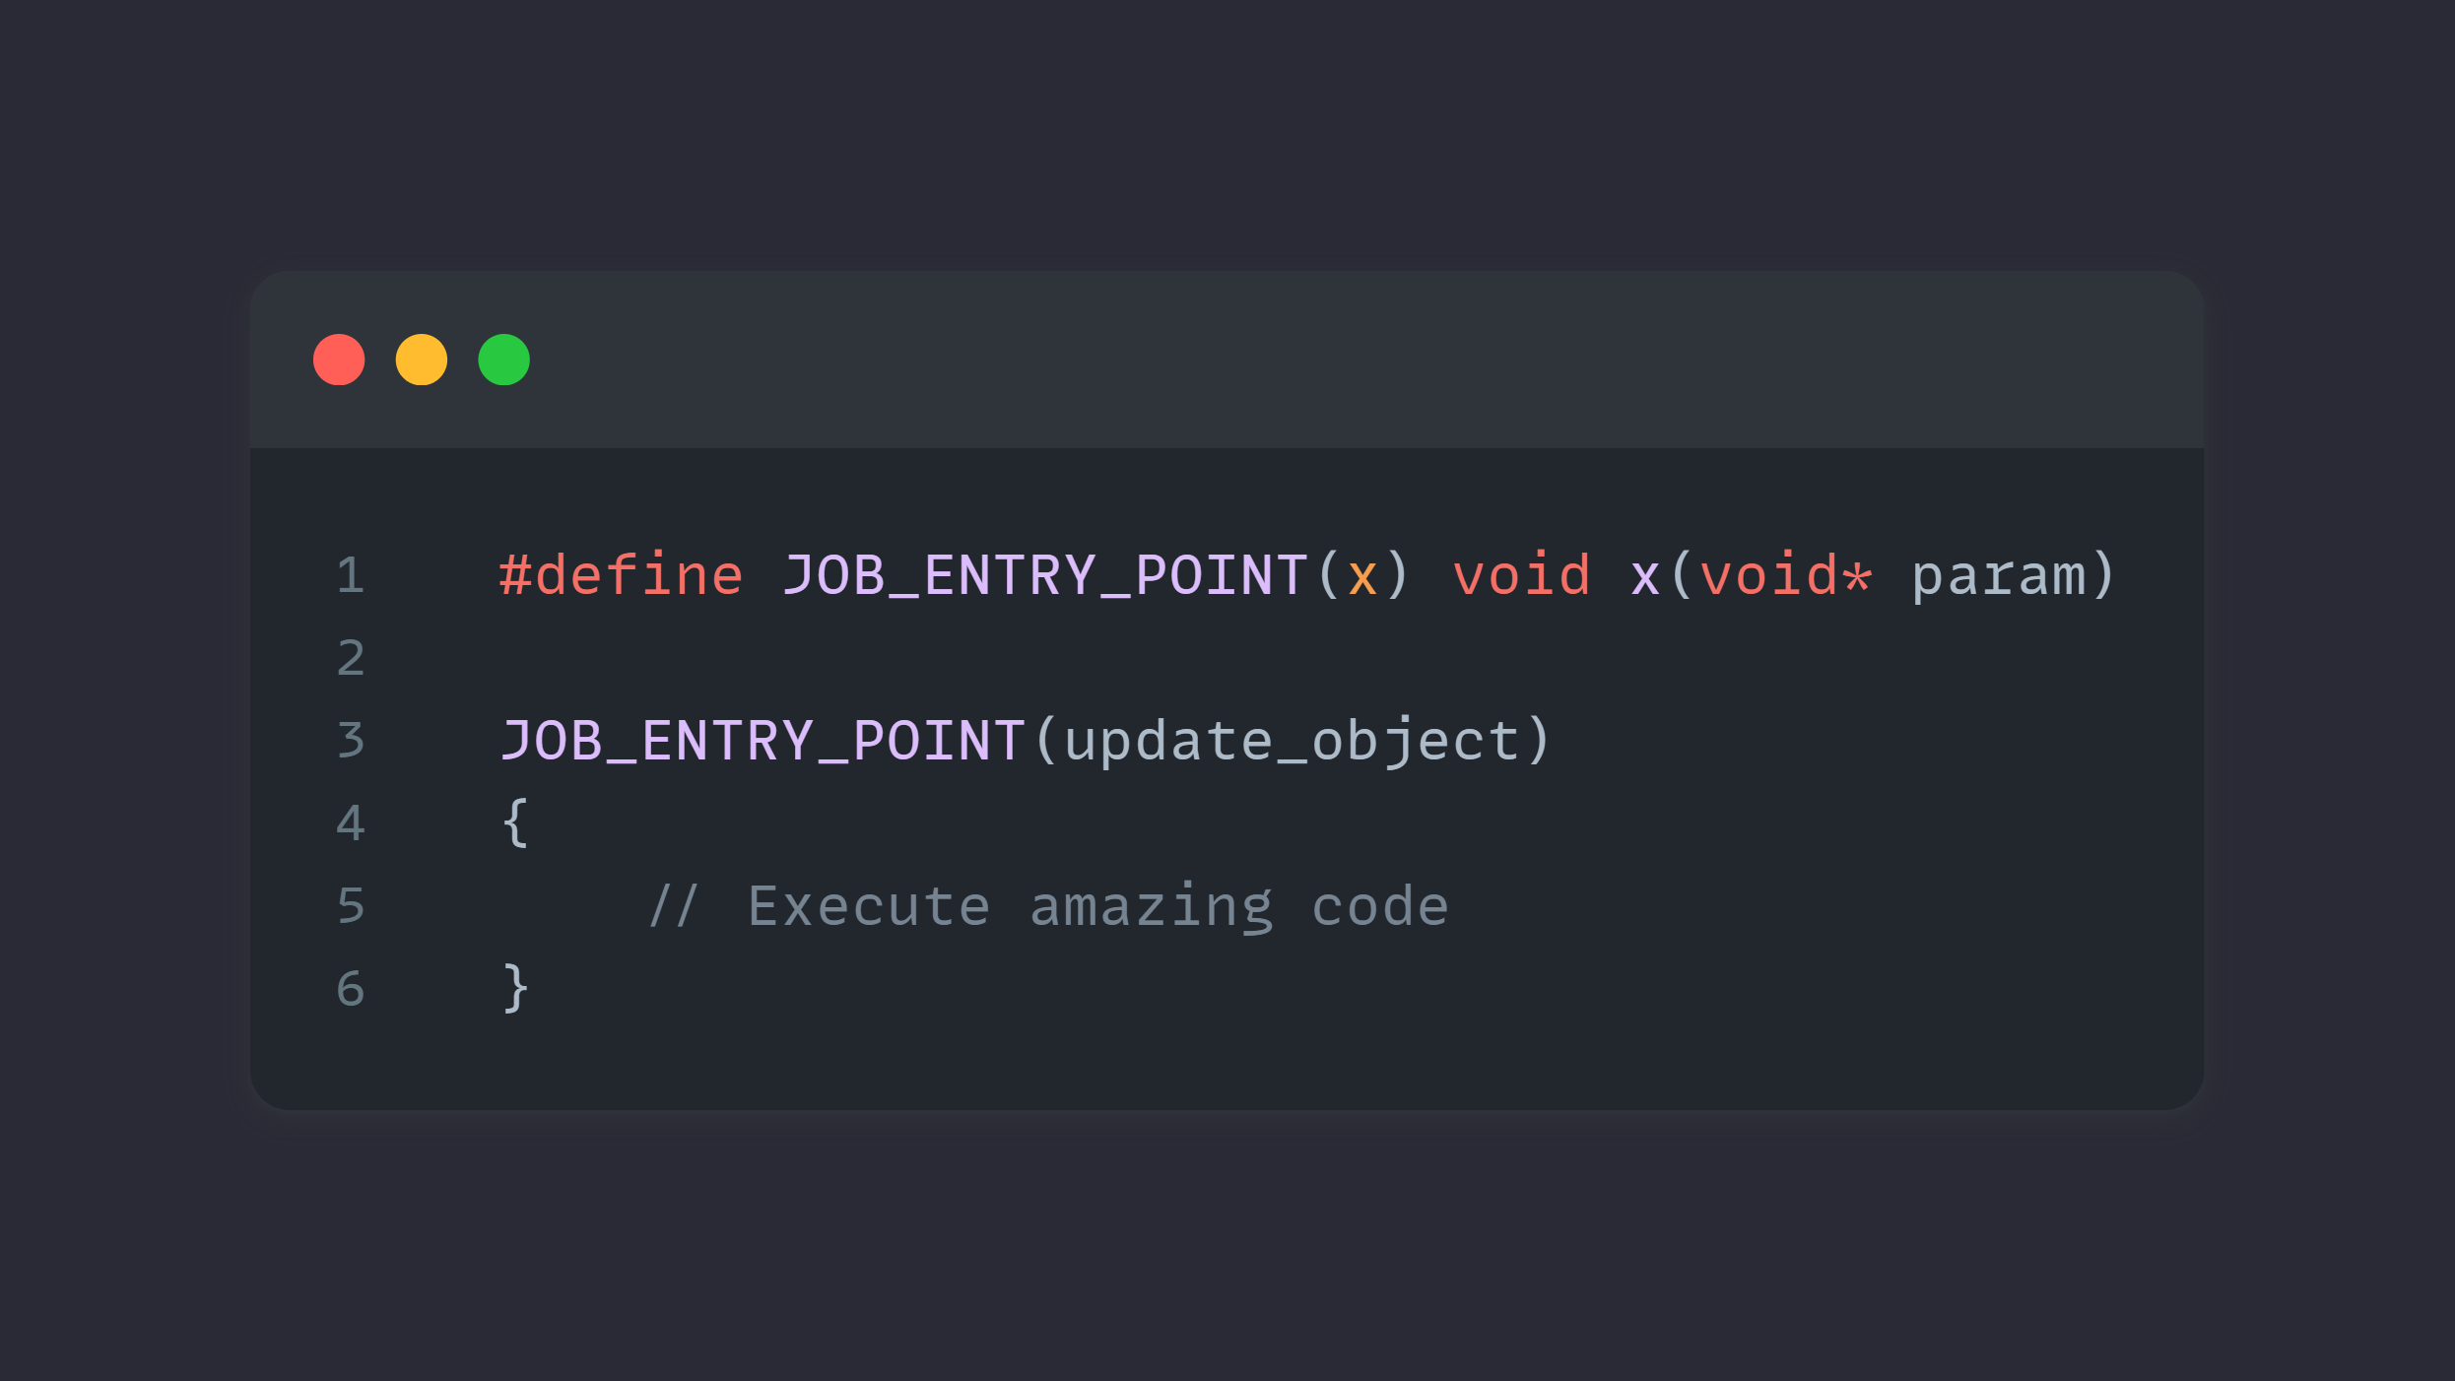
Notes:
Easy to use macro, so other programmers cannot mess up the API

Slide 53
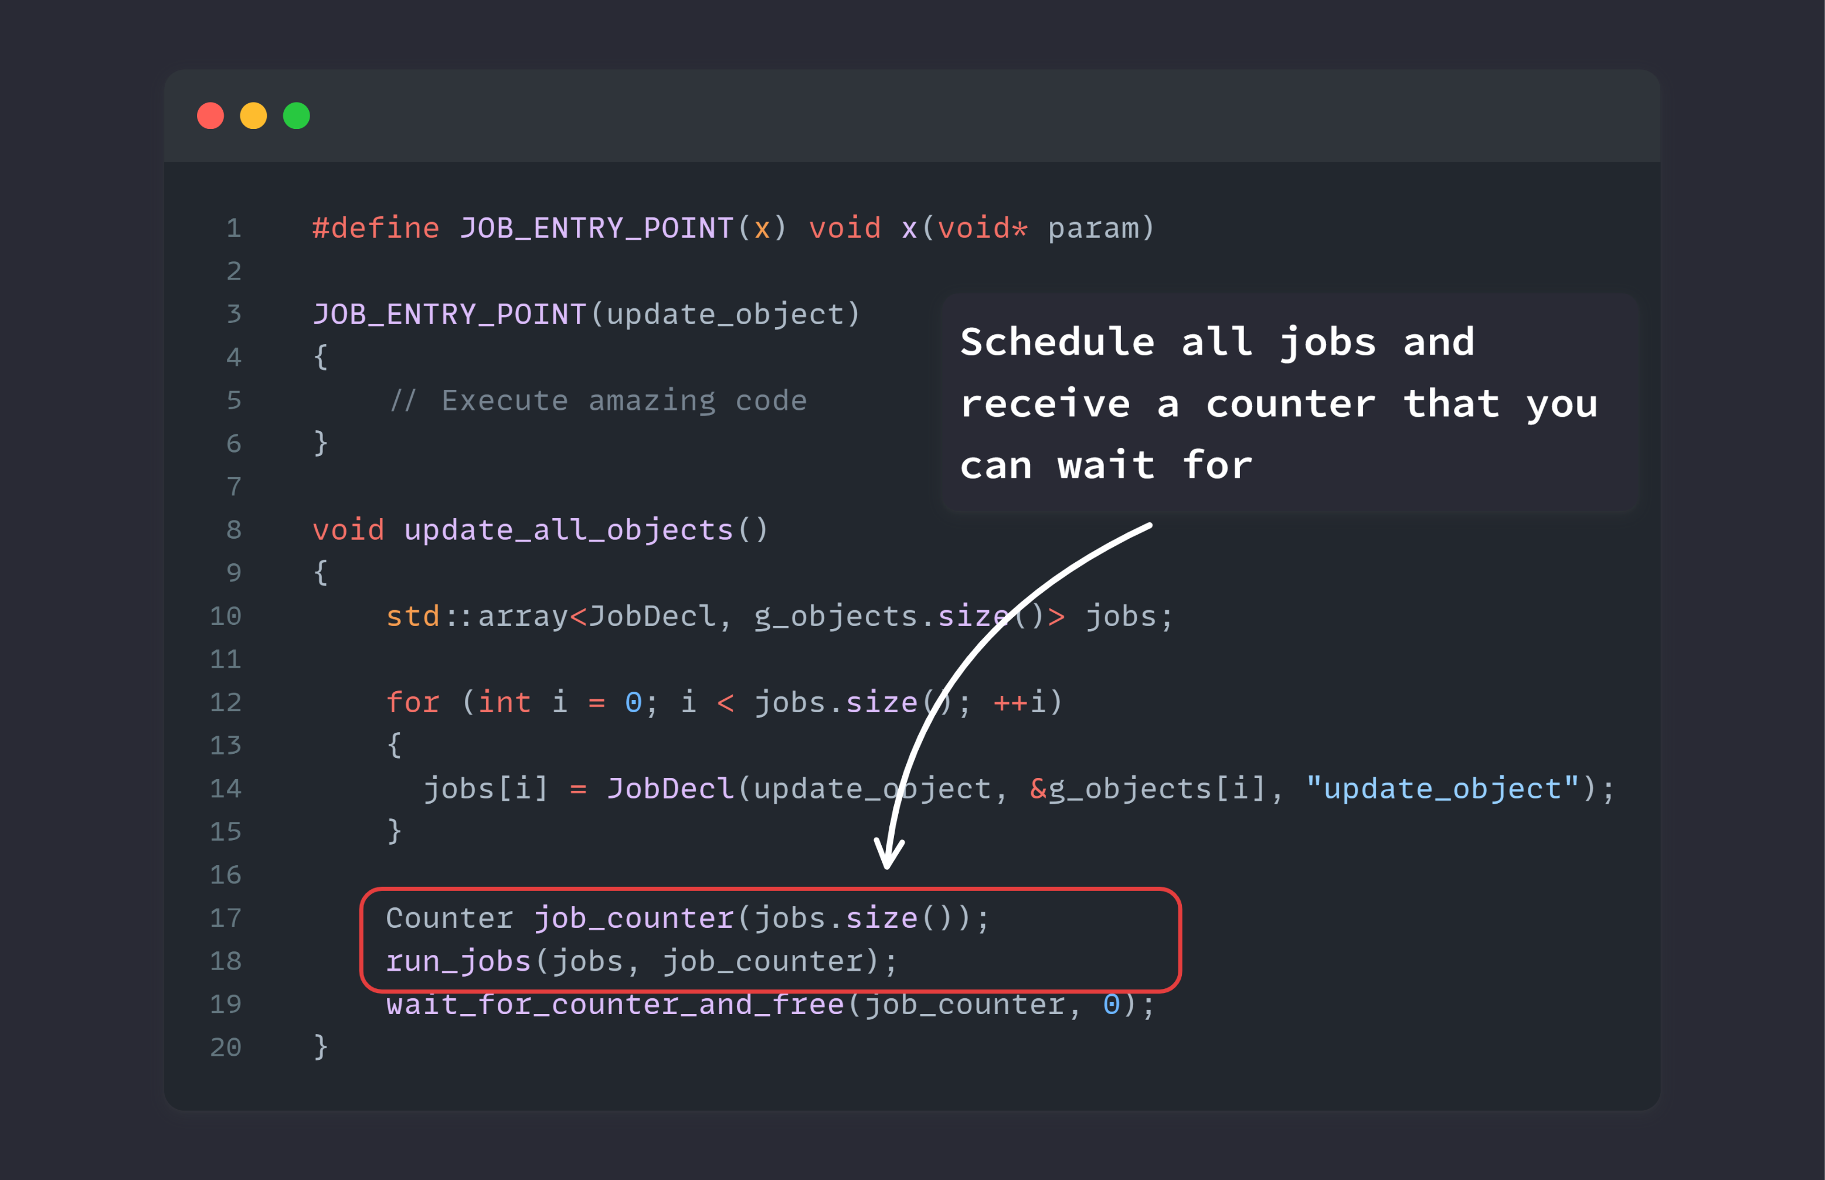

Slide 54
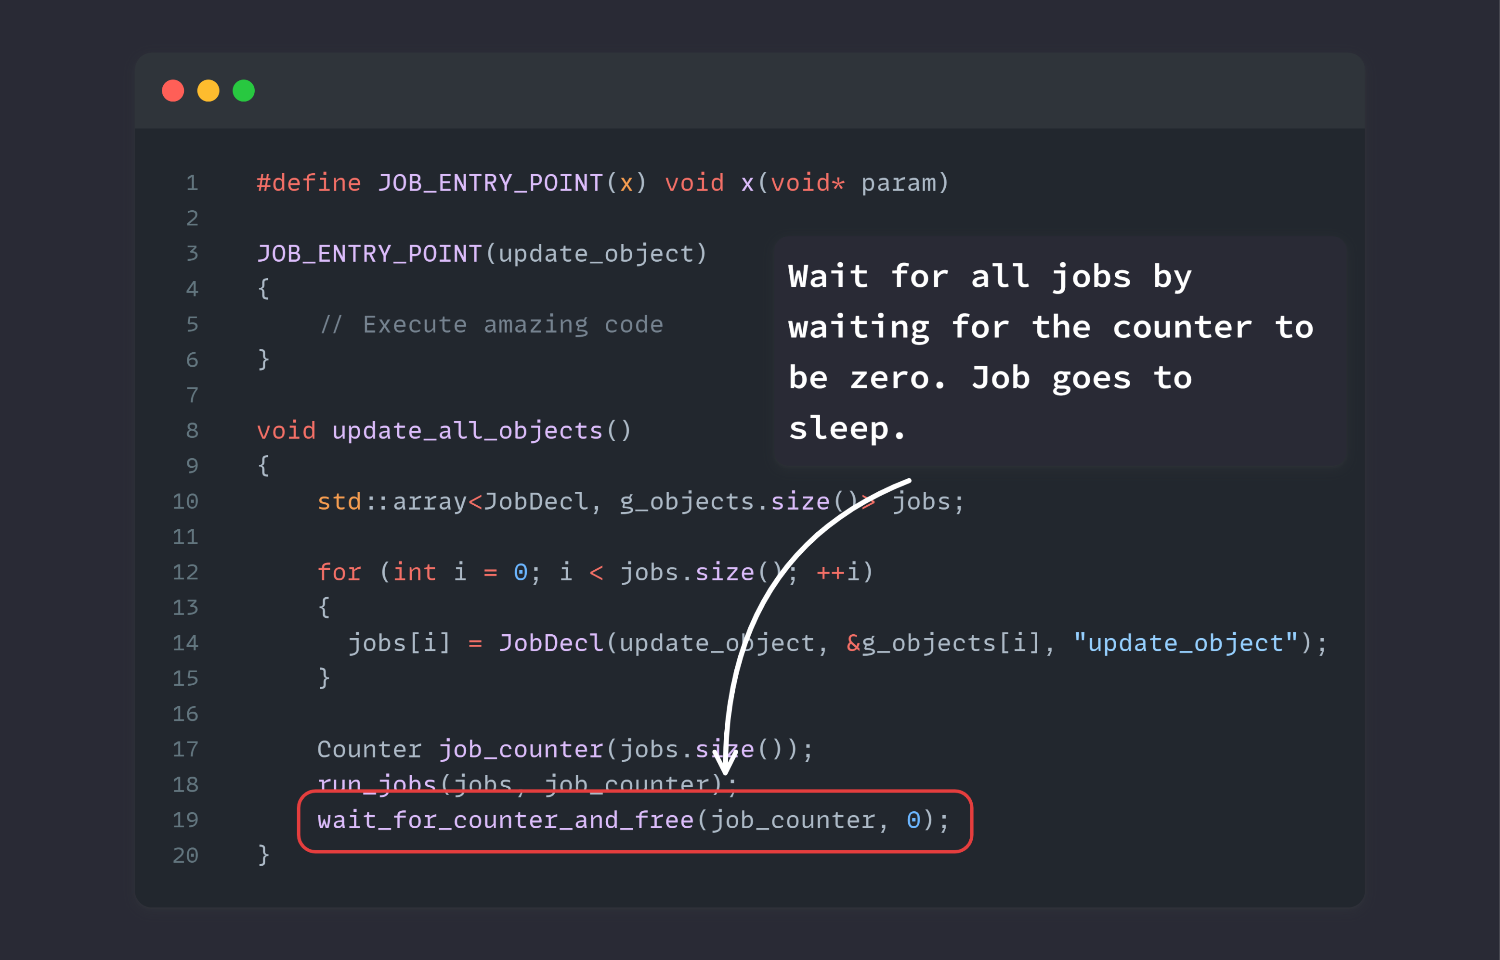

Slide 55
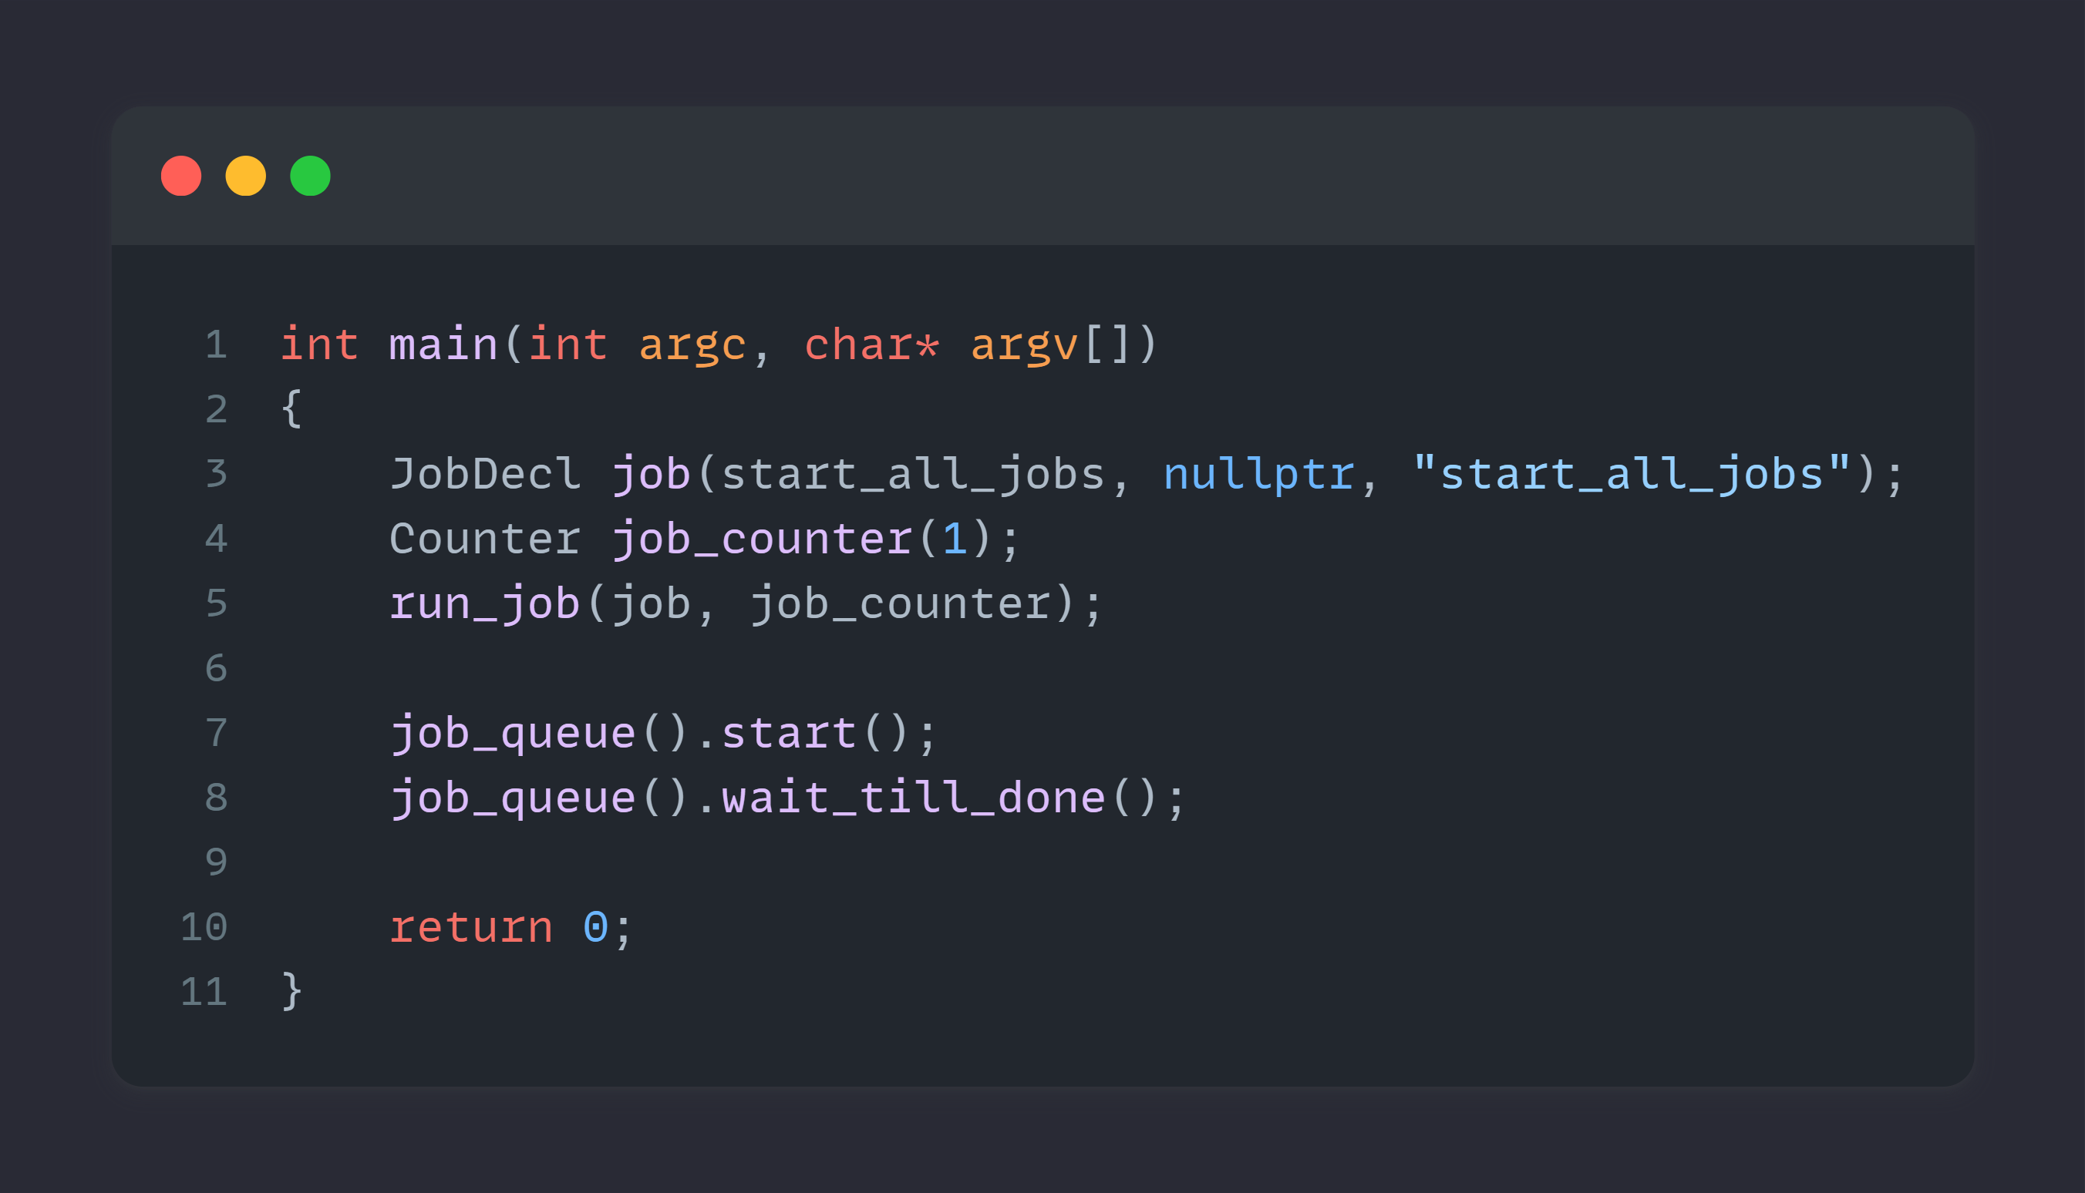
The code
Let’s zoom in a bit
Notes:
Main entry point of the example

Slide 56
The code
Notes:
We first decl a job that will start all jobs

Slide 57
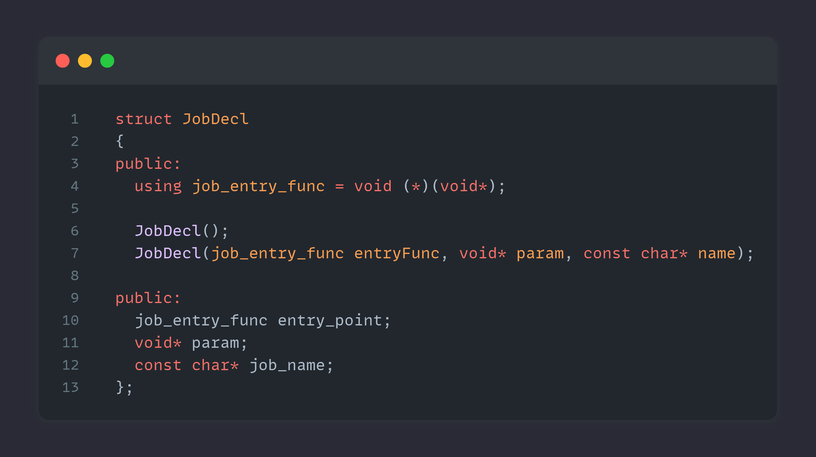
Notes:
Nothing more than a wrapper around a function pointer and a pointer to some data

Slide 58
The code
Notes:
Then we specify a counter that we will wait for

Slide 59
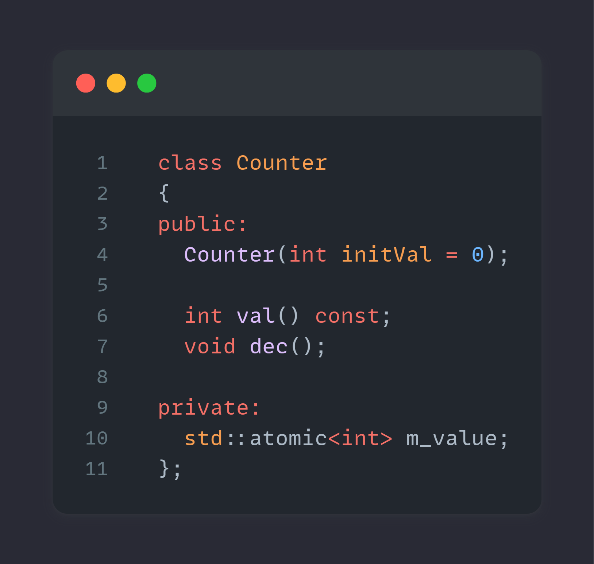
Notes:
Wrapper around an atomic integer

Slide 60
The code
Notes:
Next we call run jobs bit of a miss name because it won’t actually run anything, it will add jobs to the queue but details I would say

Slide 61
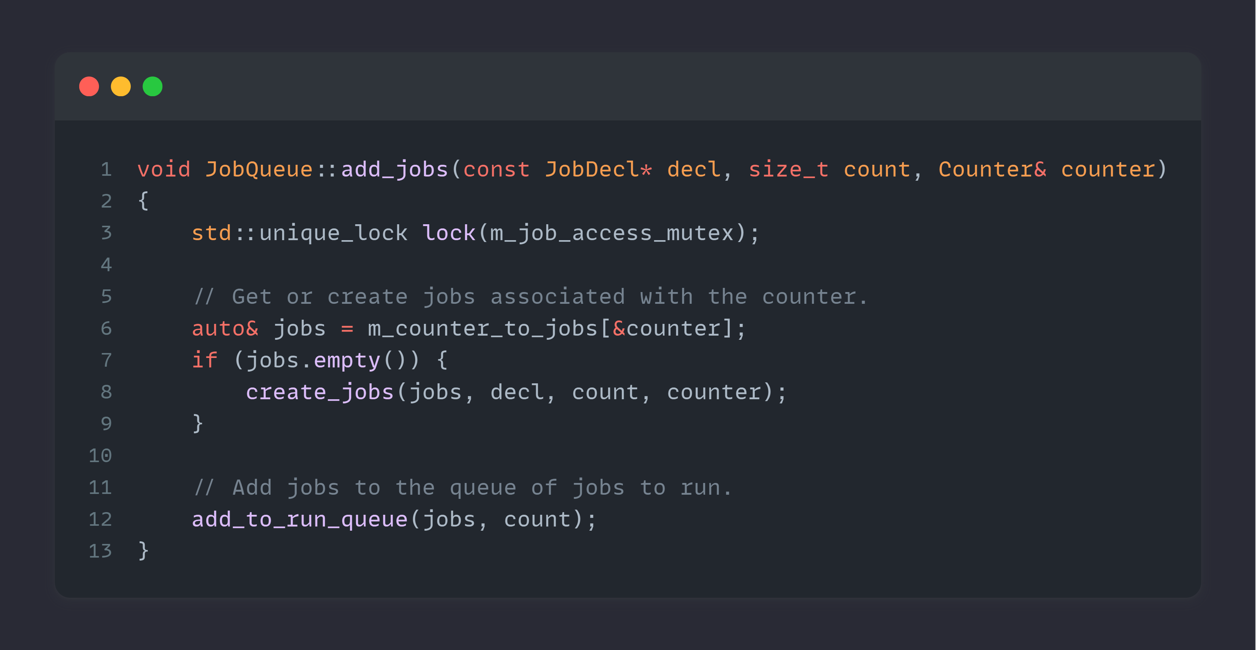
Notes:
Addition of jobs could look like this
We lock our critical section ( yes I use mutexes in this example, but this is only an example )
Check if the counter already has jobs present
If not we create them
And add those to the queue “ to run “

Slide 65
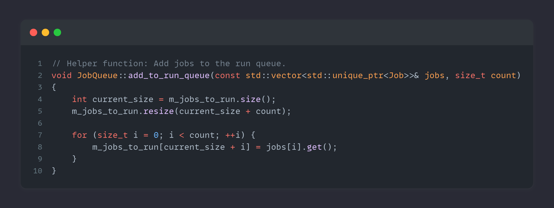

Slide 66
The code
Notes:
start the job systems, from this point on, we don't have a main thread anymore
and everything will be handled by the job system.

Slide 67
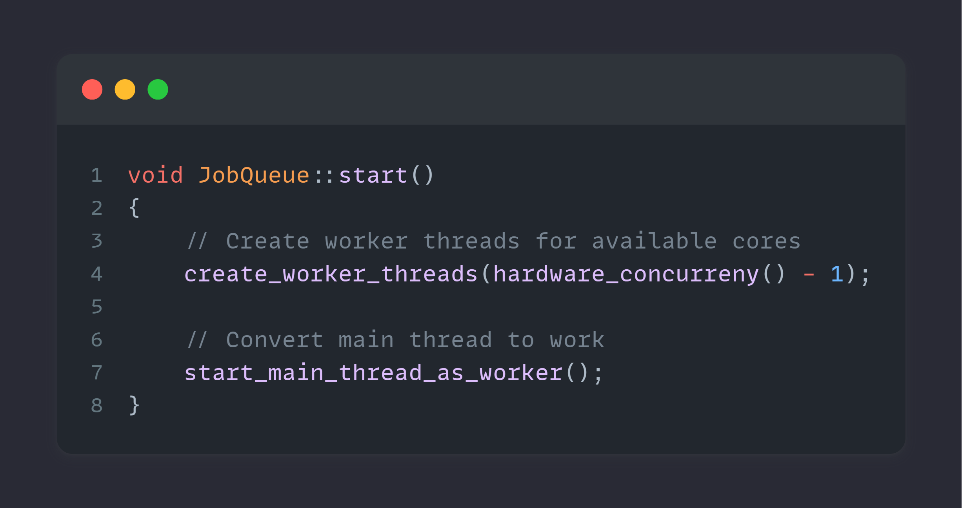

Slide 69
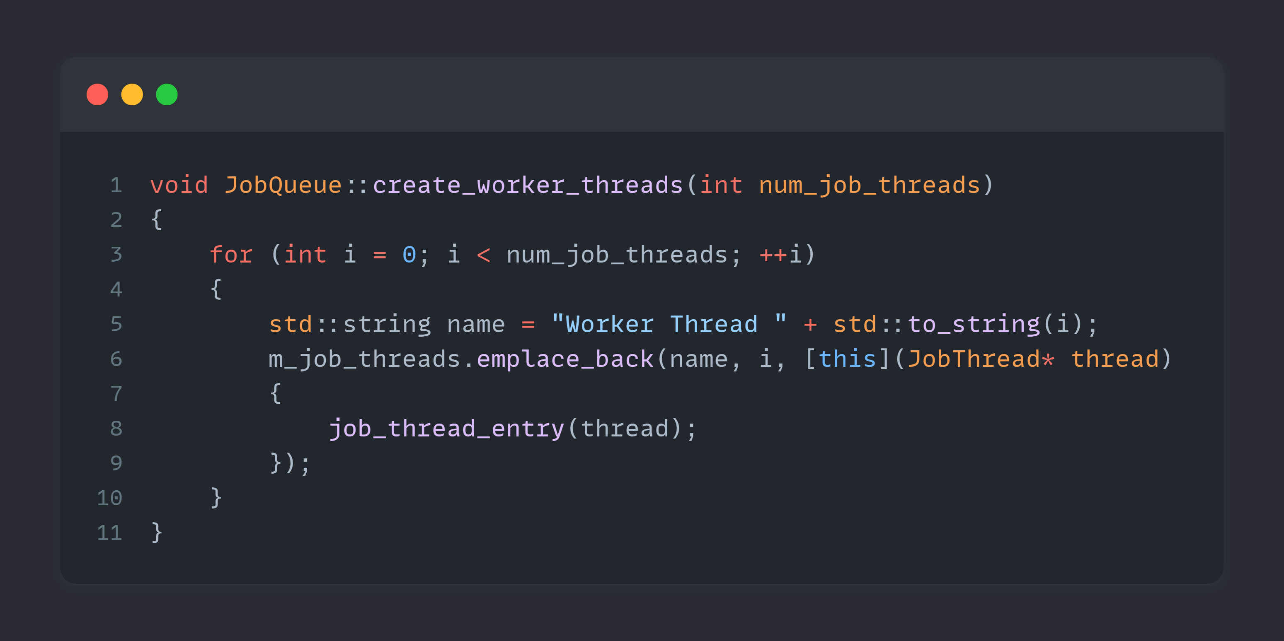
Notes:
Creation of a worker thread could look like this (next slide )

Slide 70
Notes:
This is the important part I would say, which call the ctor of JobThread

Slide 71
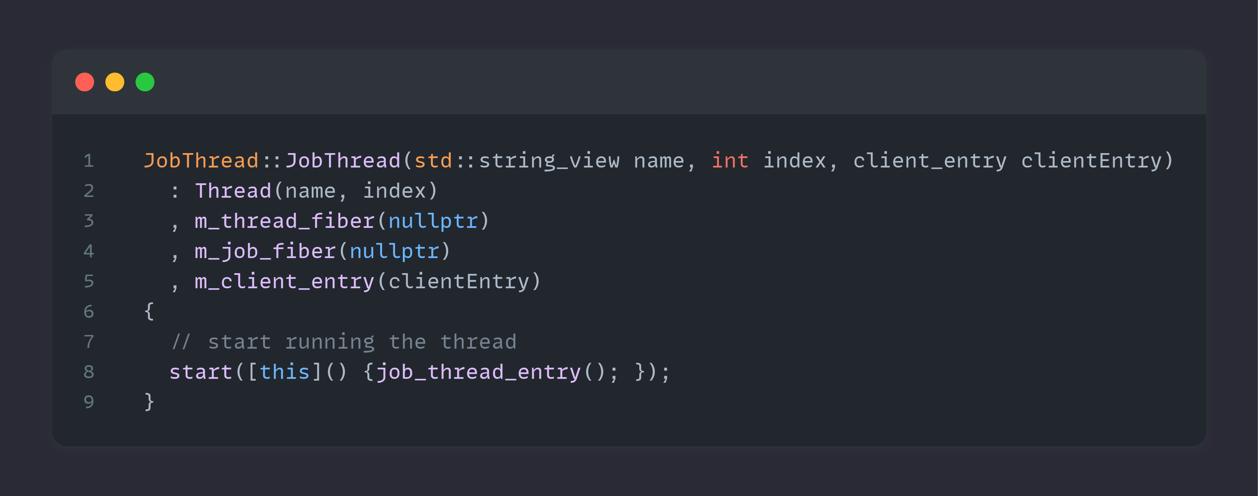
Notes:
Which will boot up the JobThread (next slide)

Slide 72
Notes:
Right here
This will call ( next slide )

Slide 73
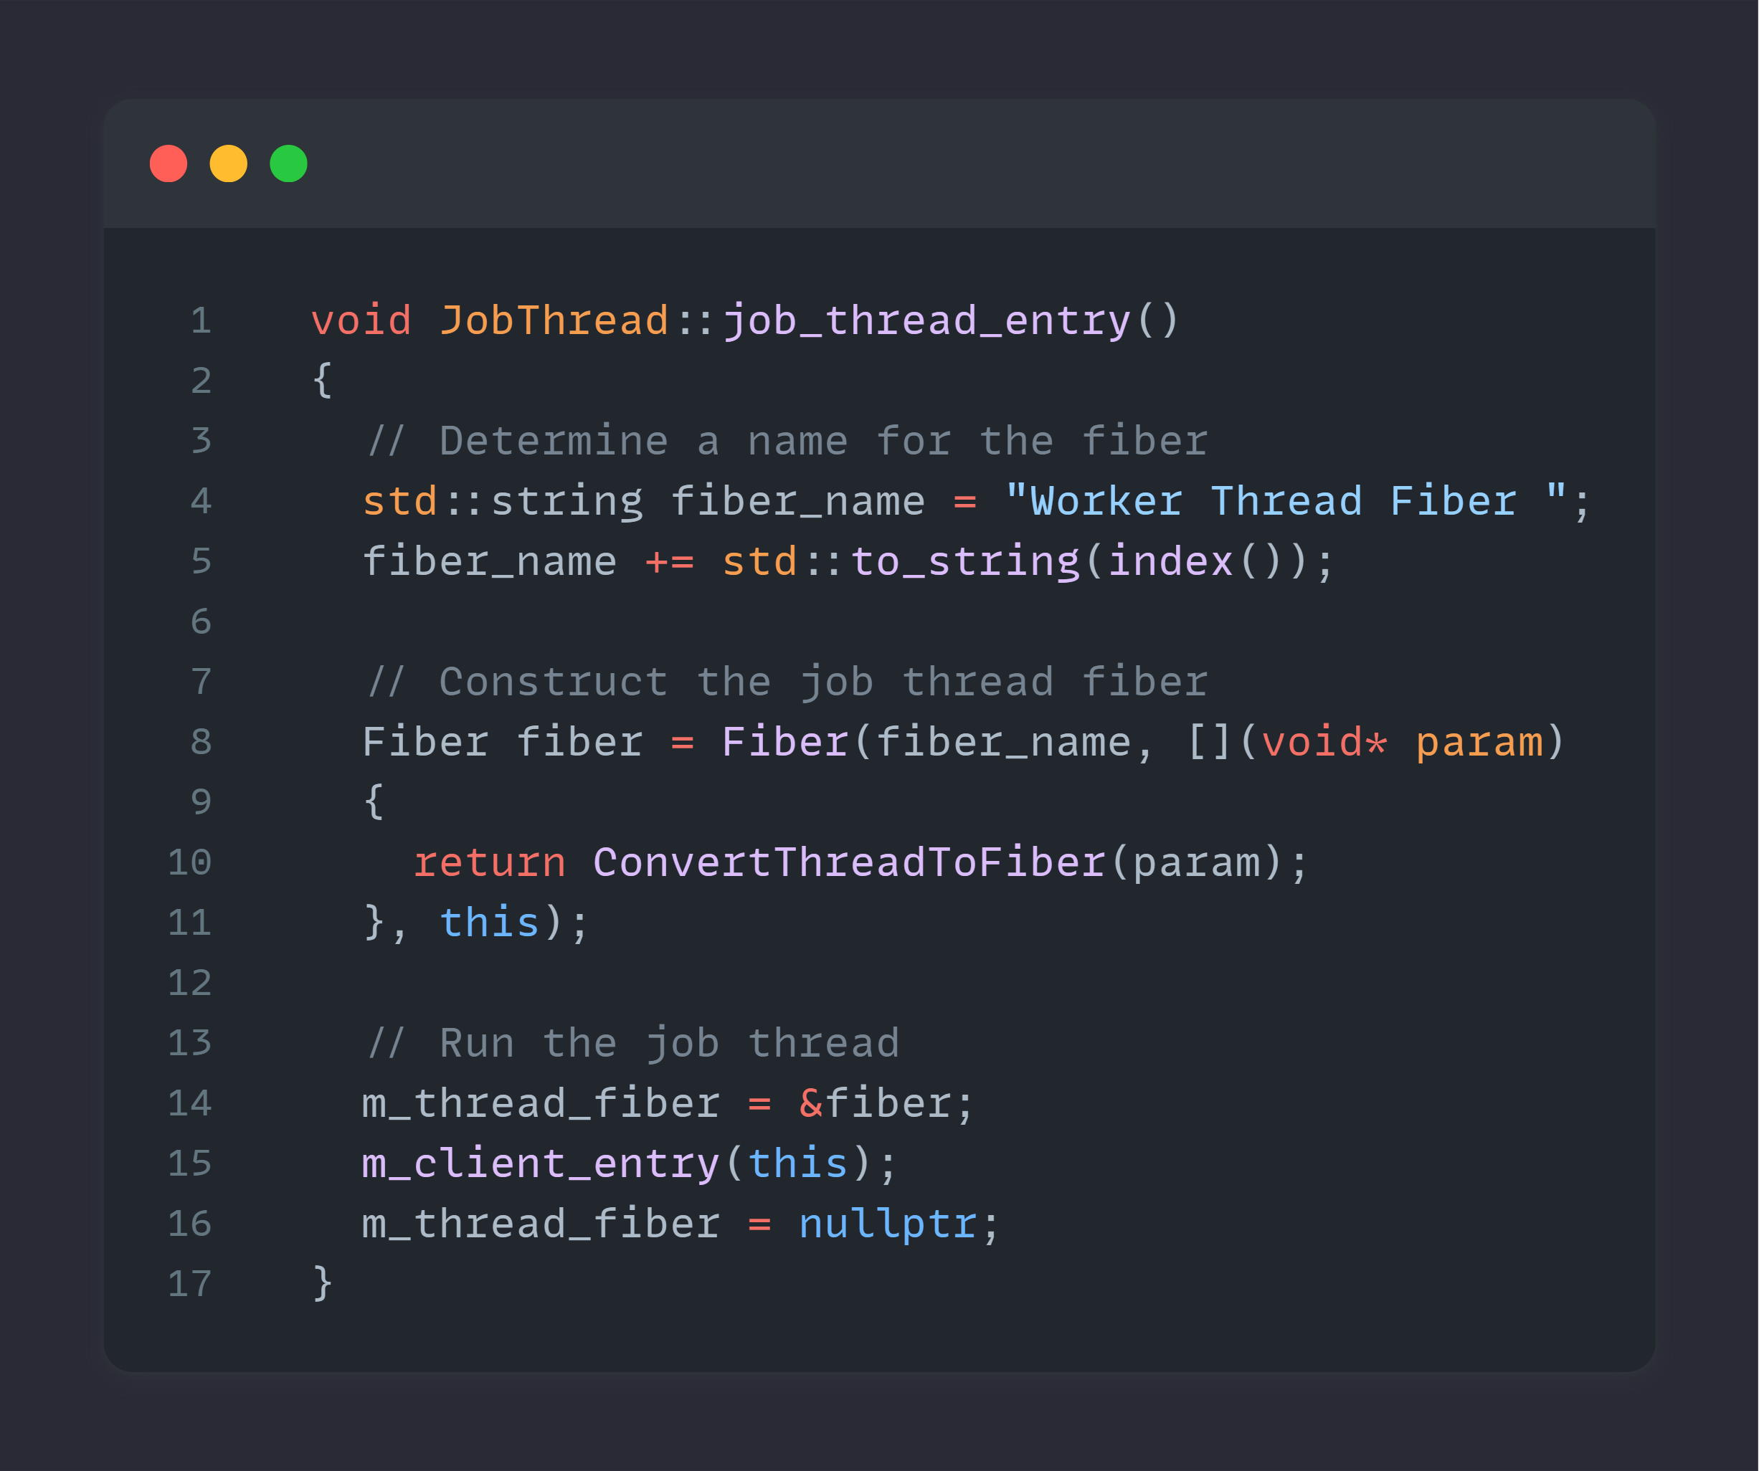
Notes:
Basically, the entry point of the thread ( next slide )

Slide 74
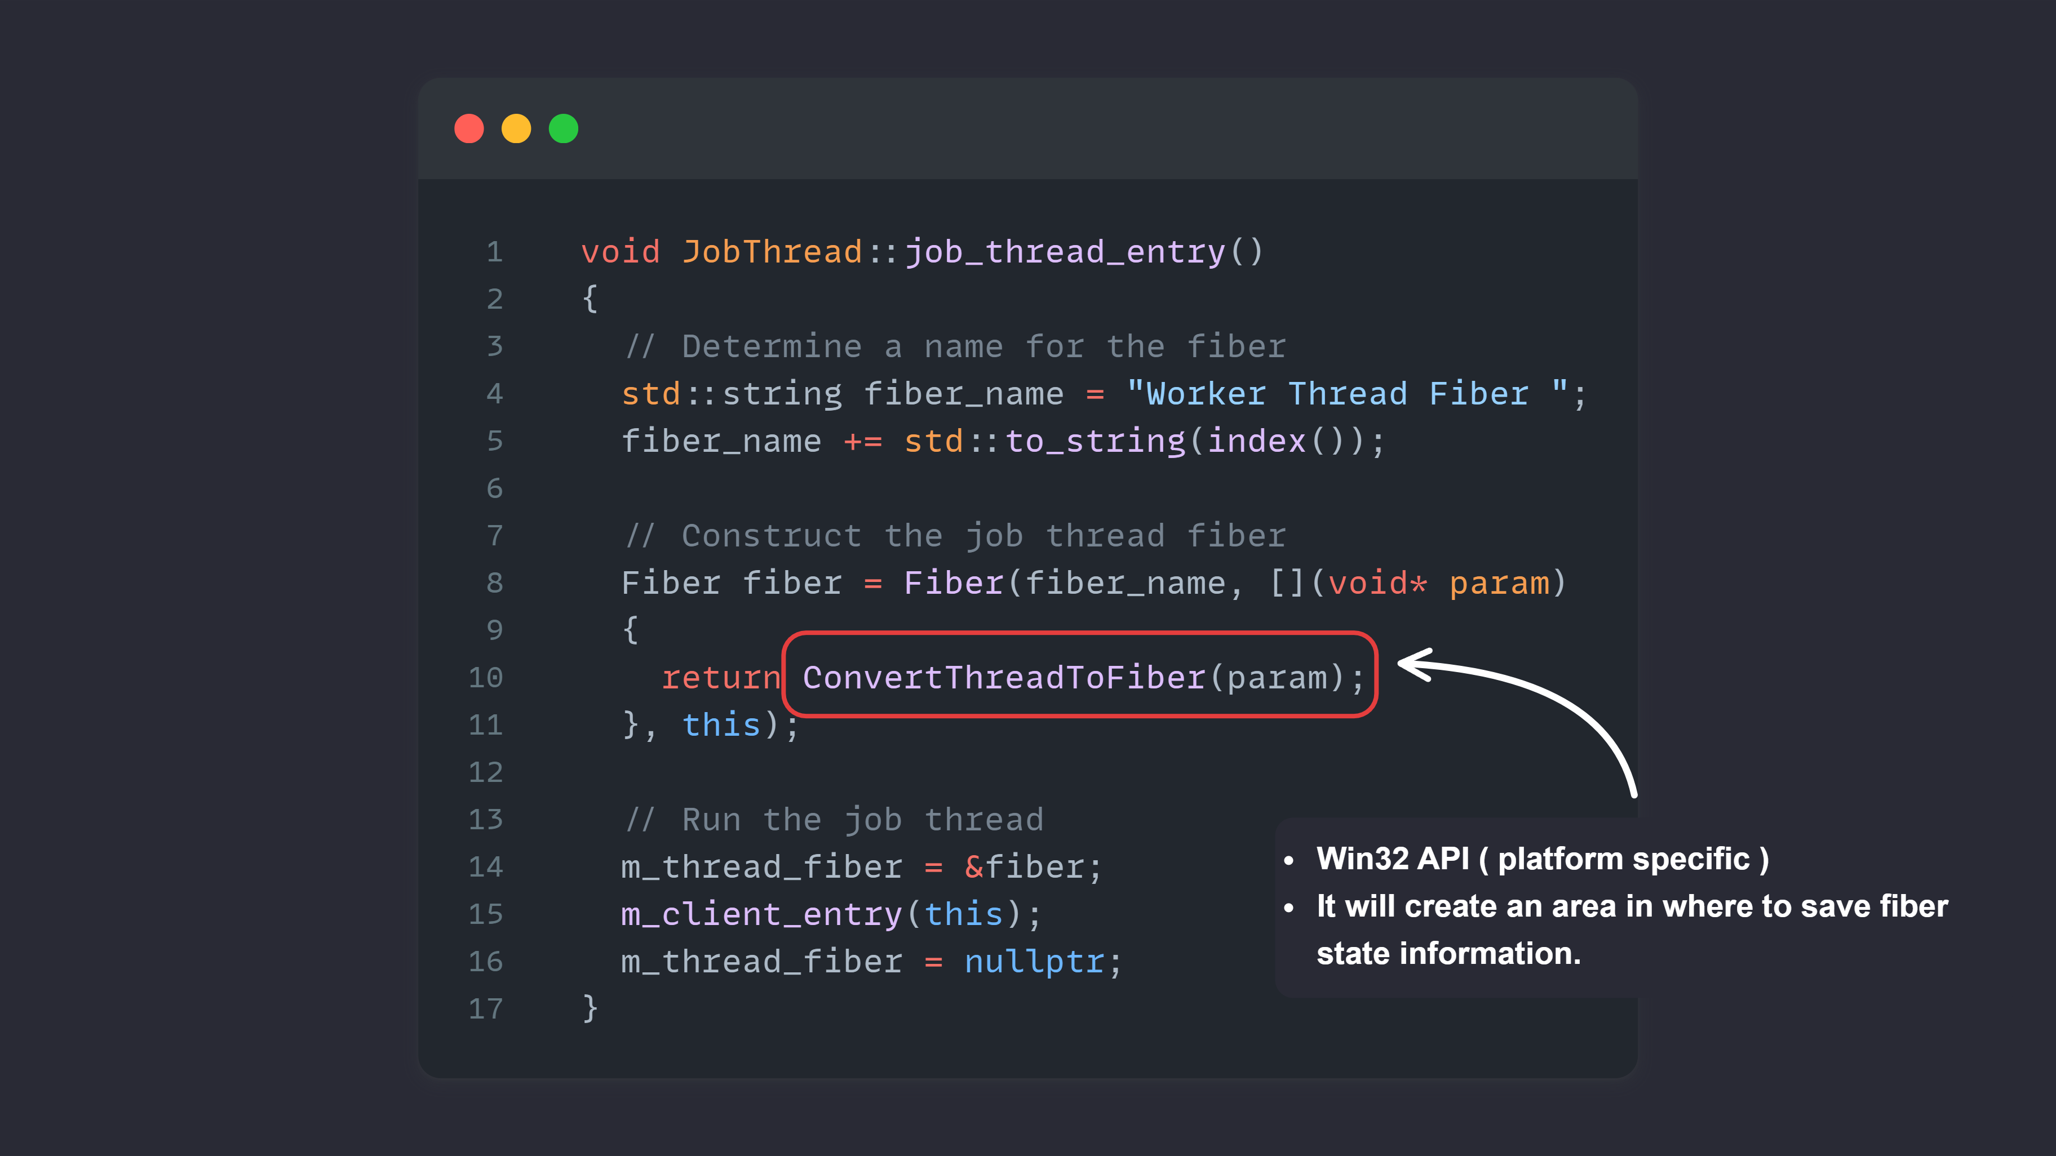
Notes:
This ( and any other spawned thread ) is the only location where we spawn a fiber not from the pool, as we are not able to switch to a fiber ( with a job ) from a thread only from fiber to fiber

Slide 75
Notes:
This callback will eventually run the thread and do the scheduling.

Slide 76
The code
Worker
Thread
Wait List
Fiber
Fiber
Fiber
Fiber
Fiber
Fiber
Fiber
Notes:
Which is when this scheme comes back into play

Slide 77
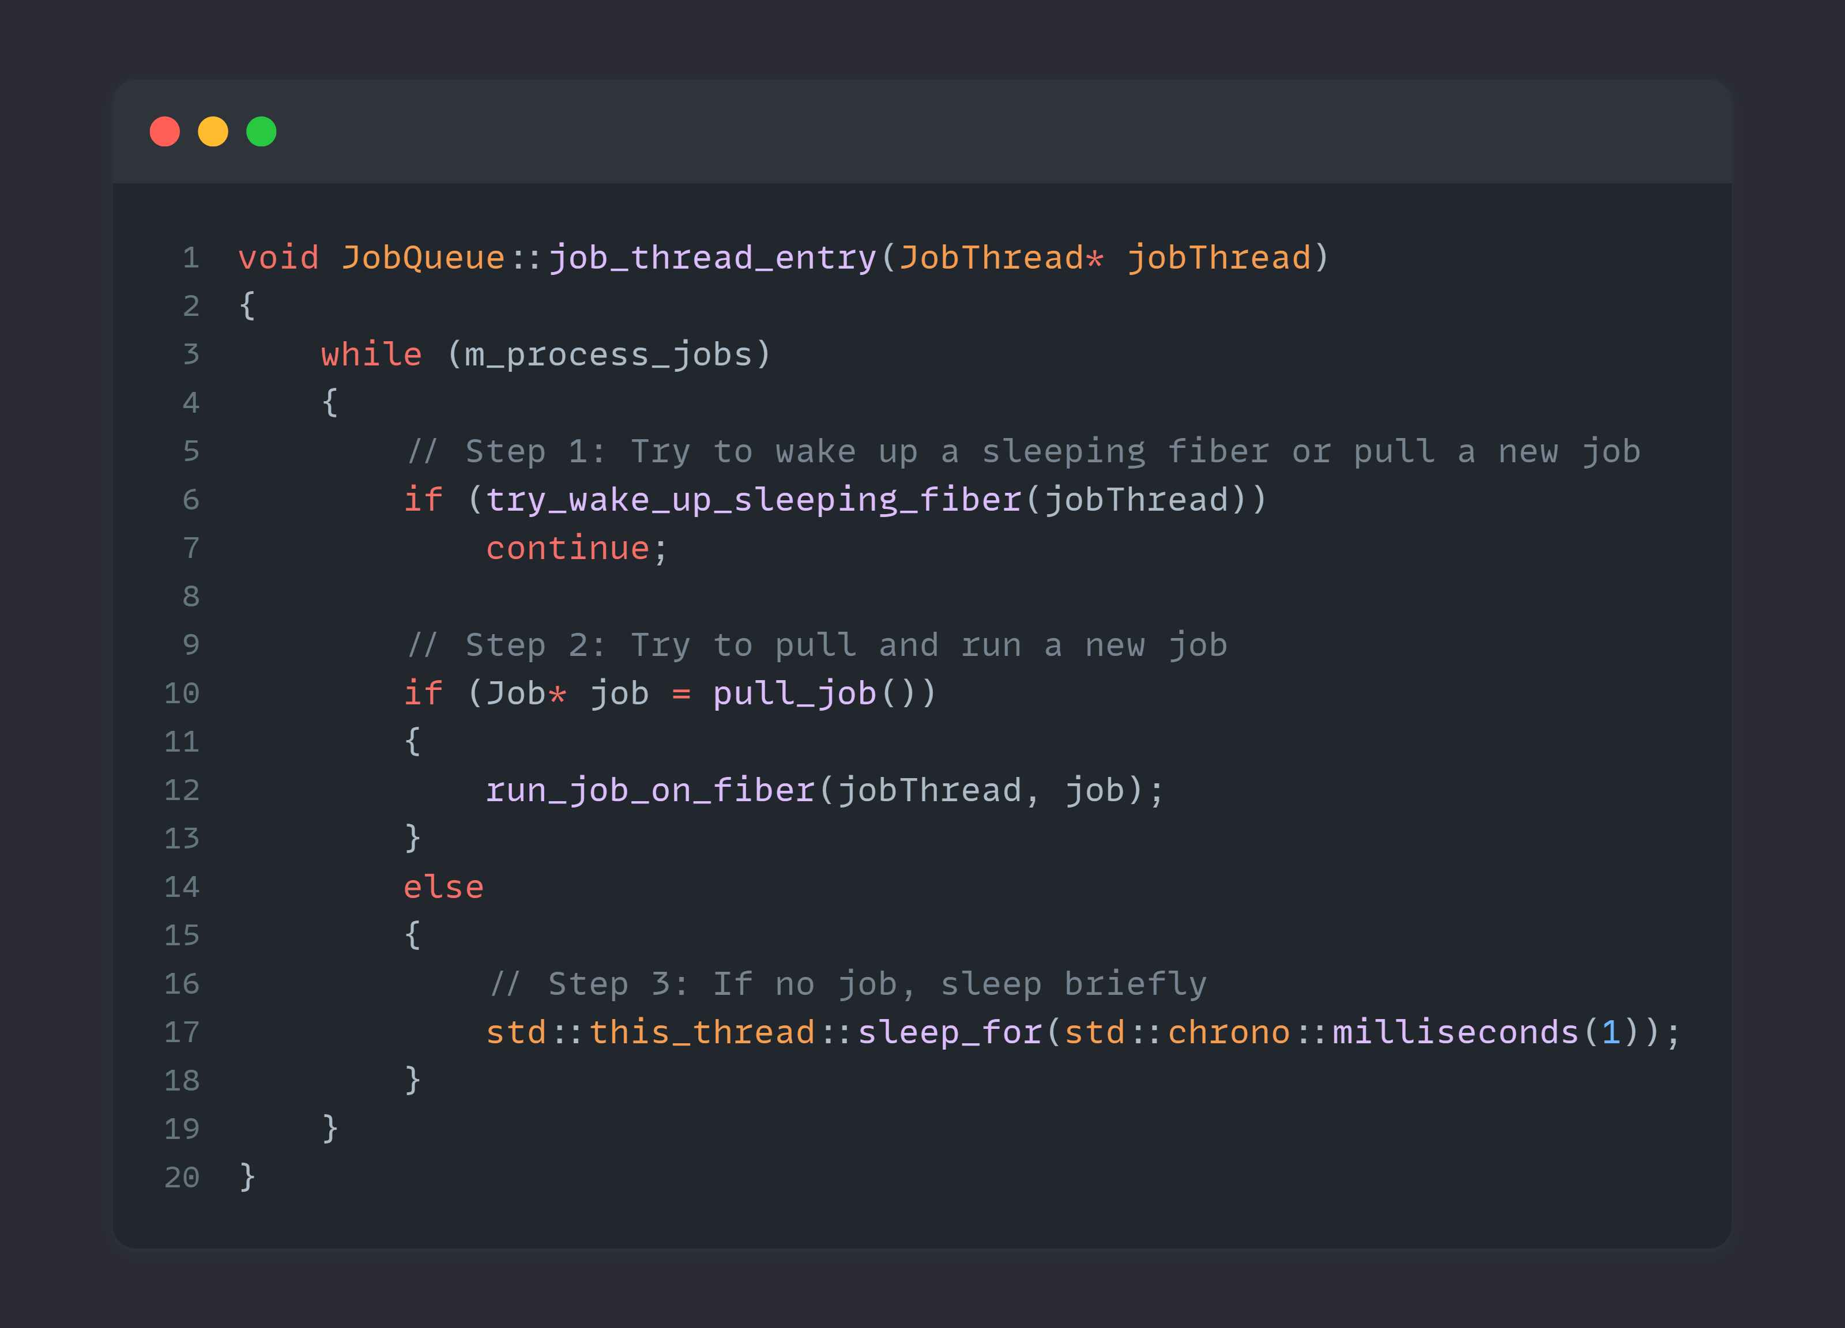
Notes:
In code could look something like this.
I won’t go into detail here due to time constraints but after I share the slides you’ll get the repo as well

Slide 78
Notes:
In code could look something like this.
I won’t go into detail here due to time constraints but after I share the slides you’ll get the repo as well
I do want to make a small jump into the “run_job_on_fiber” function to showcase what it does

Slide 79
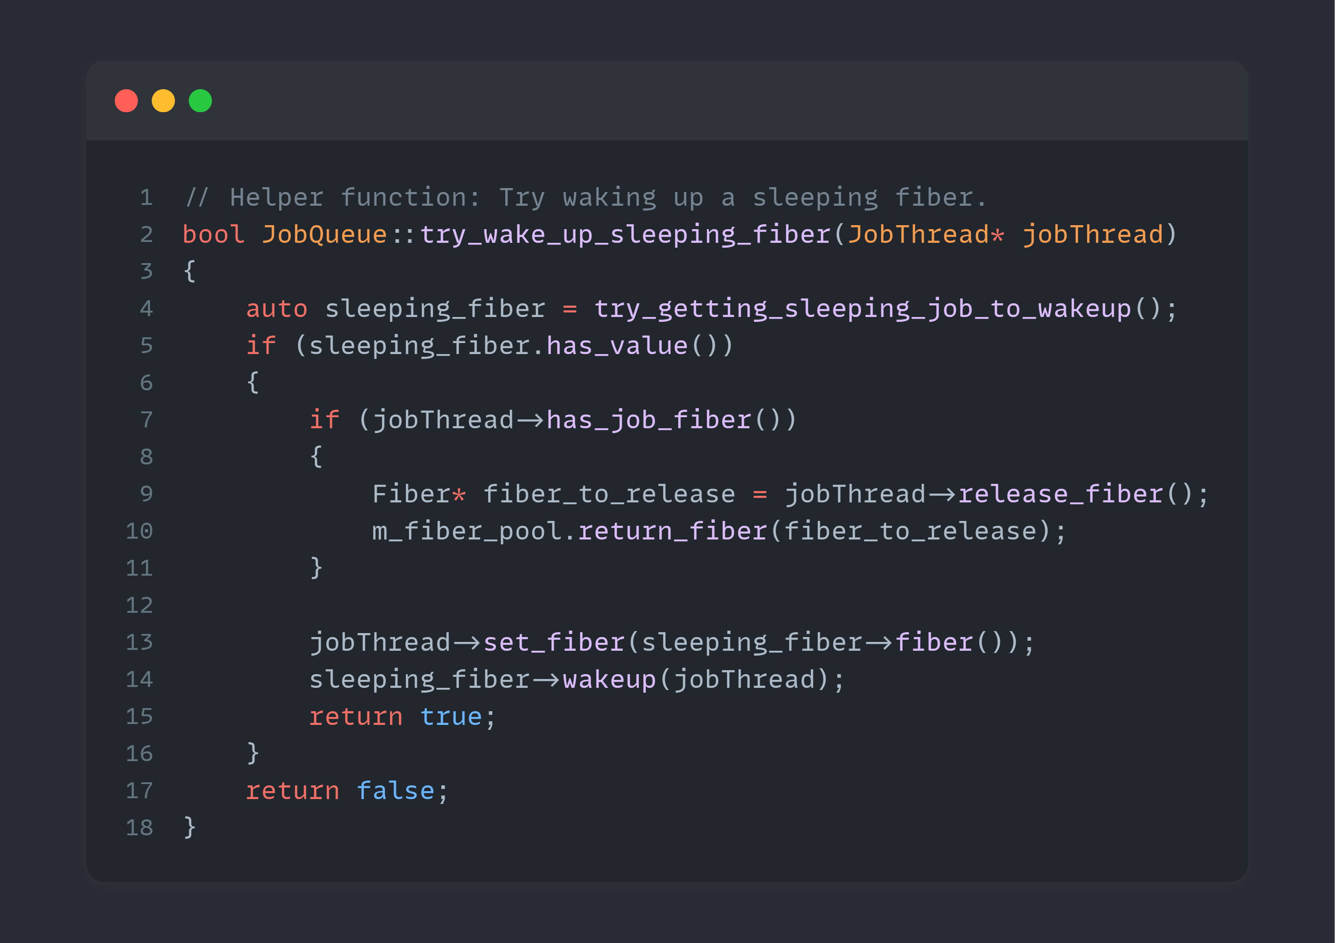

Slide 80
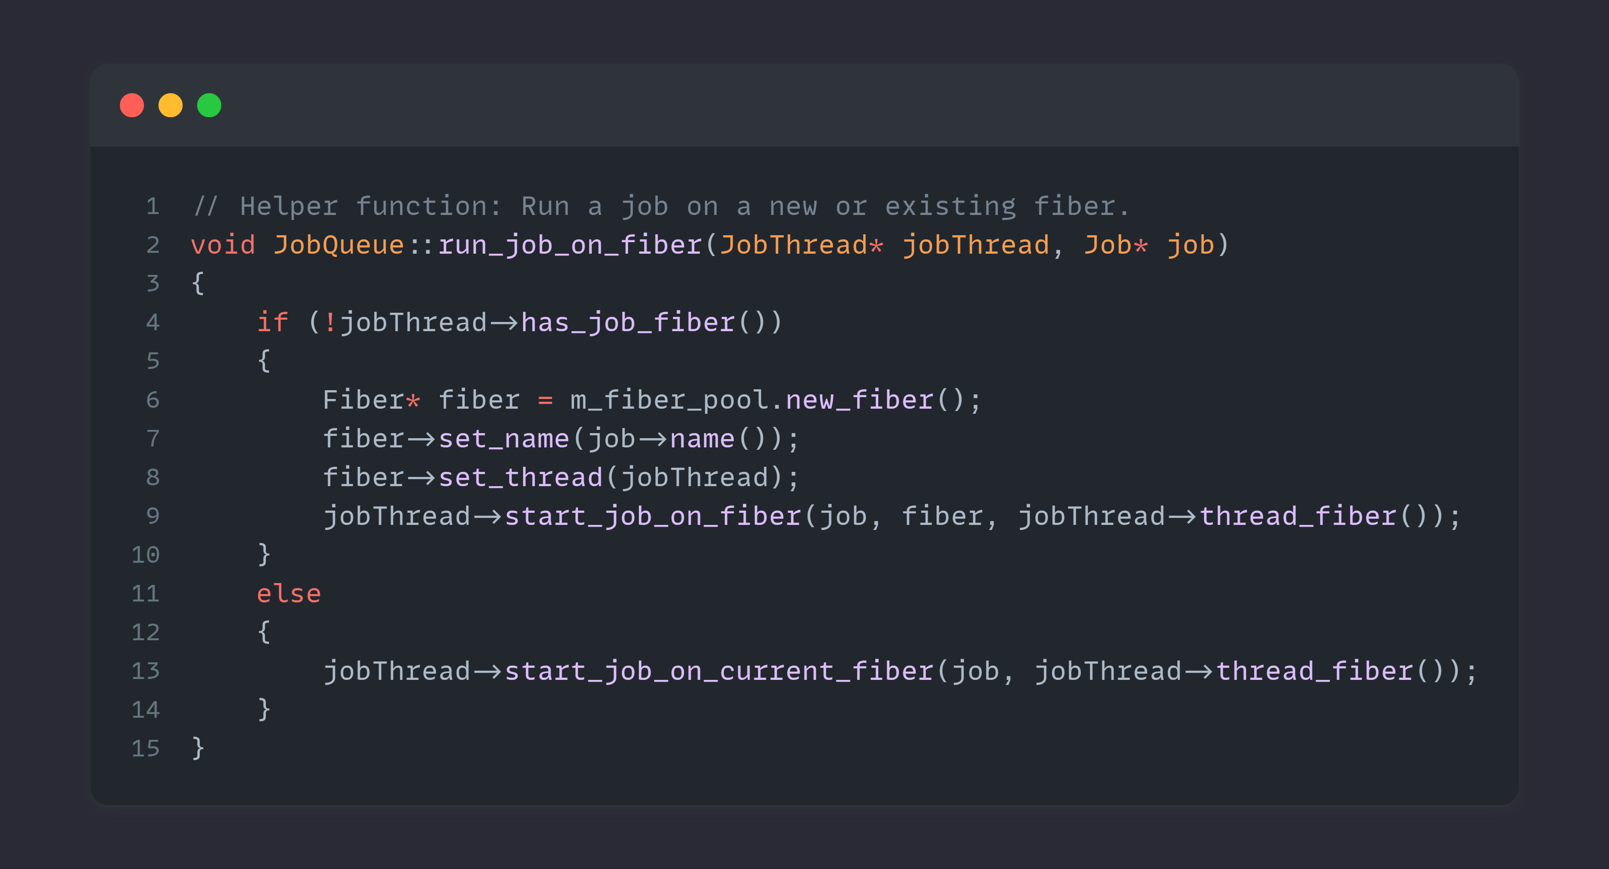
Notes:
Start job on fiber
Will set the current fiber on the JobThread and resume execution of the fiber itself.
By calling the following API call

Slide 81
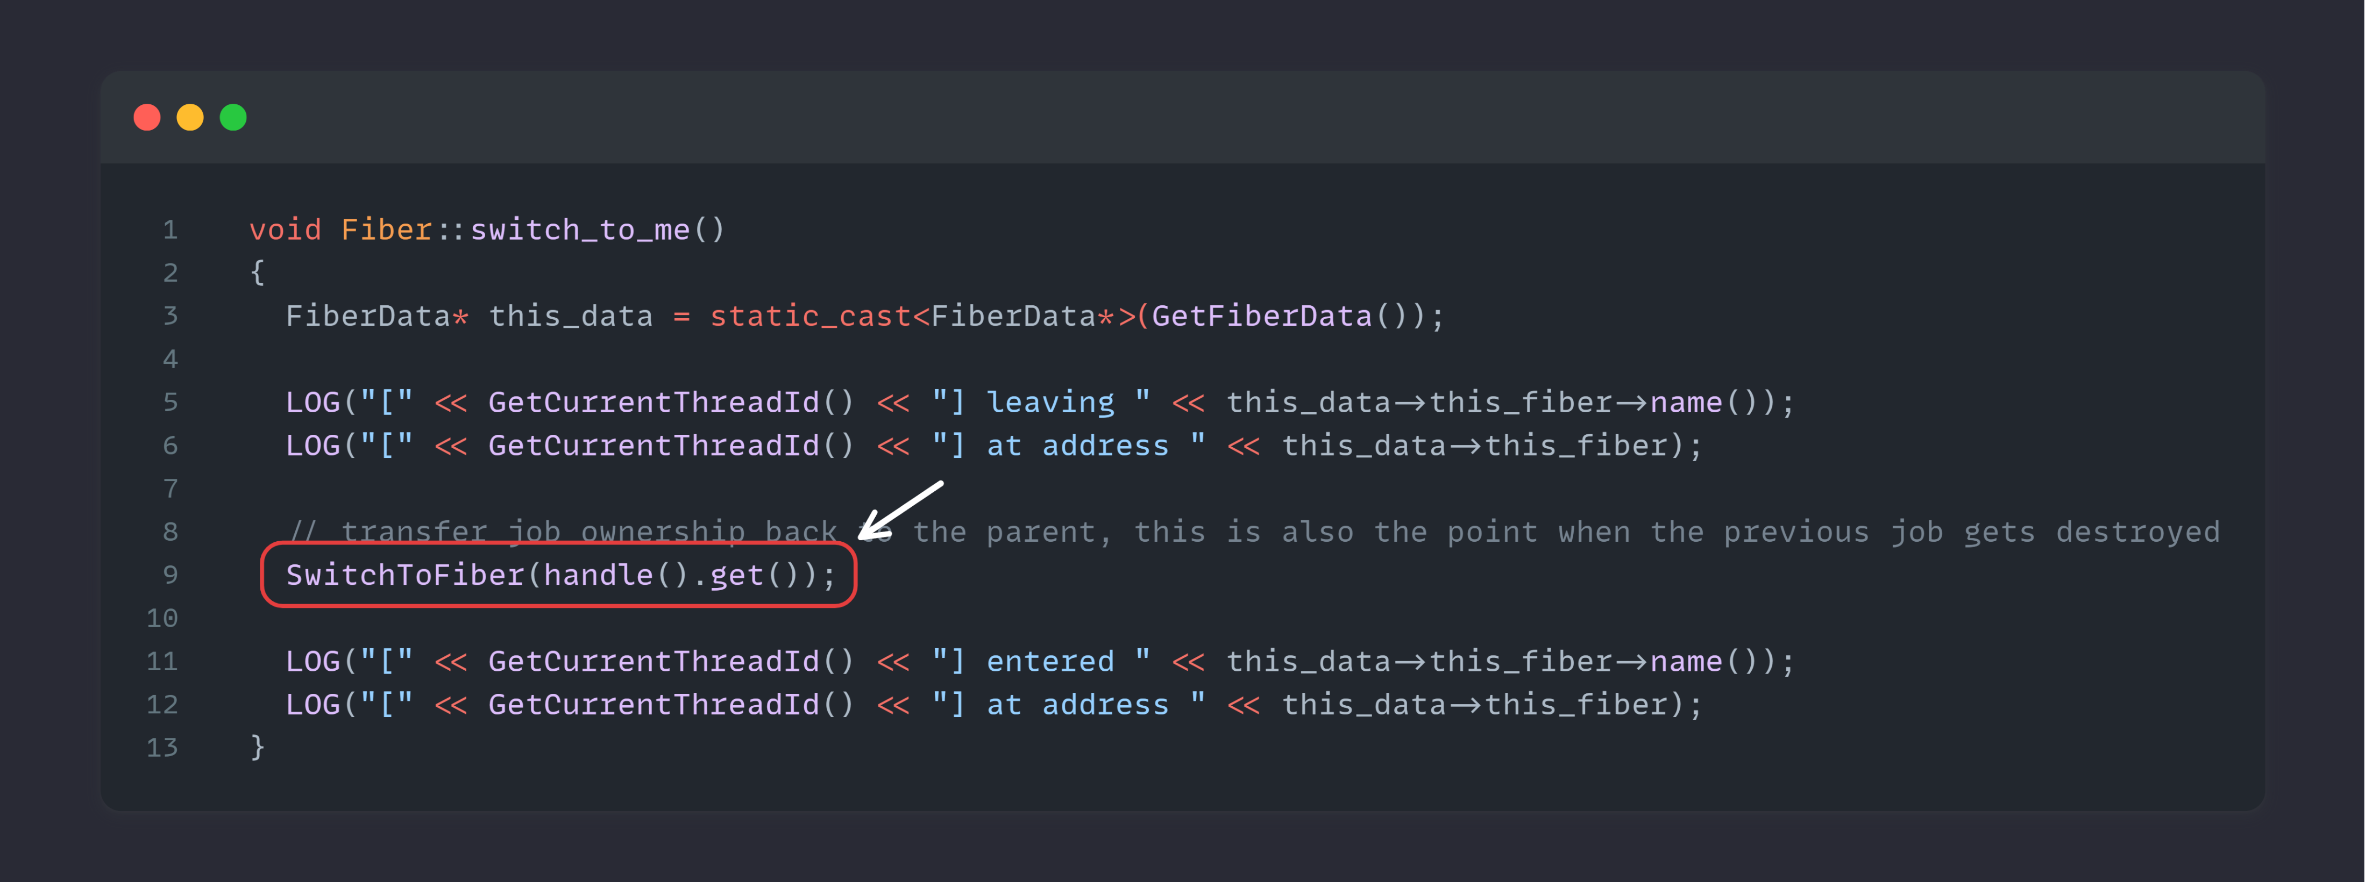
Notes:
SwitchToFiber
Which will continue the execution of the fiber

Slide 82
Pros & Cons

Slide 83
Pros & Cons
Pro
Easy to jobify a framework
Easy to sync
Lightweight
Notes:
Easy to Sync: One single function call wait_for_counter
Lightweight: Pointer switch ( when switching fibers )

Slide 84
Pros & Cons
Cons
No usage of sync primitives
Fibers can migrate between threads
Notes:
Cons
No usage of sync primitives
No mutex, no condition variables
They are tied to a thread
Fibers can migrate between threads
They can go to sleep on thread 1 and continue on thread 2

Slide 85
Pros & Cons
Worker
Thread 1
Wait List
Fiber
Worker
Thread 2
1
Fiber
Notes:
Let’s go from example here let’s say we try and wait for a certain timer …
When a mutex is locked by a thread, it remains locked until that same thread unlocks it.

Slide 86
Pros & Cons
Worker
Thread 1
Wait List
Fiber
Worker
Thread 2
0
Fiber
Notes:
But we said well if a fiber does not do any work it moves to a waitlist when the dependency is done we can continue it’s work But fibers can "wait and continue their work on another thread." This means that a fiber could lock a mutex, yield execution, and resume on a different thread
since mutexes are typically thread-bound, if a fiber locks a mutex on Thread A but then continues its execution on Thread B, the following problem will occur:
The mutex tied to the original thread (Thread A), cannot be unlocked by Thread B.
So, If the fiber doesn't resume on the original thread that holds the lock, the mutex remains locked indefinitely, causing a deadlock.

Slide 87
Pros & Cons
Most frameworks write abstractions around a sync primitives

Slide 88
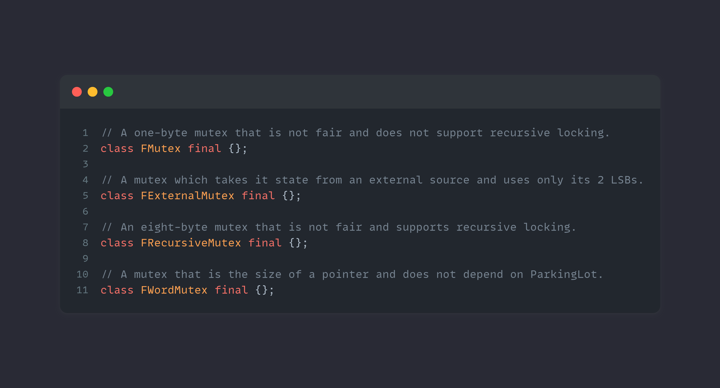
Pros & Cons
Unreal Engine 5.4 – Epic Games
Notes:
For instance, these are the mutexes within Unreal
And for those who are wondering, ( next slide )

Slide 89
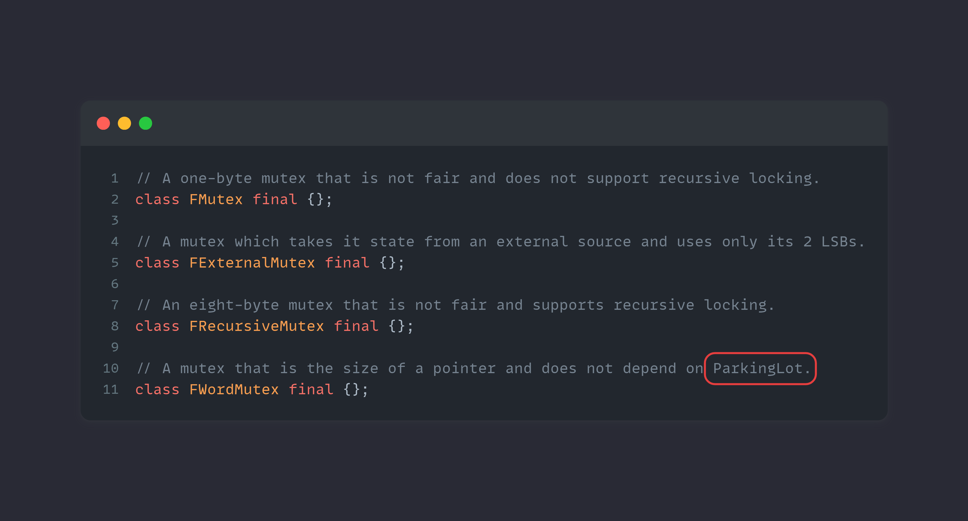
Pros & Cons
Unreal Engine 5.4 – Epic Games
Notes:
If you are wondering what a Parkinglot is, like I did.
Well a ParkingLot is a global table of queues of waiting threads keyed by memory address.
The more you know …

Slide 90
Pros & Cons
In these abstraction we can prevent any job from creating these objects

Slide 91
Pros & Cons
Synchronization must be done on the hardware level
Atomic spin locks
Special job mutex
Notes:
So how do we sync?
We sync on the hardware level
ensures that operations like locking and unlocking are fast and reliable across multiple cores or processors.
Spin locks allow a fiber (or thread) to keep checking (spinning) if a resource (mutex) is available without putting the fiber to sleep.
Special job mutex Instead of locking a resource and spinning, it puts the current fiber to sleep while waiting for a resource, freeing up the CPU to work on other tasks.

Slide 92
Support

Slide 93
Support for Fibers
Fibers and their call stack can be viewed in debuggers
You can name fibers
Crash handling
Notes:
Fibers and their call stack can be viewed in debuggers
Shows up in the thread view
View the call stack
What’s it’s doing
What it’s waiting for
You can name fibers
eg: name it to the job that it’s currently running
Crash handling
A fiber call stack is saved in core dumps

Slide 94
Support for Fibers
Fiber-Safe Thread Local Storage (TLS) Optimizations
Compilers cache TLS pointers for faster access within functions.
TLS variables may be inlined to avoid repeated lookups, improving performance.
Notes:
Compilers optimize access to TLS by caching the TLS pointer in a register or reusing the address in repeated accesses within the same function or scope.
They may also inline functions that access TLS variables. This means instead of making a call to get the TLS variable each time, the compiler can optimize it to avoid the lookup, assuming the TLS value will remain the same for the entire function.
This is a problem because Fibers can wake up on a different thread and if the TLS was cached you might end up with the wrong TLS address

Slide 95
Support for Fibers
Fiber-Safe Thread Local Storage (TLS) Optimizations
MSVC has the fiber-safe TLS flag ( /GT )
Disables TLS caching
Clang does not support this
Isolate TLS access in a separate .cpp file, this prevents the compiler from inlining and forces the TLS lookup to happen every time.

Slide 96
Support for Fibers
Use an adaptive mutex in your job system
Regular threads can post jobs in the job system
for instance, I/O thread spawn an asset processing job.
Very likely to preempt a spinlock on an atomic variable
High priority thread tries to acquire spin lock to post jobs into the job system
Will never resolve
Thread you kicked off is locked to the core it’s running on
Notes:
I know I said don’t use mutexes but this is one you will need in the job system
preempt: temporarily interrupt a thread to run another thread
spin lock: a lock where a thread repeatedly checks for a resource
atomic variable: special variable that ensures certain operations happen without interruption
When a thread is holding a spin lock and spinning (checking over and over to see if an atomic variable is free), it is actively using the CPU to do that.
Preempting a spin lock means the operating system interrupts that thread while it’s still spinning, stopping it temporarily to allow other threads to run.
the thread holding the spin lock is locked to a specific CPU core and is likely not being scheduled to run on that core. If the core is busy or if the system isn't giving time to that thread (for instance, if it is a low-priority thread), it will never get a chance to release the spin lock.As a result, the high-priority thread will keep spinning indefinitely, waiting for the lock to be released. But since the thread holding the lock can't run (because it's locked to a core that isn't currently running it), the situation creates a deadlock-like condition where the problem will "never resolve."

Slide 97
Support for Fibers
Adaptive mutexes
Locking mechanism that adjusts its behavior based on the current state of the lock

Slide 98
Support for Fibers
When a mutex is already locked, the adaptive mutex first spins (busy-waiting).
The thread keeps checking if the mutex becomes available without giving up the CPU.
If the mutex is released quickly, the thread acquires it, avoiding context switching overhead.
If the lock is held longer, the thread will block and yield the CPU to other threads.
Solves priority inversion deadlocks!
Notes:
Priority inversion is a situation in which a system where a lower-priority task holds a resource (like a lock or a semaphore) that a higher-priority task needs to proceed. This causes the higher-priority task to be blocked by the lower-priority task, even though the higher-priority task should normally take be running.

Slide 99
Support for Fibers – Priority Inversion
Task A (High Priority) needs a shared resource (e.g., a lock).
Task B (Low Priority) currently holds the lock and is in the middle of using the resource.
While Task B is using the resource, Task C (Medium Priority), which does not need the shared resource, becomes runnable and starts executing because Task B is a lower-priority task.
Task C runs because it has a higher priority than Task B.
Task B is not allowed to complete and release the lock.
Task A, despite having the highest priority, is forced to wait until Task B finishes its work, which is being delayed by Task C.
Notes:
Thus, the system behaves as though Task C has a higher priority than Task A, even though Task A has the highest priority in the system. This situation is called priority inversion because it inverts the expected priority order.

Slide 100
Support for Fibers
Fiber local storage
Stores a unique copy of a variable for each running fiber
Haven’t found a use case for this
Acts like TLS if fibers never switch threads
If switching threads does occur FLS is switched with the fiber
Fiber Local Storage ( MSDN )

Slide 101
Zooming out
Notes:
So oke, let’s zoom out a bit.
I come from a background of where I make realtime simulations ( games for instance )
And within these type of applications certain things happen.
(next slide)

Slide 102
Overview of a frame
Application Logic
Physics Step
Render
Notes:
This could be a summary of those things if it was single threaded
Other stages could exist but for simplicity sake let’s talk about these 3

Slide 103
Overview of a frame
Application Logic
Physics Step
Render
wait on each other …
Notes:
They all have to wait on each other …
That seems kind of tedious, so let’s not do that.

Slide 104
Overview of a frame
Logic
Worker Thread
1
Physics
Render
Worker Thread
2
Worker Thread
3
11ms
9ms
5ms
Notes:
This could be a profile result
To give an overview about a frame

Slide 105
Overview of a frame
Logic
Worker Thread
1
Physics
Render
Worker Thread
2
Worker Thread
3
11ms
9ms
5ms
Notes:
Lot of wasted cycles
I was not able to show real profile results as the visual studio profile result got corrupted …

Slide 106
Overview of a frame
Application Logic
Physics Step
Render
Frame n
Notes:
Instead, what we could do is the following: we sort of start in the same situation.
Next slide

Slide 107
Overview of a frame
Application Logic
Physics Step
Render
Frame n + 1
Frame n
Notes:
But when frame n of the application logic is finished we move it to the next stage in the pipeline but also kick off frame n + 1 on the application logic

Slide 108
Overview of a frame
Application Logic
Physics Step
Render
Frame n + 2
Frame n + 1
Frame n
Notes:
And we continue doing this all the way until we render.

Slide 109
Challenges with synchronization
The Physics thread needs to wait for the Logic thread to finish the logic for the current frame before it can apply physics.
The Rendering thread needs to wait for the Physics thread to complete its calculations before rendering the updated frame.
The Logic thread can start working on the next frame's logic while the Physics and Rendering threads are still processing the previous frame, but it needs to avoid modifying shared data until physics is done.

Slide 110
Challenges with synchronization
We can use double/triple buffering for sharing data between threads
Each thread has its own version of the application state
We can use condition variables to signal the readiness of another thread
This ensure each thread knows when it’s safe to proceed.
Notes:
Priority inversion is a situation in which a system where a lower-priority task holds a resource (like a lock or a semaphore) that a higher-priority task needs to proceed. This causes the higher-priority task to be blocked by the lower-priority task, even though the higher-priority task should normally take be running.

Slide 111
Overview of a frame
Logic
Worker Thread
1
Physics
Render
Worker Thread
2
Worker Thread
3
16ms
Notes:
Now if we look at it
So why am I telling you this … well it will tie into the following topic

Slide 112
Overview of a frame
No instance of the same stage can run in parallel
This does not make sense as we cannot calculate anything new without any new input
Limit the frames in flight to a reasonable number
Input lag becomes a thing quite fast
Filling up the cores with work in multi-threaded applications seems to be affecting performance way more over applying cache coherency (your use case might vary).
Notes:
Having control over how memory is handled is quite important in high performance applications.
Therefore, we override the global new operator ( or most of the allocations that happen within our framework ) and push them in a global pool of memory that we manage
There are barely any mallocs within our framework most of them are at initialization when the “stages” boot up
All data is allocated within this linear block of memory, data that done, move through stages, assets loaded in memory, etc.
When the frame is done we move back to 0 and we “get the memory back“

Slide 113
Memory

Slide 114
Memory Allocation
Linear allocators
There is no delete anywhere
This worked great for the first approach …
Offset
Allocated Memory
0
max
Notes:
Linear allocators
Contiguous block of memory + offsets in that block
Allocation is just moving the offset
Free all allocation by setting the offset back to 0
There is no delete anywhere
This worked great for the first approach …
Having control over how memory is handled is quite important in high performance applications.
Therefore, we override the global new operator ( or most of the allocations that happen within our framework ) and push them in a global pool of memory that we manage
There are barely any mallocs within our framework most of them are at initialization when the “stages” boot up
All data is allocated within this linear block of memory.
When the frame is done we move our offset back to 0 and we “get the memory back“

Slide 115
Memory Allocation
Allocation of memory that is consumed within a stage
Passed from one frame to the next frame in the same stage
Feed from one stage to another stage
Notes:
Different allocators and different lifetimes
Allocation of memory that is consumed within a stage
scratch memory
Passed from one frame to the next frame in the same stage
low-prio physics calculations
Feed from one stage to another stage
draw geometry

Slide 116
Memory Allocation
Lot of different linear allocators
All of them allocated for worst case
Notes:
Lot of different linear allocators
All of them allocated for worst case
You will never hit worst case for all allocators at the same time
Result is that you have wasted memory most of the time …

Slide 117
Tagged Heap
Parallelizing the Naughty Dog Engine Using Fibers – Naughty Dog
Notes:
But the people from Naughty Dog found a solution for this as well.

Slide 118
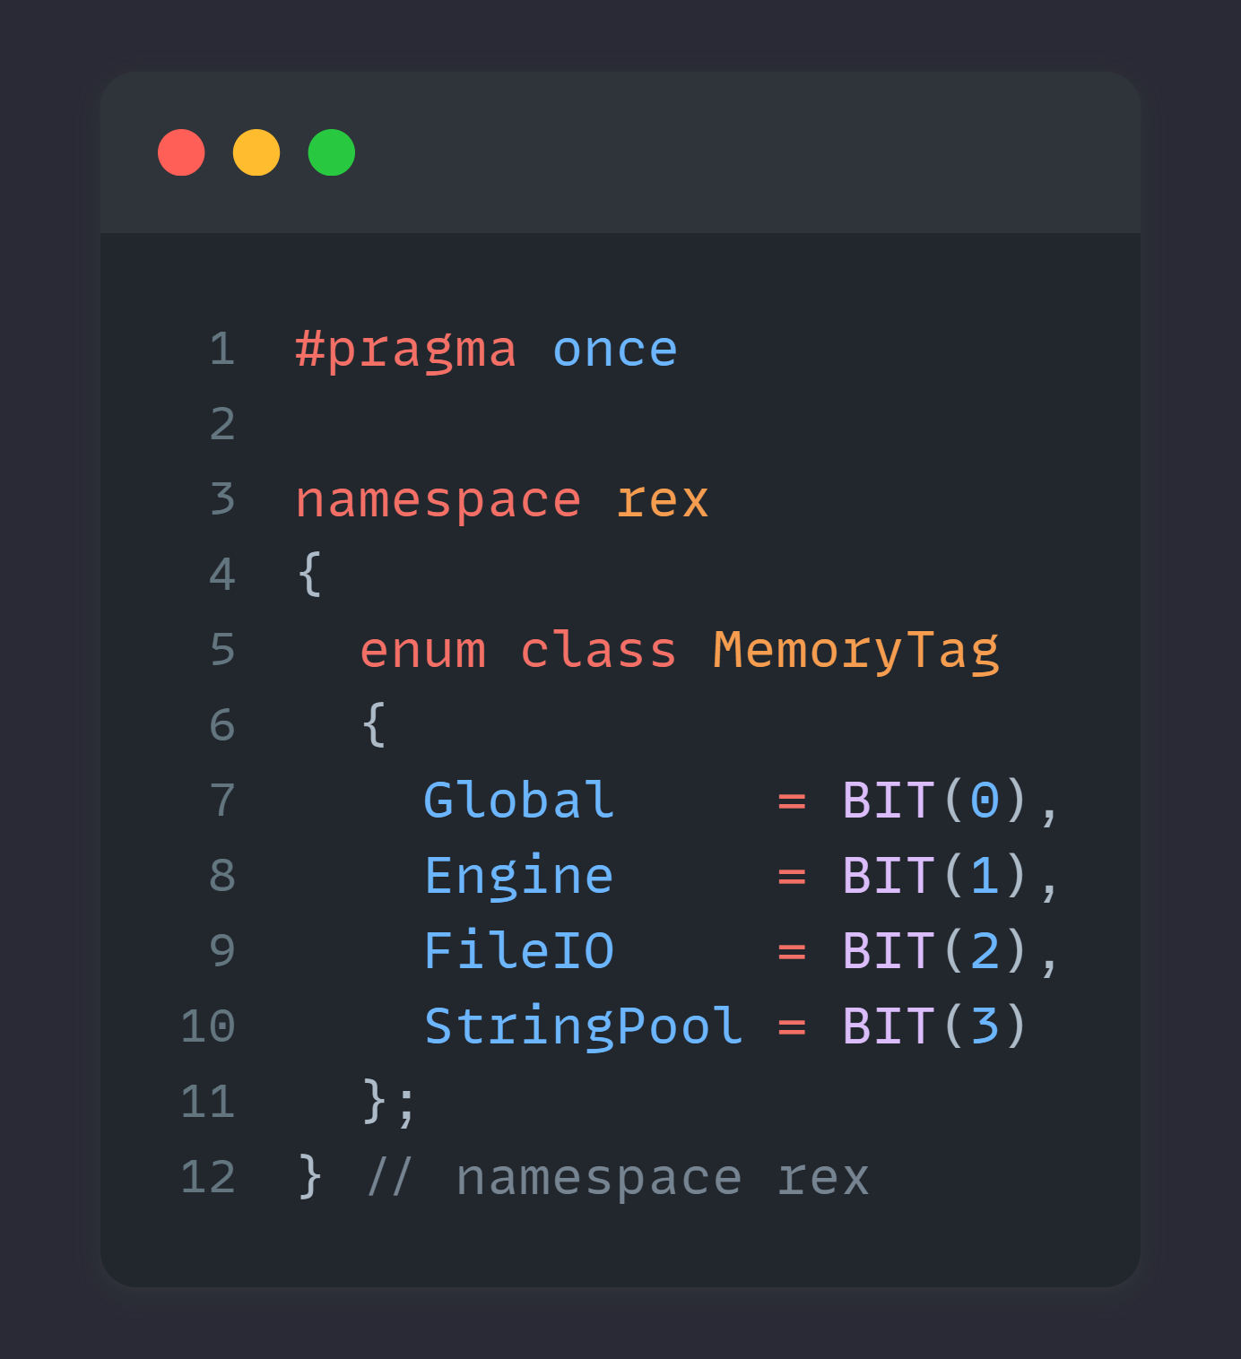
Tagged Heap
Block based allocator
Block size of 2 MiB
Each block is owned by a tag
uin64_t
No ::free(ptr) interface
Free all blocks associated with a specific tag
Notes:
2 MiB is usually a “Large Page” on Windows
TLB entry

Slide 119
Tagged Heap
TAGGED HEAP
Allocator
APP
RENDER
APP
RENDER
APP
PHYX
PHYX
Notes:
Tagged heap on the left
Allocator with a 2MB block of memory

Slide 120
Tagged Heap
TAGGED HEAP
Allocator
memory request
memory request
APP
memory request
RENDER
APP
RENDER
APP
PHYX
PHYX
Notes:
When memory requests are coming in the allocator will use it’s local block to store these requests

Slide 121
Tagged Heap
TAGGED HEAP
Allocator
APP
RENDER
APP
RENDER
APP
PHYX
PHYX
Notes:
When it runs out

Slide 122
Tagged Heap
TAGGED HEAP
Allocator
APP
RENDER
APP
alloc “APP”
RENDER
APP
PHYX
PHYX
Notes:
It will go back to the backend and ask for another 2 MB block and put it under the tag APP

Slide 123
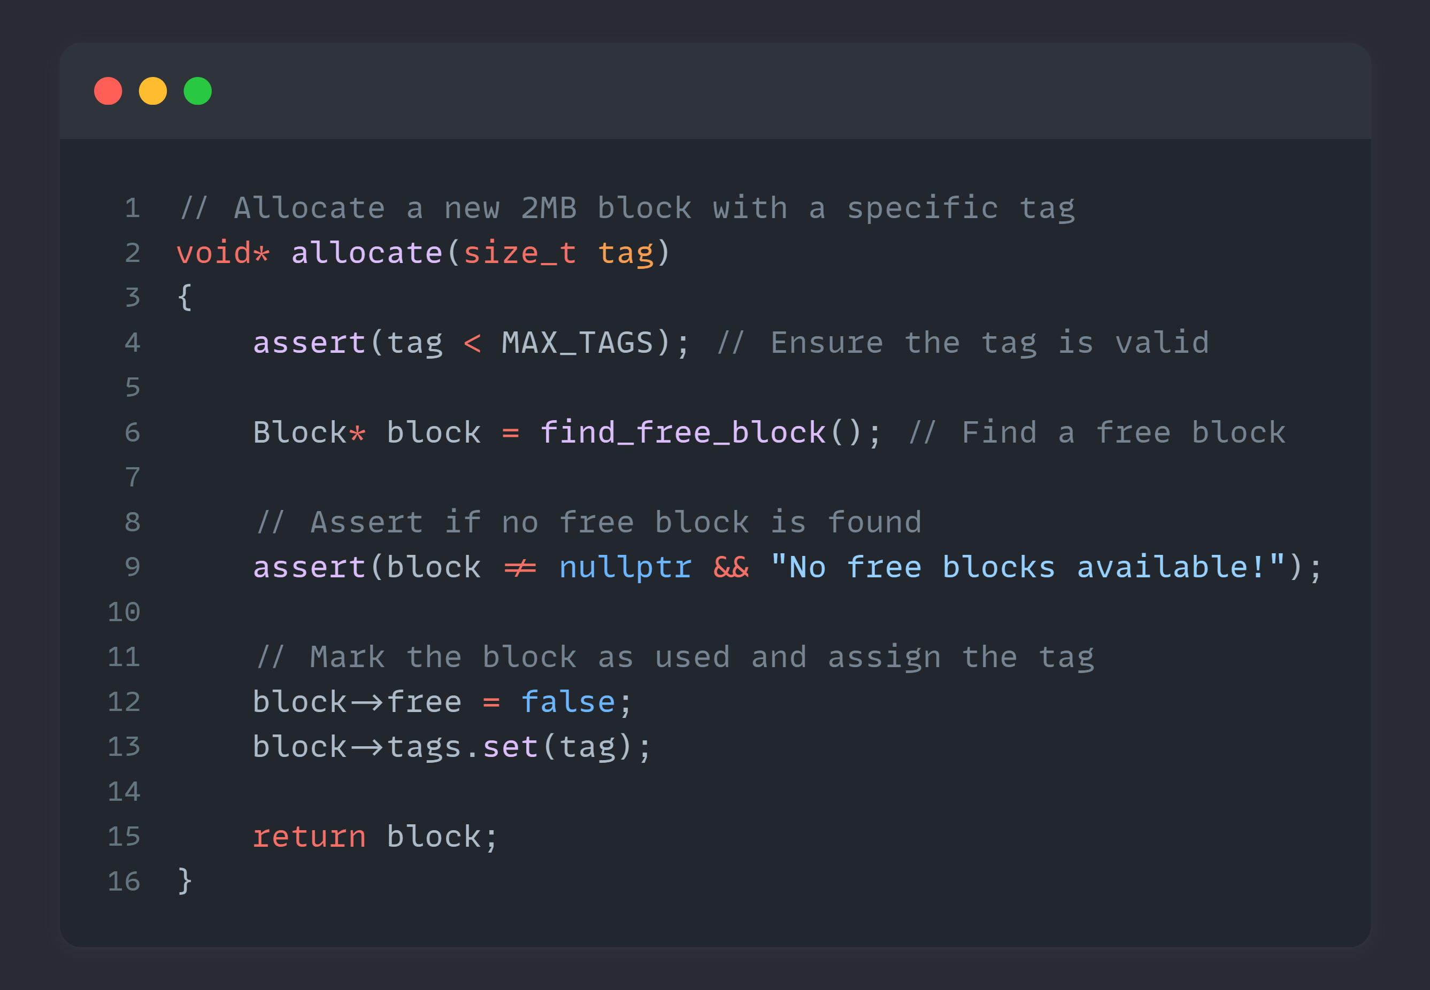
Notes:
It will go back to the backend and ask for another 2 MB block and put it under the tag APP

Slide 124
Tagged Heap
TAGGED HEAP
Allocator
memory request
memory request
APP
memory request
APP
RENDER
APP
RENDER
APP
PHYX
PHYX
Notes:
It returns it and everybody is happy again

Slide 125
Tagged Heap
TAGGED HEAP
Allocator
APP
RENDER
APP
free “APP”
RENDER
APP
PHYX
PHYX
Notes:
It will go back to the backend and ask for another 2 MB block and put it under the tag APP

Slide 126
Tagged Heap
TAGGED HEAP
Allocator
RENDER
free “APP”
RENDER
PHYX
PHYX
Notes:
It will go back to the backend and ask for another 2 MB block and put it under the tag APP

Slide 127
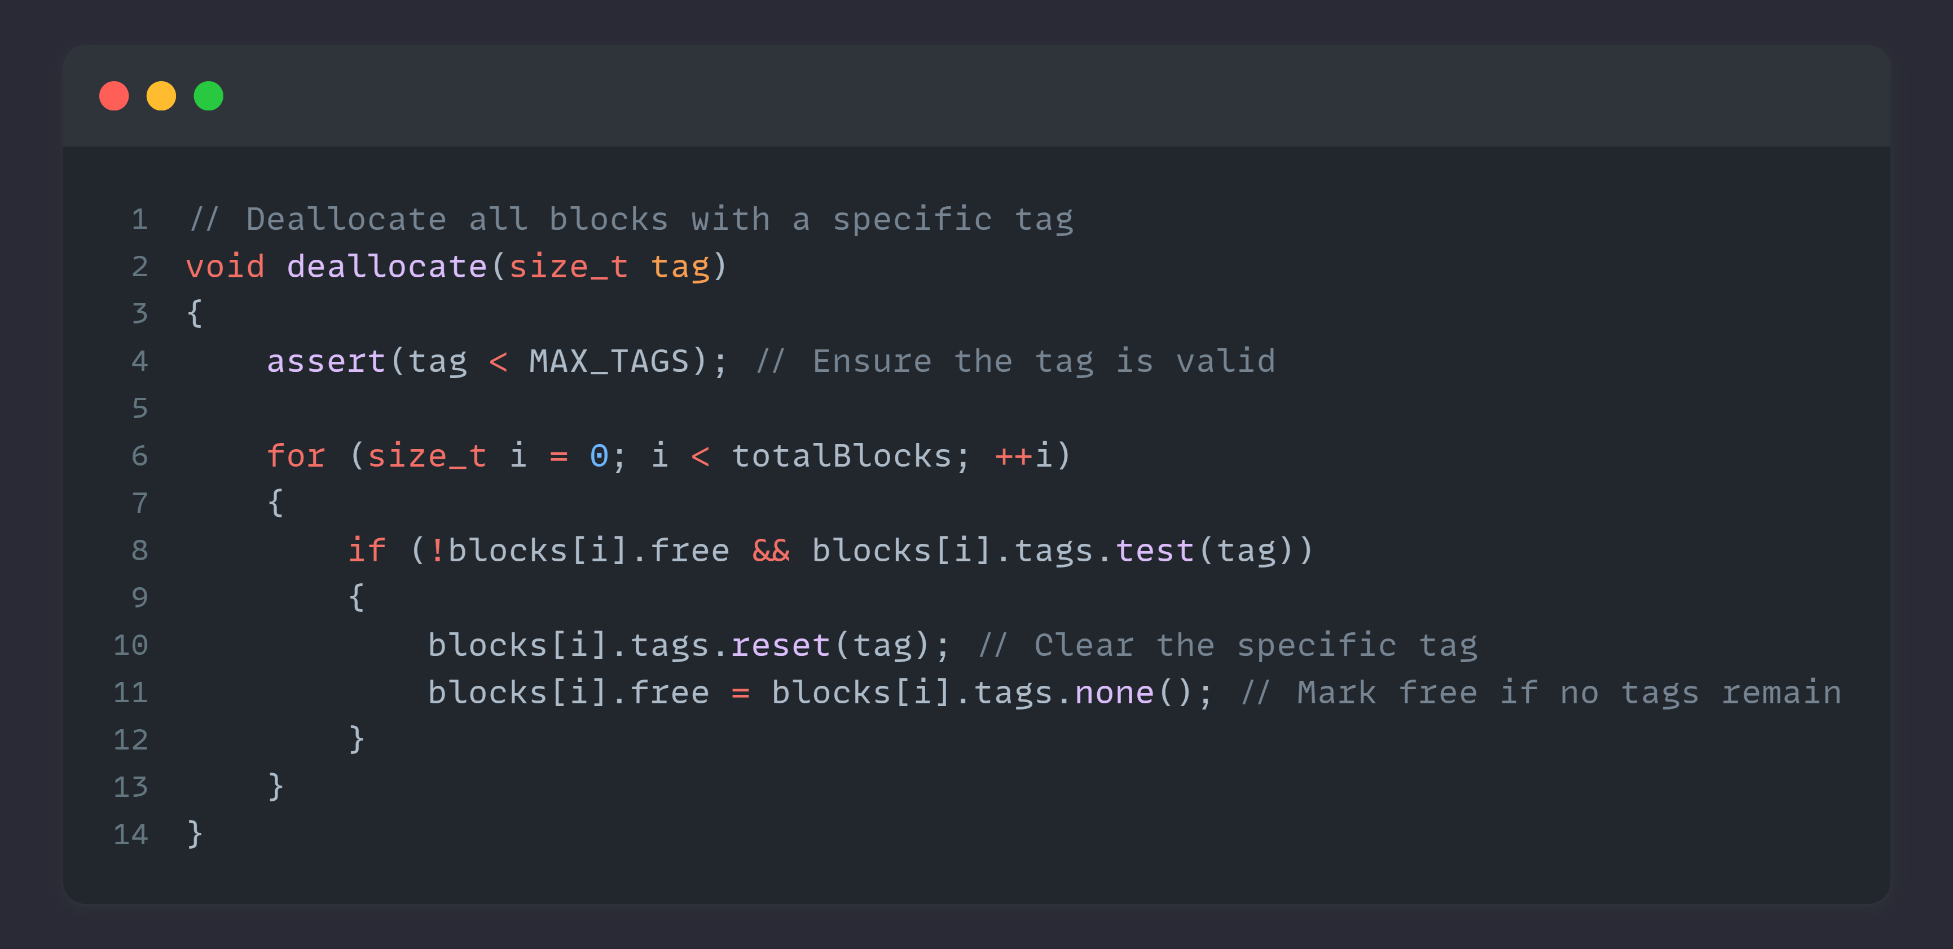
Notes:
It will go back to the backend and ask for another 2 MB block and put it under the tag APP

Slide 128
Tagged Heap
Almost all allocations are less than 2MiB
Very unlikely that every allocator would spike to the largest amount
You need enough blocks to cover the most reasonable amount of spike as a whole
Notes:
Almost all allocations are less than 2MiB
Larger than 2MiB allocations get consecutive 2MiB blocks
Very unlikely that every single allocator would spike to the largest amount
You need enough blocks to cover the most reasonable amount of spike as a whole

Slide 129
Tagged Heap
For blocks larger than 2MiB you could solve it as followed:
Increase the initial block size
Multiple block allocations
allocator would allocate multiple blocks and track that these blocks are part of a single "larger" allocation
store metadata to link these blocks together and indicate that they form a single allocation
Buddy allocation
pre-allocate memory in a large pool, and then divide that memory into blocks of varying sizes based on powers of two
if 3MiB allocation is requested, the allocator can provide a single 4MiB block instead of needing two separate blocks

Slide 130
Memory Allocations when using Fibers

Slide 131
Memory Allocations when using Fibers
Worker
Thread
Worker
Thread
Worker
Thread
Allocator
App
Locking is required when a single 2Mib block is used by multiple threads
Notes:
Oke, so how is this applied to fibers
3 worker threads
2 fibers running on the worker threads
They request memory

Slide 132
Memory Allocations when using Fibers
Worker
Thread
Worker
Thread
Worker
Thread
Allocator
App
Locking is required when a single 2Mib block is used by multiple threads
Notes:
All fibers contain memory of the same block and because we use this tagged heap when a frame ( so something has passed through all stages ) we can clear the memory with that specific tag
But every time we request memory from a block we need to lock …
That is not really ideal

Slide 133
Memory Allocations when using Fibers
Store one 2MiB block per worker thread
Store a pointer in TLS to the allocated block
All allocations on that thread go to that block
No lock required for almost all allocations
Notes:
What we could do …

Slide 134
Memory Allocations when using Fibers
Worker
Thread
Worker
Thread
Worker
Thread
Jobs are allocating from the assigned block on that thread …
Allocator
App
App
App
Notes:
To demonstrate”:
We have 2 fibers running on the first and the last worker thread and they allocated pieces of a 2MB block

Slide 135
Memory Allocations when using Fibers
Worker
Thread
Worker
Thread
Worker
Thread
… can go to sleep …
Allocator
App
App
App
Notes:
Fibers could go to sleep and wake up somewhere else that is still fine and if they do …

Slide 136
Memory Allocations when using Fibers
Worker
Thread
Worker
Thread
Worker
Thread
… and make additional allocations
Allocator
App
App
App
Notes:
They can allocate memory from that specific worker threads block
Because of the tagging when we complete a frame and all memory with a specific tag is cleared and we can be sure no stale pointers would be left behind

Slide 137
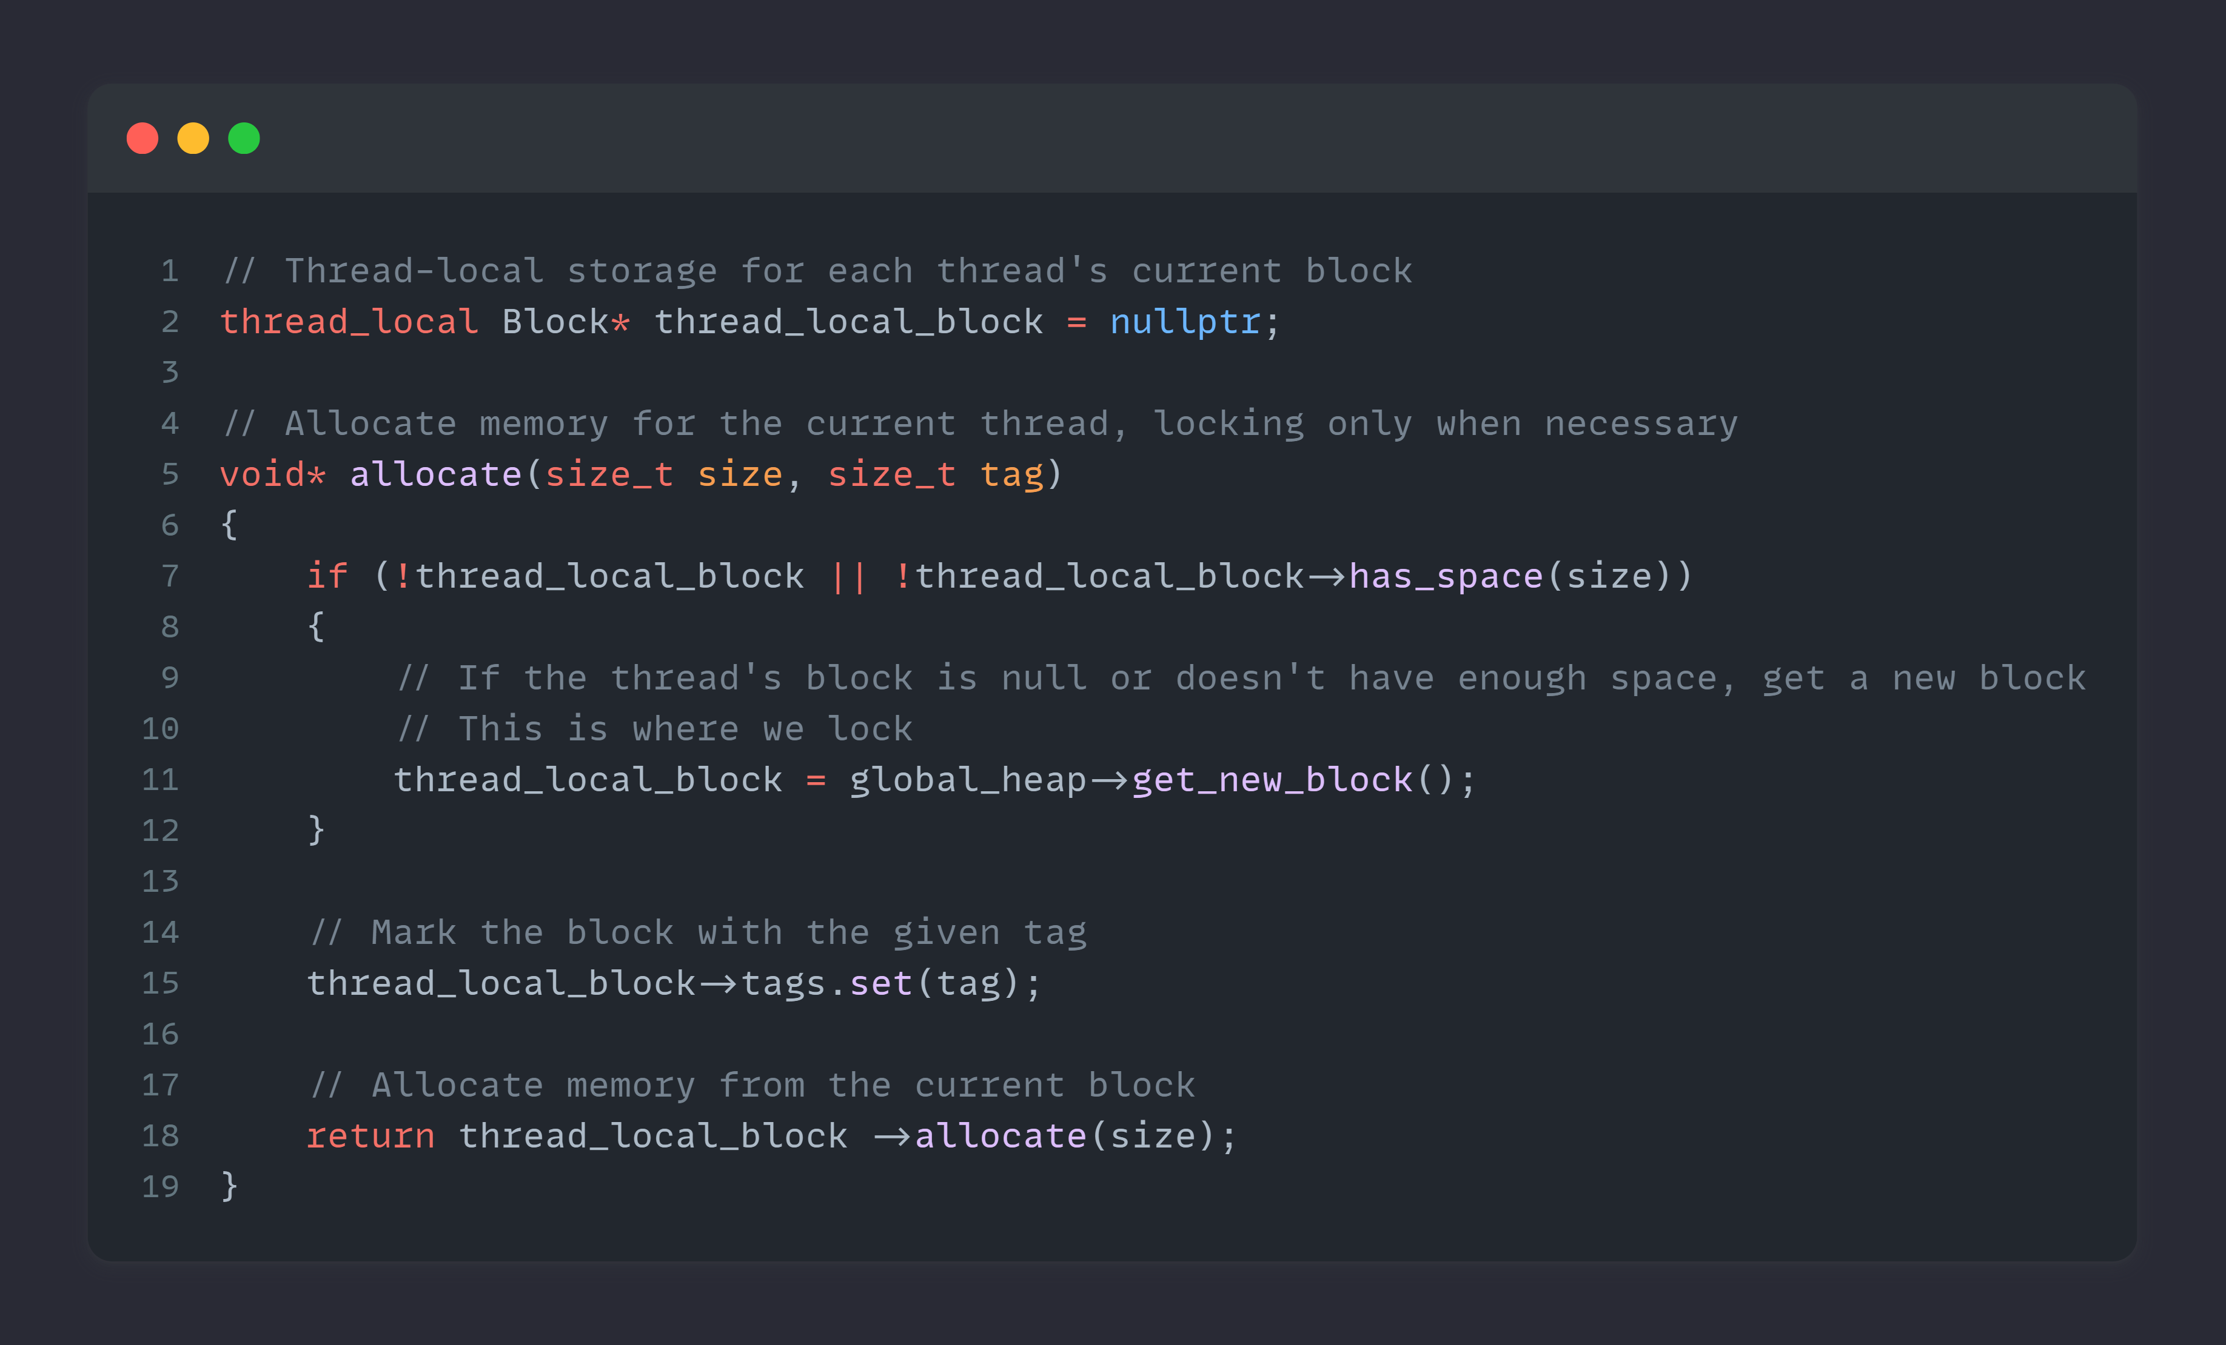
Notes:
In code

Slide 138
Summary

Slide 139
Summary
Fibers are awesome!
Easy to use
Easy to integrate
Use them with care
Sleep and wake up on different threads
No sync primitives
Carefully manage your memory

Slide 140
Summary
Parallelizing the Naughty Dog Engine Using Fibers
Christian Gyrling
GDC 2015
https://gdcvault.com/play/1022186

Slide 141
Summary
Fibers (MSDN)

Slide 142
Summary
Special Thanks
Nick De Breuck
RisingLiberty
www.nickdebreuck.com
Notes:
For making this demo framework possible, as my own framework is quite complex, and I wasn’t able to extract everything in a demonstration format.

Slide 143
www.davedebreuck.com
github.com/Dyronix
davedebreuck.gamedeveloper@gmail.com
breuck.d@buas.nl

