Slide 1
Elevating Precision in C++: A Journey below the Surface of Floating-Point
Presented by:
Tom Tesch
tom.tesch@howest.be

Slide 2
Elevating Precision in C++: A Journey below the Surface of Floating-Point
Menu
What are floating-point numbers?
How floating-point numbers work
Modern C++ and floating-point types
Dekker Doubles
Demo

Slide 3
Elevating Precision in C++: A Journey below the Surface of Floating-Point
Menu
What are floating-point numbers?
How floating-point numbers work
Modern C++ and floating-point types
Dekker Doubles
Demo
Tom Tesch
Lecturer @ DAE – Howest (GD)
tom.tesch@howest.be

Slide 4
Elevating Precision in C++: A Journey below the Surface of Floating-Point
Menu
What are floating-point numbers?
How floating-point numbers work
Modern C++ and floating-point types
Dekker Doubles
Demo

Slide 5
Elevating Precision in C++: A Journey below the Surface of Floating-Point
Menu
What are floating-point numbers?
How floating-point numbers work
Modern C++ and floating-point types
Dekker Doubles
Demo

Slide 6
FLOATING-POINT INTRO
Elevating Precision in C++: A Journey below the Surface of Floating-Point
It’s important to understand the limitations of the floating-point format
Floating-point numbers are an approximation of real numbers
Why? We only have a finite number of bits!
What if we can’t represent the value? We take the closest value instead!
Floating-point format solves the issue of dynamic range (fixed-point format)
How? The radix point can freely float within the number. Thus also fixing the waste of bits!

Slide 7
Elevating Precision in C++: A Journey below the Surface of Floating-Point
Limitations of floating-point numbers

Slide 8
Elevating Precision in C++: A Journey below the Surface of Floating-Point
Limitations of floating-point numbers

Slide 9
Elevating Precision in C++: A Journey below the Surface of Floating-Point
Limitations of floating-point numbers
DEMO
https://www.h-schmidt.net/FloatConverter/IEEE754.html

Slide 10
Elevating Precision in C++: A Journey below the Surface of Floating-Point
Limitations of floating-point numbers
I have trust issues

Slide 11
Elevating Precision in C++: A Journey below the Surface of Floating-Point
Limitations of floating-point numbers
I have trust issues

Slide 12
Elevating Precision in C++: A Journey below the Surface of Floating-Point
Limitations of floating-point numbers
I have trust issues

Slide 13
Elevating Precision in C++: A Journey below the Surface of Floating-Point
Limitations of floating-point numbers
https://godbolt.org/z/KG655sda4

Slide 14
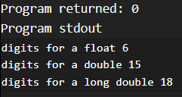
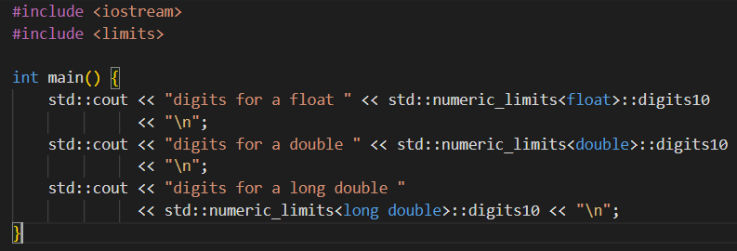
Elevating Precision in C++: A Journey below the Surface of Floating-Point
Limitations of floating-point numbers
Trust no one, etc…
https://godbolt.org/z/KG655sda4

Slide 15
Elevating Precision in C++: A Journey below the Surface of Floating-Point
Menu
What are floating-point numbers?
How floating-point numbers work
Modern C++ and floating-point types
Dekker Doubles
Demo

Slide 16
FLOATING-POINT INTRO
Elevating Precision in C++: A Journey below the Surface of Floating-Point
Floating-point format uses a scientific notation!
We need data to support this notation.
Exponent: specifies the position of the radix point
Mantissa: represents the real number, the base value
Sign bit: to represent both positive and negative values. This uses Signed Magnitude!
An simplified decimal floating-point format using scientific notation (demonstration purposes):
±
0
.
0
0
e
±
0
0
mantissa
exponent

Slide 17
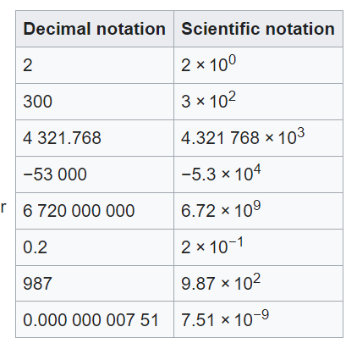
FLOATING-POINT INTRO
Elevating Precision in C++: A Journey below the Surface of Floating-Point
Floating-point format uses a scientific notation!
We need data to support this notation.
Exponent: specifies the position of the radix point
Mantissa: represents the real number, the base value
Sign bit: to represent both positive and negative values. This uses Signed Magnitude!
An simplified decimal floating-point format using scientific notation (demonstration purposes):
±
0
.
0
0
e
±
0
0
mantissa
exponent

Slide 18
FLOATING-POINT INTRO
Elevating Precision in C++: A Journey below the Surface of Floating-Point
Floating-point format uses a scientific notation!
We need data to support this notation.
Exponent: specifies the position of the radix point
Mantissa: represents the real number, the base value
Sign bit: to represent both positive and negative values. This uses Signed Magnitude!
An simplified decimal floating-point format using scientific notation (demonstration purposes):
±
0
.
0
0
e
±
0
0
mantissa
exponent

Slide 19
FLOATING-POINT IEEE-754
FRACTIONAL REPRESENTATIONS
Because there are many ways to represent and store floating-point values Intel pushed to standardize the floating-point format. Hence the “Institute of Electrical and Electronics Engineers Standard for Floating-Point Arithmetic” (IEEE-754)!
Single-Precision Floating-Point Format (type: float)
Total of 32 bits. The format uses a 24-bit (unsigned) mantissa and a 8-bit (unsigned) exponent
The 24-bit mantissa has it’s 24th bit implied, which means we get an extra bit in memory, which we use as the sign bit (signed magnitude)
31
23
15
7
0
Sign bit
Exponent bits
I
Mantissa bits
Implied bit which is always one
Notes:
One’s complement problem: +0 and -0 (remember?) – Floating-point values have this issue!

Slide 20
-1^{signbit} x (1 + decimal mantissa) x 2^{exponent}
31
23
15
7
0
Sign bit
Exponent bits
I
Mantissa bits
Implied bit which is always one
Notes:
C++ epsilon pattern

Slide 21
FLOATING-POINT IEEE-754
FRACTIONAL REPRESENTATIONS
The 8-bit exponent is unsigned, how do we represent a negative exponent? Because two’s complement would make comparison harder, they instead added an offset to the exponent, resulting in a biased exponent. To use this excess-127 format, use the following math:
Biased exponent = original exponent + 127
Original exponent = biased exponent - 127
Wouldn’t this result in extra arithmetic implementations on the CPU? Yes, but we have a dedicated FPU (Floating-Point Unit) for floating-point arithmetic's!
31
23
15
7
0
Sign bit
Exponent bits
I
Mantissa bits
Implied bit which is always one

Slide 22
SINGLE PRECISION IEEE-754
FRACTIONAL REPRESENTATIONS
The 8-bit exponent is unsigned, how do we represent a negative exponent? Because two’s complement would make comparison harder, they instead added an offset to the exponent, resulting in a biased exponent. To use this excess-127 format, use the following math:
Biased exponent = original exponent + 127
Original exponent = biased exponent - 127
Wouldn’t this result in extra arithmetic implementations on the CPU? Yes, but we have a dedicated FPU (Floating-Point Unit) for floating-point arithmetic's!

Slide 23
DOUBLE PRECISION IEEE-754
FRACTIONAL REPRESENTATIONS
The 11-bit exponent is unsigned, how do we represent a negative exponent? Because two’s complement would make comparison harder, they instead added an offset to the exponent, resulting in a biased exponent. To use this excess-1023 format, use the following math:
Biased exponent = original exponent + 1023
Original exponent = biased exponent - 1023
Wouldn’t this result in extra arithmetic implementations on the CPU? Yes, but we have a dedicated FPU (Floating-Point Unit) for floating-point arithmetic's!

Slide 24
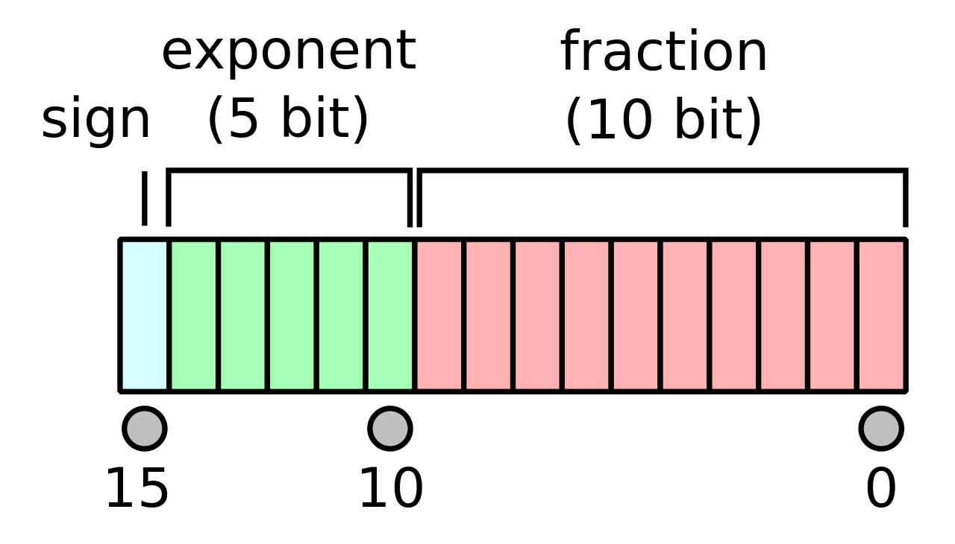
HALF PRECISION IEEE-754
FRACTIONAL REPRESENTATIONS
The 5-bit exponent is unsigned, how do we represent a negative exponent? Because two’s complement would make comparison harder, they instead added an offset to the exponent, resulting in a biased exponent. To use this excess-1023 format, use the following math:
Biased exponent = original exponent + 15
Original exponent = biased exponent - 15
new since IEEE 754-2008

Slide 25
Elevating Precision in C++: A Journey below the Surface of Floating-Point
Menu
What are floating-point numbers?
How floating-point numbers work
Modern C++ and floating-point types
Dekker Doubles
Demo

Slide 26
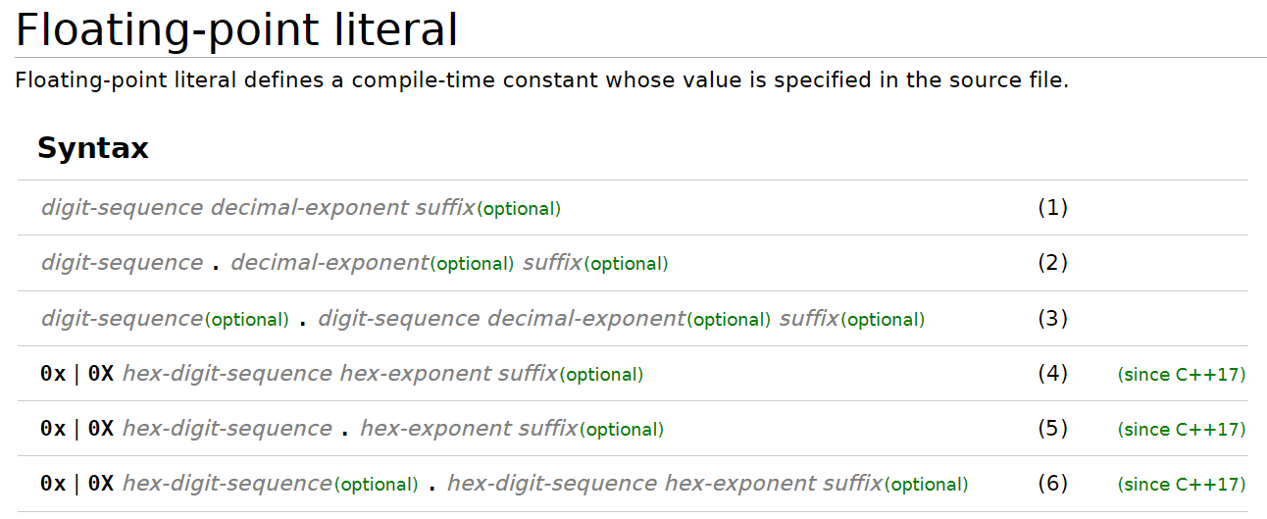
Elevating Precision in C++: A Journey below the Surface of Floating-Point
Floating point changes in C++17

Slide 27
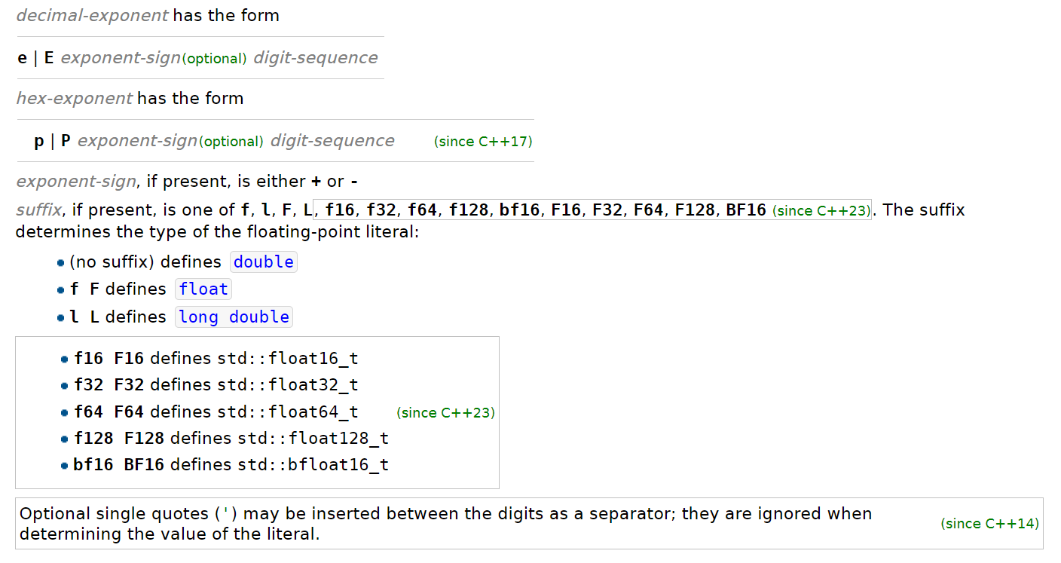
Elevating Precision in C++: A Journey below the Surface of Floating-Point
Floating point changes in C++23
https://godbolt.org/z/Gs83oz6v9

Slide 28
Elevating Precision in C++: A Journey below the Surface of Floating-Point
I have trust issues
https://godbolt.org/z/Gs83oz6v9

Slide 29
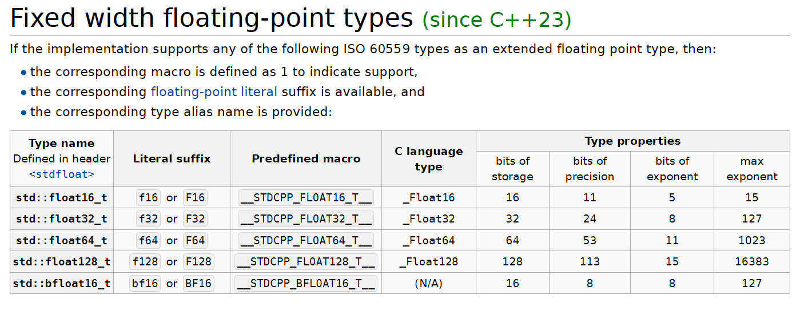
Elevating Precision in C++: A Journey below the Surface of Floating-Point
Floating point changes in C++23

Slide 30
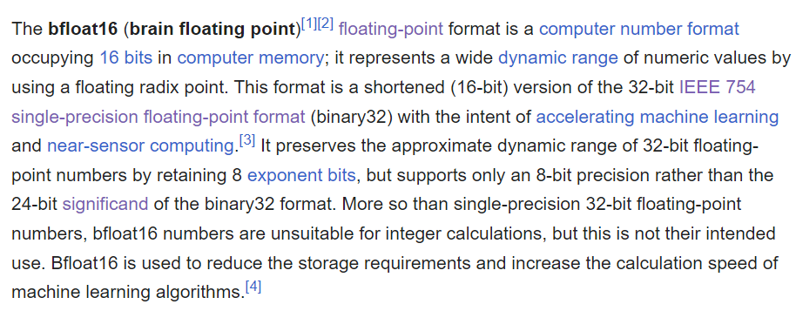
Elevating Precision in C++: A Journey below the Surface of Floating-Point
Floating point changes in C++23 – bfloat16_t?

Slide 31
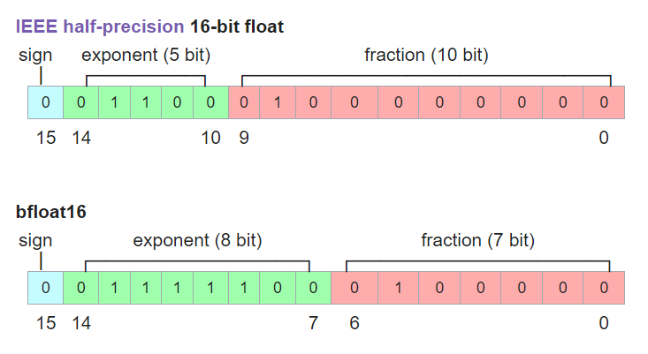
Elevating Precision in C++: A Journey below the Surface of Floating-Point
Floating point changes in C++23 – bfloat16_t?

Slide 32
Elevating Precision in C++: A Journey below the Surface of Floating-Point
Menu
What are floating-point numbers?
How floating-point numbers work
Modern C++ and floating-point types
Dekker Doubles
Demo

Slide 33
Elevating Precision in C++: A Journey below the Surface of Floating-Point
Does anyone know who this gentleman is?

Slide 34
Elevating Precision in C++: A Journey below the Surface of Floating-Point
Does anyone know who this gentleman is?
Hint:
it’s not a blonder version
of Moss from the IT crowd

Slide 35
Elevating Precision in C++: A Journey below the Surface of Floating-Point
A simplified thought experiment
A two digit [decimal] floating-point system

Slide 36
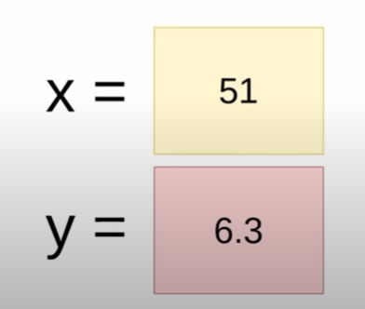
Elevating Precision in C++: A Journey below the Surface of Floating-Point
Let’s do an addition

Slide 37
Elevating Precision in C++: A Journey below the Surface of Floating-Point
Let’s do an addition

Slide 38
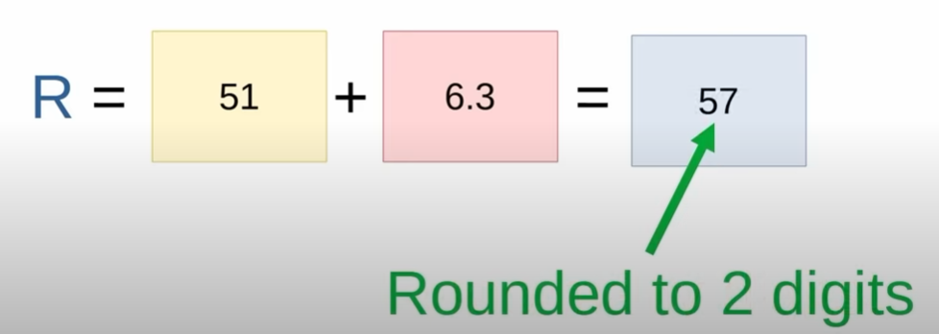
Elevating Precision in C++: A Journey below the Surface of Floating-Point
Let’s do an addition

Slide 39
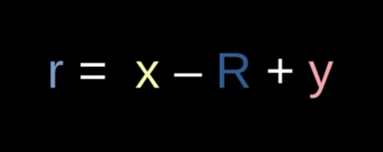
Elevating Precision in C++: A Journey below the Surface of Floating-Point
Define the error we made as ‘r’

Slide 40
Elevating Precision in C++: A Journey below the Surface of Floating-Point
Define the error we made as ‘r’
But wait:
since R = x + y
And mathematics
r = x – x + y + y = 0 ?

Slide 41
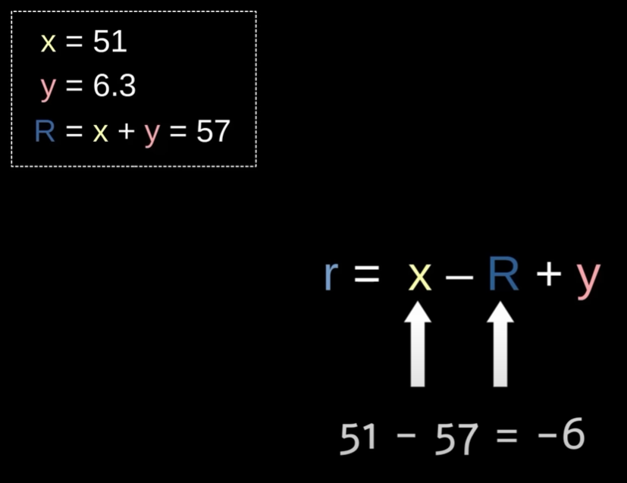
Elevating Precision in C++: A Journey below the Surface of Floating-Point
Define the error we made as ‘r’
This is not mathematics!
this is sparta!?

Slide 42
Elevating Precision in C++: A Journey below the Surface of Floating-Point
Remember the rounding we did to R
This is not mathematics!
this is C++!

Slide 43
Elevating Precision in C++: A Journey below the Surface of Floating-Point
And doing the operations going from left to right
The limits of our precision are at play here!

Slide 44
Elevating Precision in C++: A Journey below the Surface of Floating-Point
It worked!

Slide 45
Elevating Precision in C++: A Journey below the Surface of Floating-Point
This is called Double Double arithmetic!

Slide 46
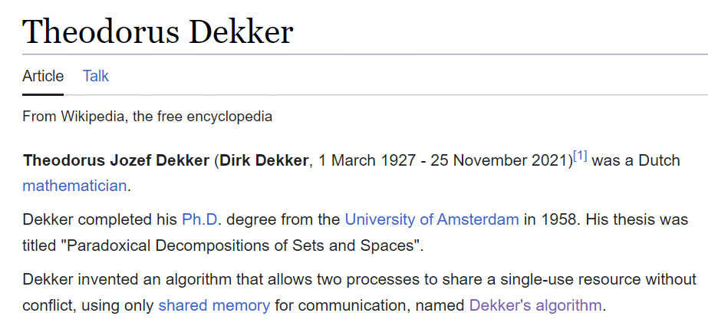
Elevating Precision in C++: A Journey below the Surface of Floating-Point
Also called Dekker Double arithmetic!

Slide 47
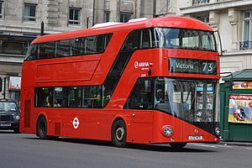
Elevating Precision in C++: A Journey below the Surface of Floating-Point
Not to be confused with

Slide 48
Elevating Precision in C++: A Journey below the Surface of Floating-Point
Also called Dekker Double arithmetic!
Famous for

Slide 49
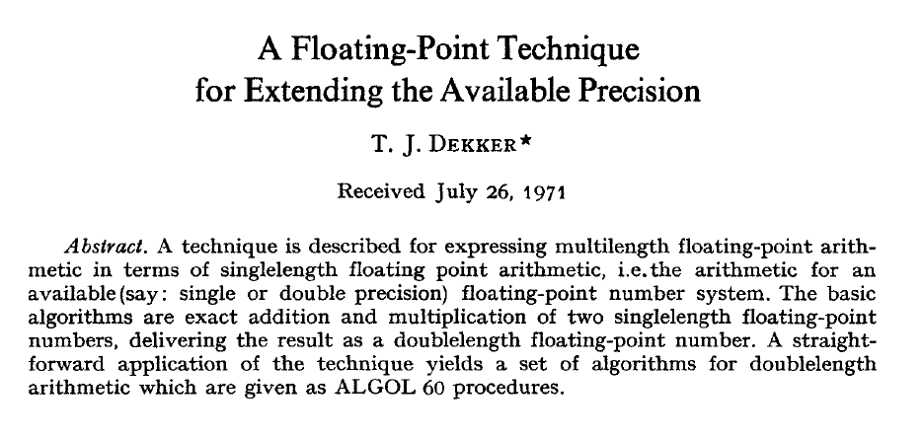
Elevating Precision in C++: A Journey below the Surface of Floating-Point
Also called Dekker Double arithmetic!
https://csclub.uwaterloo.ca/~pbarfuss/dekker1971.pdf

Slide 50
Elevating Precision in C++: A Journey below the Surface of Floating-Point
A simplified thought experiment - continued
Some notation guidelines:
bold & underline: double double e.g. A
uppercase: the upper value of a DD
lowercase: the lower value of a DD
Example:
A = 37.51 -> A = 37 a = 0.51
B = 126.8 -> B = 120 b = 6.8
Task:
Let us add A and B -> C = A + B

Slide 51
Elevating Precision in C++: A Journey below the Surface of Floating-Point
A simplified thought experiment - continued
Task:
Let us add A and B -> C = A + B
Not just:
A + B + a + b
Dekker Addition Algorithm:
Add upper halves
Find the error
Add lower halves and that error
Allow this to overflow (or “carry”) into the upper half
Remove any overflow form the lower result

Slide 52
Elevating Precision in C++: A Journey below the Surface of Floating-Point
A simplified thought experiment - continued
Task:
Let us add A and B -> C = A + B
1. Add upper halves
Intermediate value R
R = A + B -> R = 37 + 120 = 157
-> R = 160

Slide 53
Elevating Precision in C++: A Journey below the Surface of Floating-Point
A simplified thought experiment - continued
Intermediate value R
R = A + B -> R = 37 + 120 = 157
-> R = 160
2. Find the error
Error we made in R gets added to r
r = B – R + A
r = 120 – 160 + 37
r = -3

Slide 54
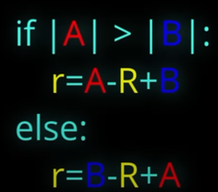
Elevating Precision in C++: A Journey below the Surface of Floating-Point
A simplified thought experiment - continued
Intermediate value R
R = A + B -> R = 37 + 120 = 157
-> R = 160
3. Add lower halves and that error
Error we made in R gets added to r
r = B – R + A
r = 120 – 160 + 37
r = -3
For precision:
Subtract R from the larger value first

Slide 55
Elevating Precision in C++: A Journey below the Surface of Floating-Point
A simplified thought experiment - continued
Error we made in R gets added to r
r = B – R + A
r = 120 – 160 + 37
r = -3
r contains the error + the sum of a and b
r = r + a + b
r = -3 + 0.51 + 6.8
r = -2.5 + 6.8
r = 4.3

Slide 56
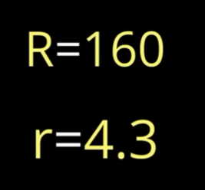
Elevating Precision in C++: A Journey below the Surface of Floating-Point
A simplified thought experiment - continued
4. Allow this to overflow (or “carry”) into the upper half
C = R + r = 160 + 4.3
= 164.3
= 160
5. Remove any overflow form the lower result
C = R – C + r = 160 – 160 + 4.3
= 0 + 4.3
= 4.3

Slide 57
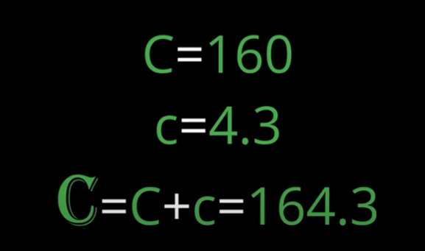
Elevating Precision in C++: A Journey below the Surface of Floating-Point
A simplified thought experiment - continued
Final result – as good as it could be

Slide 58
Elevating Precision in C++: A Journey below the Surface of Floating-Point
Terrible code – from youtube

Slide 59
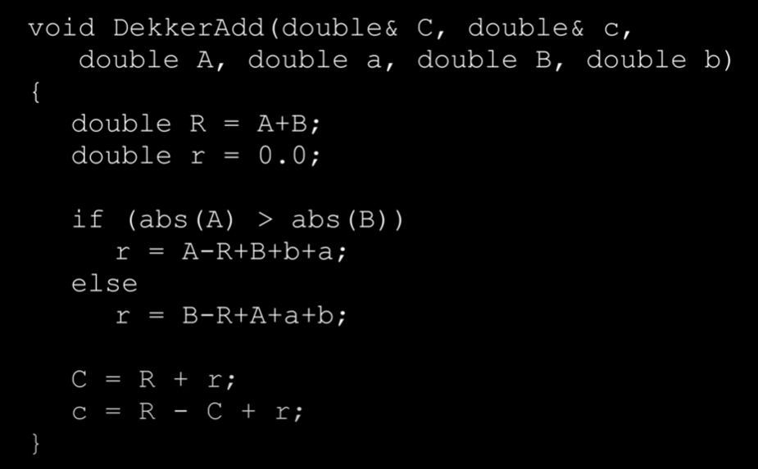
Elevating Precision in C++: A Journey below the Surface of Floating-Point
Terrible code – from youtube

Slide 60
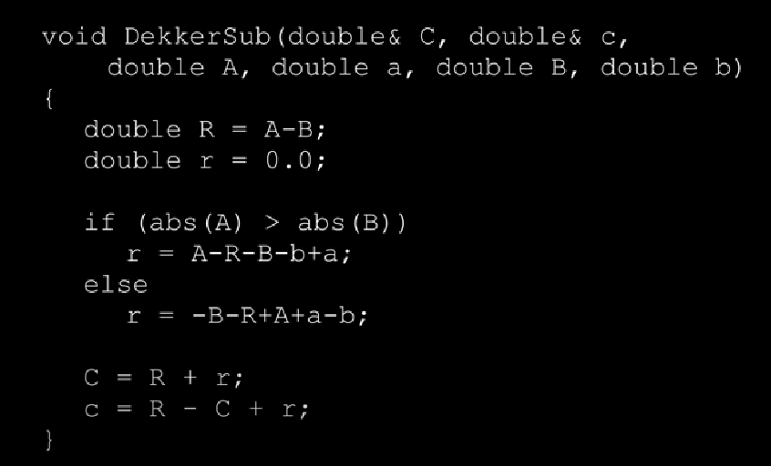
Elevating Precision in C++: A Journey below the Surface of Floating-Point
Terrible code – from youtube

Slide 61
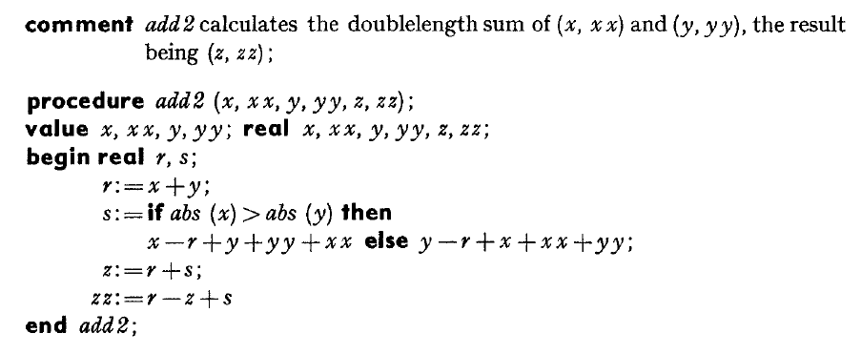
Elevating Precision in C++: A Journey below the Surface of Floating-Point
The ALGOL 60 code: addition

Slide 62
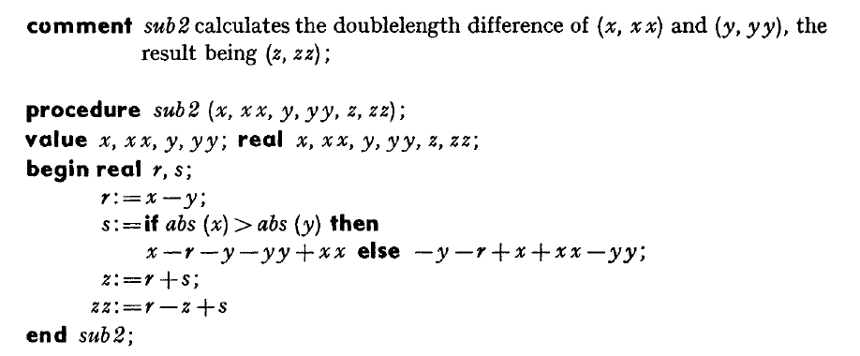
Elevating Precision in C++: A Journey below the Surface of Floating-Point
The ALGOL 60 code: subtraction

Slide 63
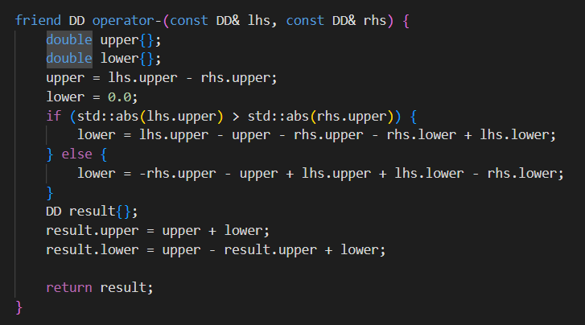
Elevating Precision in C++: A Journey below the Surface of Floating-Point
The ALGOL 60 code: subtraction
Notes:
https://godbolt.org/z/6764xM9ae

Slide 64
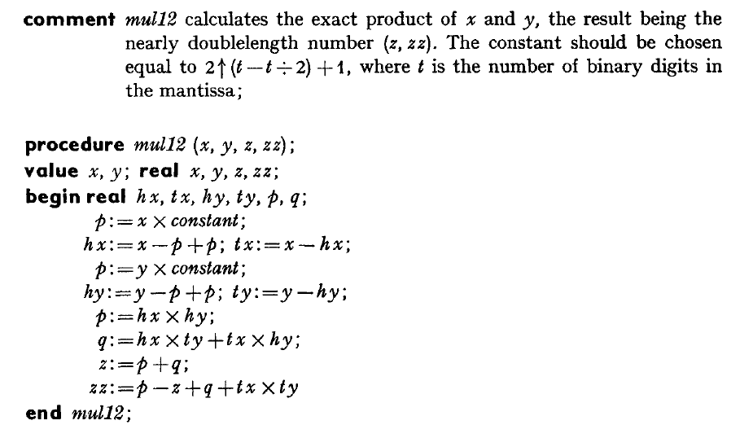
Elevating Precision in C++: A Journey below the Surface of Floating-Point
The ALGOL 60 code:
multiply two doubles into a Dekker Double

Slide 65
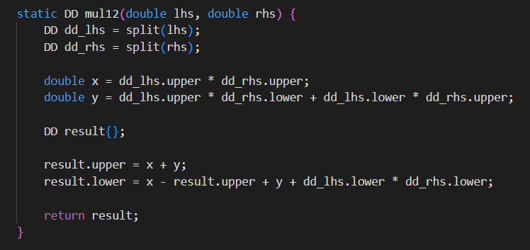
Elevating Precision in C++: A Journey below the Surface of Floating-Point
The ALGOL 60 code:
multiply two doubles into a Dekker Double

Slide 66
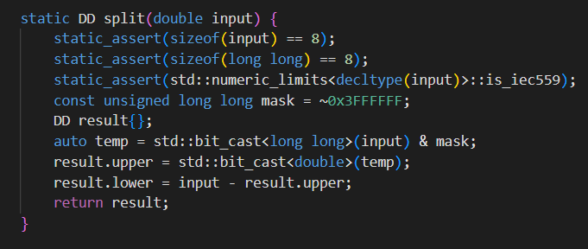
Elevating Precision in C++: A Journey below the Surface of Floating-Point
The ALGOL 60 code:
Split a double into a Dekker Double

Slide 67
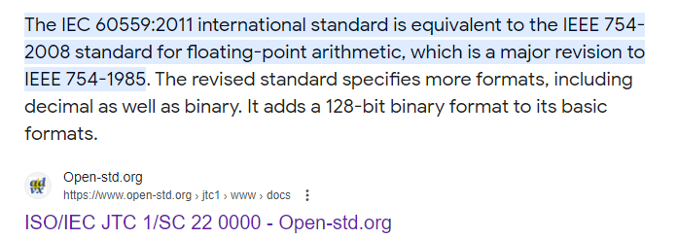
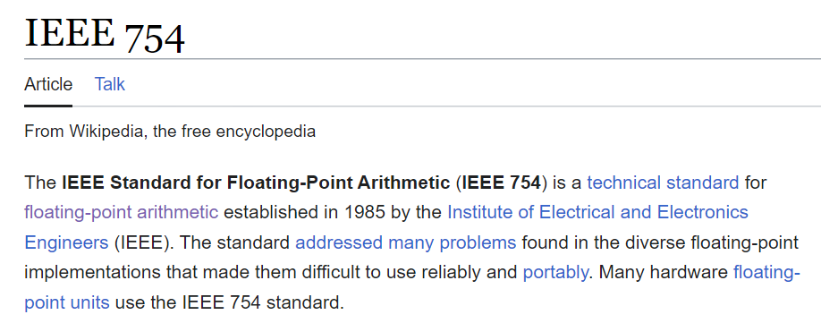
Elevating Precision in C++: A Journey below the Surface of Floating-Point
std::numeric_limits<T>::is_iec559?

Slide 68
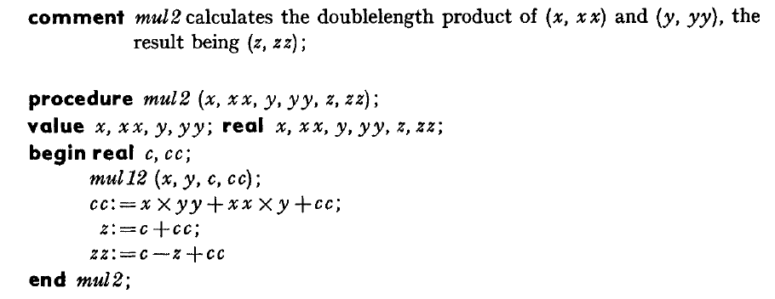
Elevating Precision in C++: A Journey below the Surface of Floating-Point
The ALGOL 60 code: multiply two Dekker Doubles

Slide 69
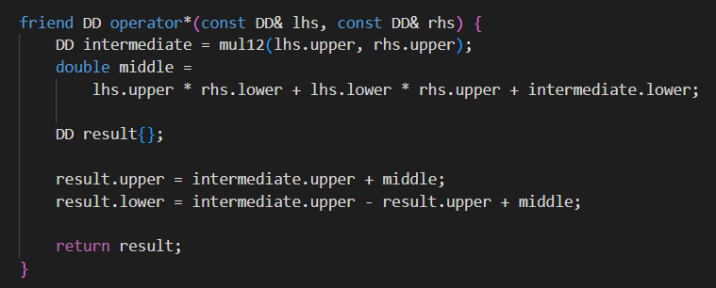
Elevating Precision in C++: A Journey below the Surface of Floating-Point
The ALGOL 60 code: multiply two Dekker Doubles

Slide 70
Elevating Precision in C++: A Journey below the Surface of Floating-Point
Menu
What are floating-point numbers?
How floating-point numbers work
Modern C++ and floating-point types
Dekker Doubles
Demo

Slide 71
Elevating Precision in C++: A Journey below the Surface of Floating-Point
Demo time
Compiler explorer demo code
https://godbolt.org/z/5a6xeWrYW
Quickbench:
https://quick-bench.com/q/aY3BiCbO24N21cNMu6x4aPXHukM

Slide 72
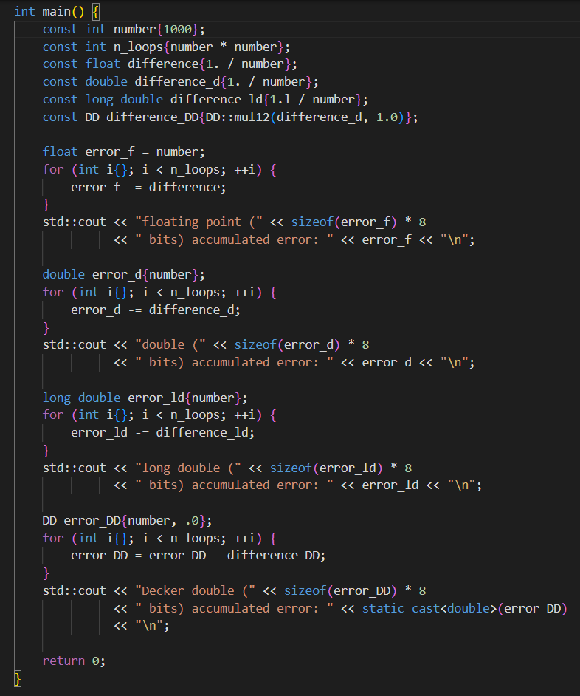
Elevating Precision in C++: A Journey below the Surface of Floating-Point
Demo time

Slide 73
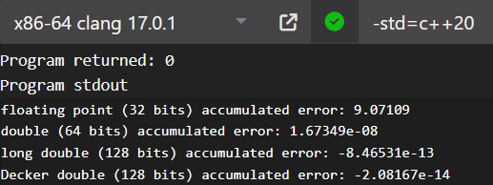
Elevating Precision in C++: A Journey below the Surface of Floating-Point
Demo time – I have trust issues

Slide 74
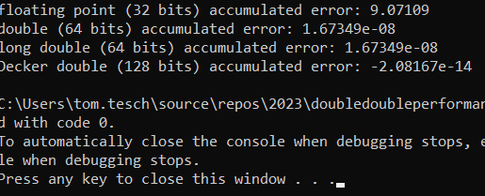
Elevating Precision in C++: A Journey below the Surface of Floating-Point
Demo time – I have trust issues (with Visual Studio)

Slide 75
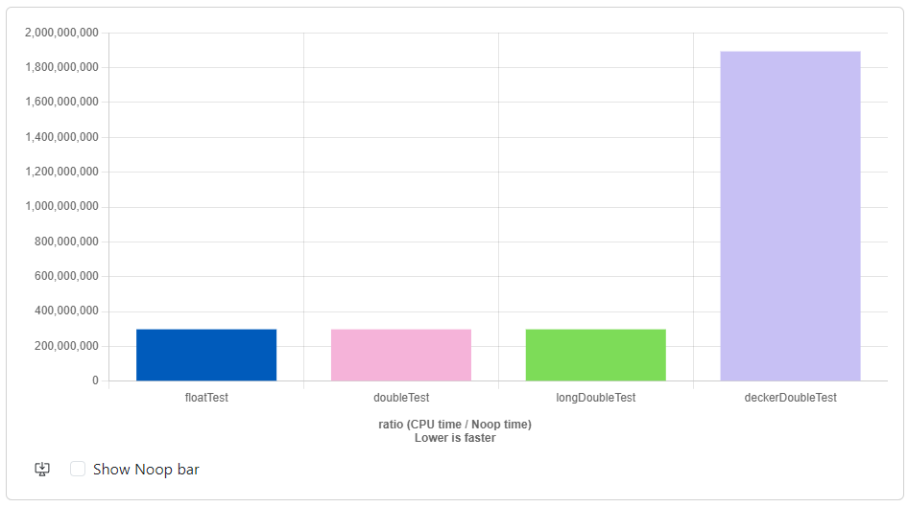
Elevating Precision in C++: A Journey below the Surface of Floating-Point
Demo time – I have trust issues

Slide 76
Elevating Precision in C++: A Journey below the Surface of Floating-Point
Templates + concepts
Left as an exercise to the listener/reader

Slide 77
Elevating Precision in C++: A Journey below the Surface of Floating-Point
References
Double it Like Dekker: A Remarkable Technique to Double Floating Point Precision (Part 1)
https://youtu.be/6OuqnaHHUG8
Double it Like Dekker 2: Dekker Multiplication and Division
https://youtu.be/5IL1LJ5noww
IEEE-754 Floating Point Converter
https://www.h-schmidt.net/FloatConverter/IEEE754.html

Slide 78
Elevating Precision in C++: A Journey below the Surface of Floating-Point
That’s all folks!
Questions?

