Slide 1
Concepts
2023-17-1
Notes:
Abstract
This presentation consists of two parts:
First, I explain how you can, and more importantly should, constrain your template arguments using requires clauses and, typically, concepts.
Doing so results in more readable compilation errors, more self-documenting template definitions, and easier, more expressive template specialization.
Next, I show how you can define your own concepts using the new syntax introduced in C++20.
Quite some new syntax to learn, for sure, but you’ll quickly see that constraints and concepts are far easier to master (or at least understand)
than the more advanced SFINAE techniques (std::enable_if_t, std::void_t, ...) they essentially supersede.

Slide 2
Motivation

Slide 3
Unconstrained Template
template <typename T>
constexpr void sort(T first, T last);
template <typename T>
class PointCloud;

Slide 4
Unconstrained Template
template <typename RandomIt>
constexpr void sort(RandomIt first, RandomIt last);
template <typename PointType>
class PointCloud;

Slide 5
Constrained Template
template<std::ranges::random_access_range R>
constexpr auto sort(R&& r);
template <concepts::Point P>
class PointCloud;
Notes:
First advantage: self-documenting

Slide 6
Unconstrained Templates: Bad Error Messages
std::list numbers{ 4, 1, 3, 2 };
std::sort(begin(numbers), end(numbers));

Slide 7
In file included from <source>:2:
In file included from [...]/include/c++/13.0.0/algorithm:61:
[...]/include/c++/13.0.0/bits/stl_algo.h:1948:22: error: invalid operands to binary expression ('std::_List_iterator<int>' and 'std::_List_iterator<int>')
std::__lg(__last - __first) * 2,
~~~~~~ ^ ~~~~~~~
[...]/include/c++/13.0.0/bits/stl_algo.h:4860:12: note: in instantiation of function template specialization 'std::__sort<std::_List_iterator<int>, __gnu_cxx::__ops::_Iter_less_iter>' requested here
std::__sort(__first, __last, __gnu_cxx::__ops::__iter_less_iter());
^
<source>:6:8: note: in instantiation of function template specialization 'std::sort<std::_List_iterator<int>>' requested here
std::sort(begin(numbers), end(numbers));
^
[...]/include/c++/13.0.0/bits/stl_iterator.h:621:5: note: candidate template ignored: could not match 'reverse_iterator' against '_List_iterator'
operator-(const reverse_iterator<_IteratorL>& __x,
^
[...]/include/c++/13.0.0/bits/stl_iterator.h:1778:5: note: candidate template ignored: could not match 'move_iterator' against '_List_iterator'
operator-(const move_iterator<_IteratorL>& __x,
^
In file included from <source>:2:
In file included from [...]/include/c++/13.0.0/algorithm:61:
[...]/include/c++/13.0.0/bits/stl_algo.h:1857:18: error: invalid operands to binary expression ('std::_List_iterator<int>' and 'std::_List_iterator<int>')
if (__last - __first > int(_S_threshold))
~~~~~~ ^ ~~~~~~~
[...]/include/c++/13.0.0/bits/stl_algo.h:1950:9: note: in instantiation of function template specialization 'std::__final_insertion_sort<std::_List_iterator<int>, __gnu_cxx::__ops::_Iter_less_iter>' requested here
std::__final_insertion_sort(__first, __last, __comp);
^
[...]/include/c++/13.0.0/bits/stl_algo.h:4860:12: note: in instantiation of function template specialization 'std::__sort<std::_List_iterator<int>, __gnu_cxx::__ops::_Iter_less_iter>' requested here
std::__sort(__first, __last, __gnu_cxx::__ops::__iter_less_iter());
^
<source>:6:8: note: in instantiation of function template specialization 'std::sort<std::_List_iterator<int>>' requested here
std::sort(begin(numbers), end(numbers));
^
[...]/include/c++/13.0.0/bits/stl_iterator.h:621:5: note: candidate template ignored: could not match 'reverse_iterator' against '_List_iterator'
operator-(const reverse_iterator<_IteratorL>& __x,
^
[...]/include/c++/13.0.0/bits/stl_iterator.h:1778:5: note: candidate template ignored: could not match 'move_iterator' against '_List_iterator'
operator-(const move_iterator<_IteratorL>& __x,
^
2 errors generated.

Slide 8
In file included from <source>:2:
In file included from [...]/include/c++/13.0.0/algorithm:61:
[...]/include/c++/13.0.0/bits/stl_algo.h:1948:22: error: invalid operands to binary expression ('std::_List_iterator<int>' and 'std::_List_iterator<int>')
std::__lg(__last - __first) * 2,
~~~~~~ ^ ~~~~~~~
[...]/include/c++/13.0.0/bits/stl_algo.h:4860:12: note: in instantiation of function template specialization 'std::__sort<std::_List_iterator<int>, __gnu_cxx::__ops::_Iter_less_iter>' requested here
std::__sort(__first, __last, __gnu_cxx::__ops::__iter_less_iter());
^
<source>:6:8: note: in instantiation of function template specialization 'std::sort<std::_List_iterator<int>>' requested here
std::sort(begin(numbers), end(numbers));
^
[...]/include/c++/13.0.0/bits/stl_iterator.h:621:5: note: candidate template ignored: could not match 'reverse_iterator' against '_List_iterator'
operator-(const reverse_iterator<_IteratorL>& __x,
^
[...]/include/c++/13.0.0/bits/stl_iterator.h:1778:5: note: candidate template ignored: could not match 'move_iterator' against '_List_iterator'
operator-(const move_iterator<_IteratorL>& __x,
^
In file included from <source>:2:
In file included from [...]/include/c++/13.0.0/algorithm:61:
[...]/include/c++/13.0.0/bits/stl_algo.h:1857:18: error: invalid operands to binary expression ('std::_List_iterator<int>' and 'std::_List_iterator<int>')
if (__last - __first > int(_S_threshold))
~~~~~~ ^ ~~~~~~~
[...]/include/c++/13.0.0/bits/stl_algo.h:1950:9: note: in instantiation of function template specialization 'std::__final_insertion_sort<std::_List_iterator<int>, __gnu_cxx::__ops::_Iter_less_iter>' requested here
std::__final_insertion_sort(__first, __last, __comp);
^
[...]/include/c++/13.0.0/bits/stl_algo.h:4860:12: note: in instantiation of function template specialization 'std::__sort<std::_List_iterator<int>, __gnu_cxx::__ops::_Iter_less_iter>' requested here
std::__sort(__first, __last, __gnu_cxx::__ops::__iter_less_iter());
^
<source>:6:8: note: in instantiation of function template specialization 'std::sort<std::_List_iterator<int>>' requested here
std::sort(begin(numbers), end(numbers));
^
[...]/include/c++/13.0.0/bits/stl_iterator.h:621:5: note: candidate template ignored: could not match 'reverse_iterator' against '_List_iterator'
operator-(const reverse_iterator<_IteratorL>& __x,
^
[...]/include/c++/13.0.0/bits/stl_iterator.h:1778:5: note: candidate template ignored: could not match 'move_iterator' against '_List_iterator'
operator-(const move_iterator<_IteratorL>& __x,
^
2 errors generated.

Slide 9
Constrained Templates: Better Error Messages
std::list numbers{ 4, 1, 3, 2 };
std::ranges::sort(numbers);

Slide 10
<source>:6:3: error: no matching function for call to object of type 'const __sort_fn'
std::ranges::sort(numbers);
^~~~~~~~~~~~~~~~~
[...]/include/c++/13.0.0/bits/ranges_algo.h:1791:7: note: candidate template ignored: constraints not satisfied [with _Range = std::list<int> &, _Comp = ranges::less, _Proj = identity]
operator()(_Range&& __r, _Comp __comp = {}, _Proj __proj = {}) const
^
[...]/include/c++/13.0.0/bits/ranges_algo.h:1787:14: note: because 'std::list<int> &' does not satisfy 'random_access_range'
template<random_access_range _Range,
^
[...]/include/c++/13.0.0/bits/ranges_base.h:677:37: note: because 'iterator_t<list<int, allocator<int>> &>' (aka '_List_iterator<int>') does not satisfy 'random_access_iterator'
= bidirectional_range<_Tp> && random_access_iterator<iterator_t<_Tp>>;
^
[...]/include/c++/13.0.0/bits/iterator_concepts.h:683:10: note: because 'derived_from<__detail::__iter_concept<iterator_t<list<int, allocator<int> > &> >, random_access_iterator_tag>' evaluated to false
&& derived_from<__detail::__iter_concept<_Iter>,
^
[...]/include/c++/13.0.0/concepts:67:28: note: because '__is_base_of(random_access_iterator_tag, __detail::__iter_concept<iterator_t<list<int, allocator<int> > &> >)' evaluated to false
concept derived_from = __is_base_of(_Base, _Derived)
^
[...]/include/c++/13.0.0/bits/ranges_algo.h:1778:7: note: candidate function template not viable: requires at least 2 arguments, but 1 was provided
operator()(_Iter __first, _Sent __last,
^
1 error generated.
Notes:
Shorter, only one error, and…

Slide 11
<source>:6:3: error: no matching function for call to object of type 'const __sort_fn'
std::ranges::sort(numbers);
^~~~~~~~~~~~~~~~~
[...]/include/c++/13.0.0/bits/ranges_algo.h:1791:7: note: candidate template ignored: constraints not satisfied [with _Range = std::list<int> &, _Comp = ranges::less, _Proj = identity]
operator()(_Range&& __r, _Comp __comp = {}, _Proj __proj = {}) const
^
[...]/include/c++/13.0.0/bits/ranges_algo.h:1787:14: note: because 'std::list<int> &' does not satisfy 'random_access_range'
template<random_access_range _Range,
^
[...]/include/c++/13.0.0/bits/ranges_base.h:677:37: note: because 'iterator_t<list<int, allocator<int>> &>' (aka '_List_iterator<int>') does not satisfy 'random_access_iterator'
= bidirectional_range<_Tp> && random_access_iterator<iterator_t<_Tp>>;
^
[...]/include/c++/13.0.0/bits/iterator_concepts.h:683:10: note: because 'derived_from<__detail::__iter_concept<iterator_t<list<int, allocator<int> > &> >, random_access_iterator_tag>' evaluated to false
&& derived_from<__detail::__iter_concept<_Iter>,
^
[...]/include/c++/13.0.0/concepts:67:28: note: because '__is_base_of(random_access_iterator_tag, __detail::__iter_concept<iterator_t<list<int, allocator<int> > &> >)' evaluated to false
concept derived_from = __is_base_of(_Base, _Derived)
^
[...]/include/c++/13.0.0/bits/ranges_algo.h:1778:7: note: candidate function template not viable: requires at least 2 arguments, but 1 was provided
operator()(_Iter __first, _Sent __last,
^
1 error generated.

Slide 12
Constrain All Template Parameters!!!
Better error messages
Self-documenting code
Well-defined, stable API
Open to modification
Easier template specialization
Proper semantics for function template specialization
std::enable_if_t / std::void_t / std::declval() / static_assert() / …

Slide 13
So… Concepts
template<std::ranges::random_access_range R>
constexpr auto sort(R&& r);
template<typename R>
requires std::ranges::random_access_range<R>
constexpr auto sort(R&& r);
Type constraint
Requires clause
Concept expression

Slide 14
Use of concepts
Constraining template parameters
Easy template specialization
Constraining auto
Alternative to e.g. type traits (constexpr if, …)

Slide 15
Conceptually... Concept = Named set of Requirements

Slide 16
Requirements
Syntactic requirements
*i, i++, ++i, i + n, i -= n, i[n], etc. are valid expressions
Semantic requirements
i[n] is equivalent to *(i + n)
i -= n is equivalent to i += -n
i += n is equivalent to n times ++i or i++
etc.
Complexity requirements
i += n, i[n], etc. evaluate in constant time

Slide 17
Requirements
Syntactic requirements
*i, i++, ++i, i + n, i -= n, i[n], etc. are valid expressions
Semantic requirements
i[n] is equivalent to *(i + n)
i -= n is equivalent to i += -n
i += n is equivalent to n times ++i or i++
etc.
Complexity requirements
i += n, i[n], etc. evaluate in constant time
Notes:
The only requirements that we can put into actual code, however, are the syntactic ones. These are also the only kind of requirements that a compiler can decidably enforce (automatically validating semantic or complexity requirements is very hard at best, and provenly impossible in general). But that does not mean these other requirements are of any less importance—on the contrary, the implied semantic and complexity requirements of a concept are typically far more important than the syntactic ones.

Slide 18
Defining Concepts

Slide 19
Concept Definitions and Expressions
Concept definition
Concept expressions
name<arguments>
template <parameter list>
concept name = constraints;

Slide 20
Concept Definitions and Expressions
Concept definition
Concept expressions
static_assert(Small<bool>);
if constexpr (Small<std::string>)
...
template <typename T>
concept Small = sizeof(T) <= sizeof(int);

Slide 21
Constraints in
template <parameter list>
concept name = constraints;
Conjunctions and disjunctions of Boolean constant expressions
Concept expressions
Type trait expressions
Requires expressions
…
template <typename T>
concept SignedIntegral = Integral<T> && std::is_signed_v<T>;
template <typename Iter>
concept RandomAccessIterator = BidirectionalIterator<Iter>
&& /* Additional (syntactic) requirements... */;

Slide 22
Requires Expressions

Slide 23
Requires Expressions
requires { requirements }
requires (parameter list) { requirements }
Simple requirements expr;
Compound requirements { expr } noexcept -> type-constraint;
Type requirements typename name;
Nested requirements requires constraints;

Slide 24
Simple Requirements
template <typename Iter>
concept RandomAccessIterator = BidirectionalIterator<Iter>
&& requires (Iter i, Iter j, int n)
{
i + n;
i - n;
n + i;
i += n; i -= n;
i[n];
i < j; i > j; i <= j; i >= j;
};

Slide 25
Simple Requirements
template <typename Iter>
concept RandomAccessIterator = BidirectionalIterator<Iter>
&& requires (Iter i, Iter j)
{
int n;
i + n; i - n; n + i;
i += n; i -= n;
i[n];
i < j; i > j; i <= j; i >= j;
};

Slide 26
Simple Requirements
template <typename Iter>
concept RandomAccessIterator = BidirectionalIterator<Iter>
&& requires (Iter i, Iter j, int n)
{
i + n; i - n;
n + i;
i += n; i -= n;
i[n];
i < j; i > j; i <= j; i >= j;
};

Slide 27
Simple Requirements: const
template <typename Iter>
concept RandomAccessIterator = BidirectionalIterator<Iter>
&& requires (const Iter i, const Iter j, Iter k, const int n)
{
i + n; i - n; n + i; i[n]; // const operands
k += n; k -= n; // (left) non-const
i < j; i > j; i <= j; i >= j; // const operands
};

Slide 28
Compound Requirements
{ expr };
expr is a valid expression (same as expr;)
{ expr } noexcept;
expr is a valid expression
expr doesn’t throw exceptions
{ expr } -> type-constraint;
expr is a valid expression
Type of expr satisfies type-constraint
{ expr } noexcept -> type-constraint;

Slide 29
Compound Requirements: noexcept
template <typename T>
concept NoExceptDestructible =
requires (T& value) { { value.~T() } noexcept; };

Slide 30
Compound Requirements: Type Constraints
template<class Iter>
concept RandomAccessIterator = BidirectionalIterator<Iter> &&
requires(const Iter i, const Iter j, Iter k, const int n)
{
{ i - n } -> std::same_as<Iter>;
{ i + n } -> std::same_as<Iter>;
{ n + i } -> std::same_as<Iter>;
{ k += n }-> std::same_as<Iter&>;
{ k -= n }-> std::same_as<Iter&>;
{ i[n] } -> std::same_as<decltype(*i)>;
{ i < j } -> std::convertible_to<bool>;
// ... same for i > j, i <= j, and i >= j
};

Slide 31
Type Constraints, not Types
template<class Iter>
concept RandomAccessIterator = BidirectionalIterator<Iter> &&
requires(const Iter i, const Iter j, Iter k, const int n)
{
{ i - n } -> Iter;
{ i + n } -> Iter;
{ n + i } -> Iter;
{ k += n }-> Iter&;
{ k -= n }-> Iter&;
{ i[n] } -> decltype(*i);
{ i < j } -> std::convertible_to<bool>;
// ... same for i > j, i <= j, and i >= j
};

Slide 32
Type Constraints, not Types
template<class Iter>
concept RandomAccessIterator = BidirectionalIterator<Iter> &&
requires(const Iter i, const Iter j, Iter k, const int n)
{
{ i - n } -> std::same_as<Iter>;
{ i + n } -> std::same_as<Iter>;
{ n + i } -> std::same_as<Iter>;
{ k += n }-> std::same_as<Iter&>;
{ k -= n }-> std::same_as<Iter&>;
{ i[n] } -> std::same_as<decltype(*i)>;
{ i < j } -> std::convertible_to<bool>;
// ... same for i > j, i <= j, and i >= j
};

Slide 33
Type Constraint: Always Based on Concept
{ i - n } -> std::same_as<Iter>;
Type constraint: std::same_as<Iter>
Concept expression: std::same_as<decltype(i - n), Iter>
Concept:
template <typename T1, typename T2> concept same_as = std::same_as_v<T1, T2>; // (simplified)

Slide 34
Type Constraints: omitting <>
template<class Container>
concept RandomAccessContainer =
requires (Container c)
{
{ c.begin() } -> RandomAccessIterator;
// Short for RandomAccessIterator<>
// Evaluates concept expression
// RandomAccessIterator<decltype(c.begin())>
// ...
};

Slide 35
Requires Expressions
Conjunctions and disjunctions of Boolean constant expressions
Concept expressions
Type trait expressions
Requires expressions
…
requires { requirements }
requires (parameter list) { requirements }
Simple requirements expr;
Compound requirements { expr } noexcept -> type-constraint;
Type requirements typename name;
Nested requirements requires constraints;
template <parameter list>
concept name = constraints;

Slide 36
Type and Nested Requirements
template <typename S>
concept String = std::ranges::range<S> &&
requires(S& s, const S& cs)
{
typename S::value_type;
requires Character<typename S::value_type>;
// ...
};

Slide 37
Compound -> Simple + Nested Requirements
template <typename S>
concept String = std::ranges::range<S> &&
requires(S& s, const S& cs)
{
// ...
// { cs.length() } noexcept -> std::integral;
cs.length();
requires noexcept(cs.length());
requires std::integral<decltype(cs.length())>;
// ...
};

Slide 38
Requires Expressions
requires { requirements }
requires (parameter list) { requirements }
Simple requirements expr;
Compound requirements { expr } noexcept -> type-constraint;
Type requirements typename name;
Nested requirements requires constraints;

Slide 39
Standard Concepts
Headers <concepts>, <ranges>, <iterator>, <algorithm>

Slide 40
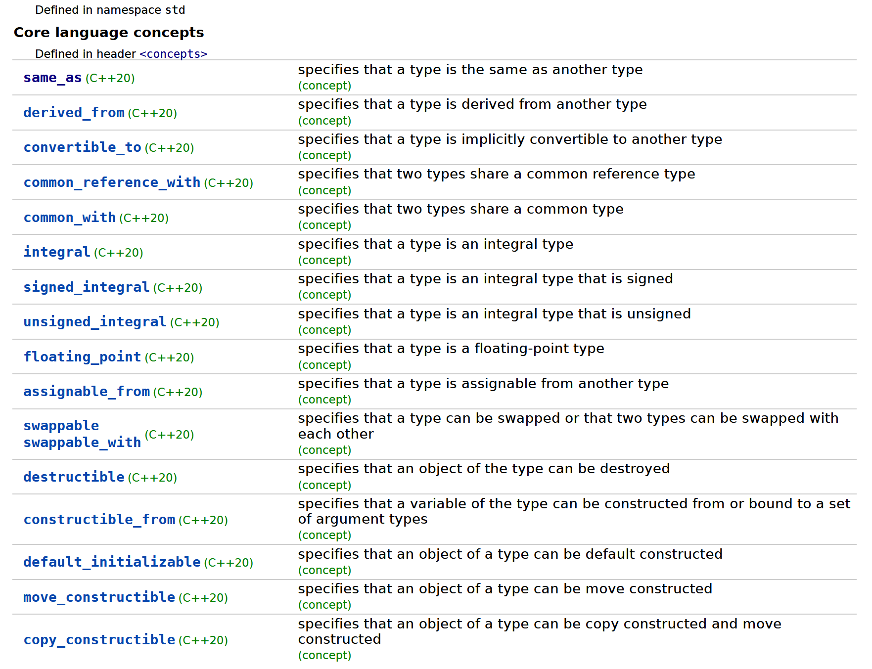
…

Slide 41
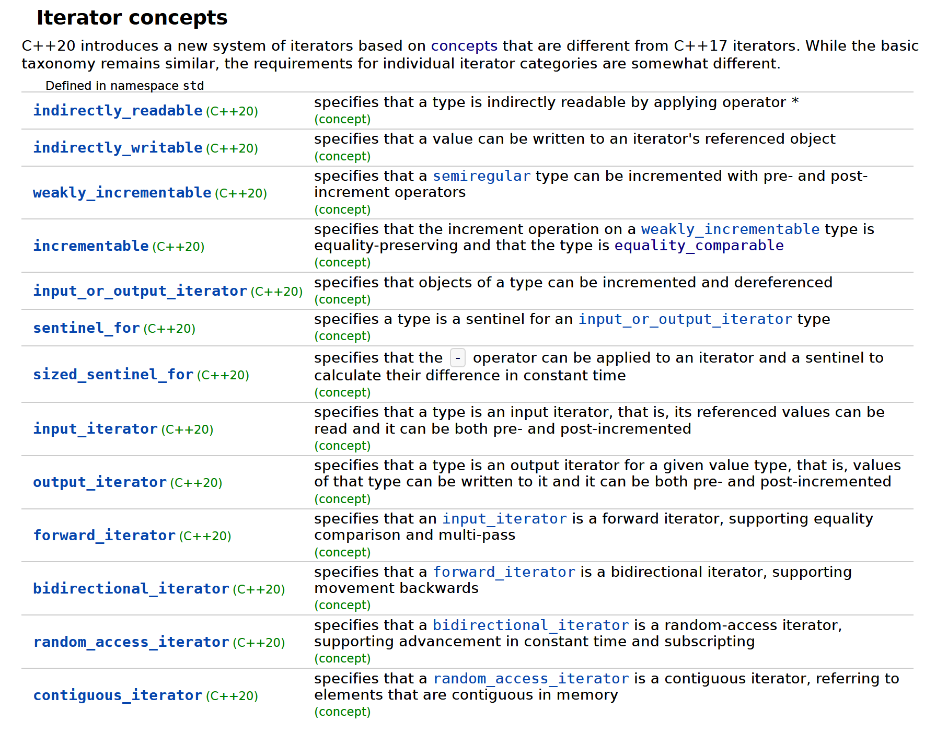
…

Slide 42
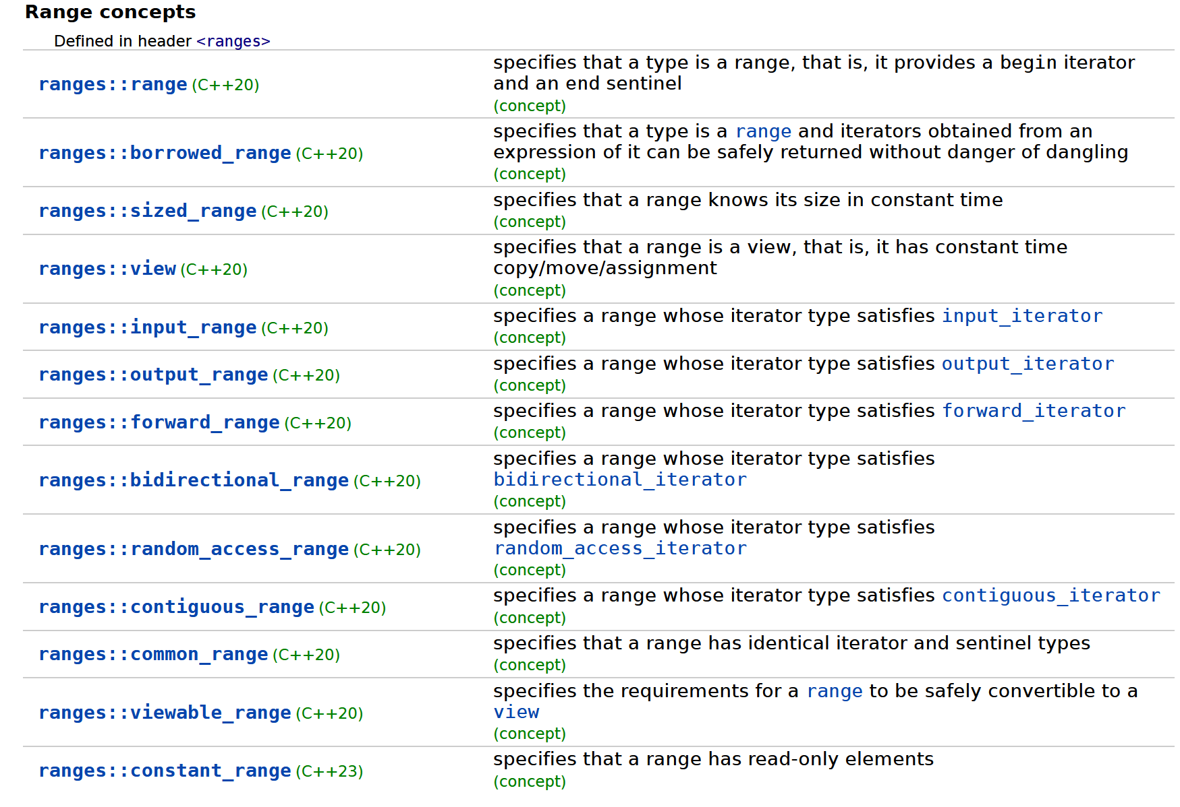
…

Slide 43
Applying Concepts: requires Clauses

Slide 44
Requires Clauses in Constrained Templates
template <parameter list> requires constraints
template body;
template <parameter list>
concept name = constraints;
Conjunctions and disjunctions of Boolean constant expressions
Concept expressions
Type trait expressions
Requires expressions
…

Slide 45
Example
template <typename T>
requires constraints
const T& max(const T& a, const T& b) {
return a > b ? a : b;
}

Slide 46
Example: Ad-Hoc Constraint
template <typename T>
requires requires (T x) {
{x > x} -> std::convertible_to<bool>;
}
const T& max(const T& a, const T& b) {
return a > b ? a : b;
}

Slide 47
Guidelines
Proper concepts correlate to clean, semantic notions, and therefore impose requirements for complete, coherent sets of operations
+ operator generally implies +=, -, -=
Avoid concepts with solely syntactic requirements
Avoid: “has a + operator”
Better: “iterator”, “number”, “string”
Semantic and complexity requirements -> code comments

Slide 48
Example: Requires Clause with Concept
template <typename T>
requires std::totally_ordered<T>
const T& max(const T& a, const T& b) {
return a > b ? a : b;
}
Requires all <, >, <=, >=, ==, and != operations to exist and behave as expected (only syntactical and type constraints are verified by the compiler).

Slide 49
Shorthand Notation
template <std::totally_ordered T>
const T& max(const T& a, const T& b) {
return a > b ? a : b;
}
Type constraint

Slide 50
Concepts and Preconditions
Do floating-point types model std::totally_ordered?
Yes
BUT… Aren’t floating-point numbers only partially ordered?
Yes (NaN <= X and X >= NaN are both false)
How do you explain that?
std::totally_ordered: constrains not only types, but also imposes preconditions on values
That is: behavior with NaN values is undefined

Slide 51
Constraining Multiple Template Type Parameters
template <typename T1, typename T2>
requires std::totally_ordered_with<T1, T2>
auto&& larger(const T1& a, const T2& b) {
return a > b ? a : b;
}

Slide 52
Shorthand Notation: Multiple Parameters
template <typename T1, std::totally_ordered_with<T1> T2>
auto&& larger(const T1& a, const T2& b) {
return a > b ? a : b;
}

Slide 53
Shorthand Notation
template <std::derived_from<SomeBaseClass> T>
void foo(const T& x);
template <std::convertible_to<SomeType> T>
void bar(const T& x);

Slide 54
Constrained Class Templates
template <typename T>
requires default_initializable<T> && destructible<T>
class Array
{
public:
explicit Array(size_t size);
~Array();
// ...
};

Slide 55
Constrained Class Templates
template <typename T>
requires default_initializable<T> && destructible<T>
Array<T>::Array(size_t size)
: m_elements {new T[size] {}}, m_size {size}
{}
template <typename T>
requires default_initializable<T> && destructible<T>
Array<T>::~Array() { delete m_elements; }

Slide 56
Constrained Class Members
template <typename T>
requires default_initializable<T> && destructible<T>
class Array
{
public:
// ...
Array(const Array& array) requires copyable<T>;
Array& operator=(const Array& rhs) requires copyable<T>;
Array(Array&& array) noexcept requires movable<T>;
Array& operator=(Array&& rhs) noexcept requires movable<T>;
void push_back(T value) requires movable<T>;
// ...
};

Slide 57
Constrained Class Members
template <typename T>
requires default_initializable<T> && destructible<T>
Array<T>::Array(const Array& array)
requires copyable<T>
: Array{ array.m_size } {
ranges::copy_n(array.m_elements,m_size,m_elements);
}

Slide 58
Constraint-Based Specialization

Slide 59
Specialization
// Precondition: incrementing first eventually leads to last
template <std::input_or_output_iterator Iter>
requires std::equality_comparable<Iter>
auto distanceBetween(Iter first, Iter last)
{
std::iter_difference_t<Iter> result {};
while (first != last) { ++first; ++result; }
return result;
}
template <std::random_access_iterator Iter>
auto distanceBetween(Iter first, Iter last)
{
return last - first;
}

Slide 60
Subsumption
What if type satisfy requirements for multiple templates?
Step 1: normalization
Expansion to conjunctions and disjunctions of Boolean constant expressions
random_access_iterator<I> -> bidirectional_iterator<I> && totally_ordered<I> && ... -> forward_iterator<I> && ... && equality_comparable<I> && ... -> …
Step 2: subsumption
Constraint solver
P subsumes Q iff P implies Q

Slide 61
Constraint Solver Limitations
Never reasons about negation (only conjunction and disjunction)
Never reasons semantically, only syntactically
sizeof(T) > 5 does not subsume sizeof(T) > 4
Only expands concept expressions
std::integral_t<T> does not subsume std::fundamental_t<T> (std::signed_integral<T> does subsume std::integral<T>)

Slide 62
Constraining auto

Slide 63
Suppose we have…
namespace stdx {
template <typename T>
concept numeric =
std::integral<T> || std::floating_point<T>;
}

Slide 64
Suppose we have…
template <typename T>
auto pow4(const T& x)
{
const auto& squared{ x * x };
return squared * squared;
}

Slide 65
Constraining template parameter
template <typename T> requires stdx::numeric<T>
auto pow4(const T& x)
{
const auto& squared{ x * x };
return squared * squared;
}

Slide 66
Shorthand notation
template <stdx::numeric T>
auto pow4(const T& x)
{
const auto& squared{ x * x };
return squared * squared;
}

Slide 67
Abbreviated Template
auto pow4(const auto& x)
{
const auto squared{ x * x };
return squared * squared;
}

Slide 68
Constraining auto
stdx::numeric auto pow4(const stdx::numeric auto& x)
{
const stdx::numeric auto squared{ x * x };
return squared * squared;
}
Notes:
Why? Self-documenting, open for modification (auto iter -> random_access_iterator auto …), earlier error messages, …

Slide 69
Discussion

