Slide 1
SpaceShip Operator
Lieven de Cock
www.codeblocks.org

Slide 2
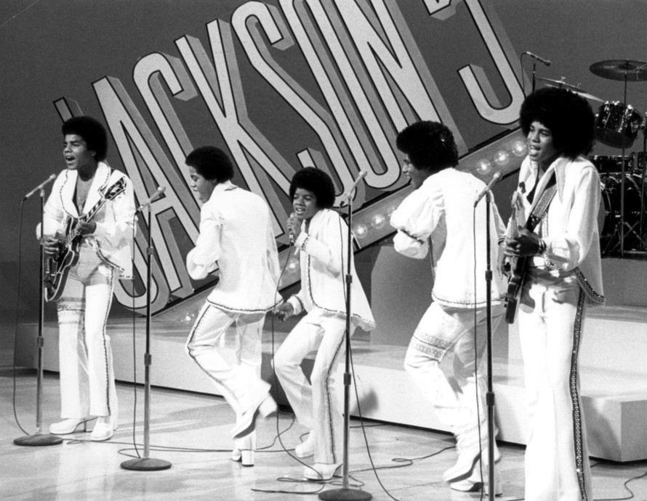
Interactive Session
Who are these ?

Slide 3
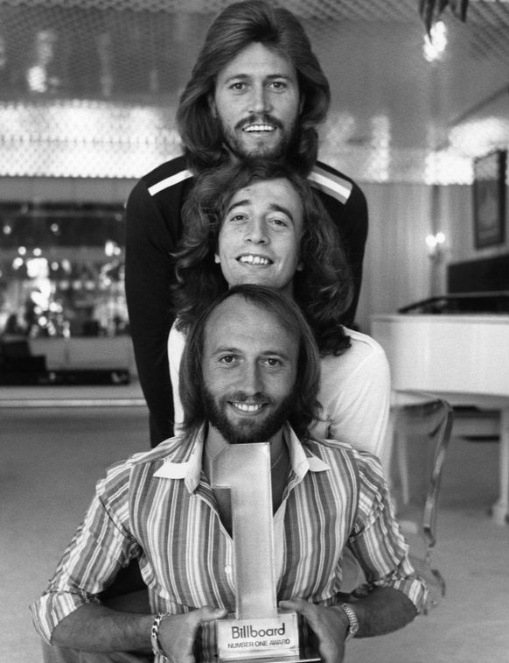
Interactive Session
Who are these ?

Slide 4
Interactive Session
Who are these ?

Slide 5
Interactive Session
Who are these ?

Slide 6
Interactive Session
Who are these ?

Slide 7
Siblings in Music
Struct : SirName, FirstName
Vector of these
Sort

Slide 8
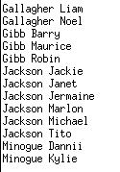
Siblings in Music : Solution
std::vector<SiblingsInMusic> siblings
{
{"Jackson", "Tito"},
{"Jackson", "Jackie"},
{"Jackson", "Michael"},
{"Jackson", "Jermaine"},
{"Jackson", "Marlon"},
{"Gallagher", "Noel"},
{"Gallagher", "Liam"},
{"Jackson", "Janet"},
{"Gibb", "Robin"},
{"Gibb", "Barry"},
{"Gibb", "Maurice"},
{"Minogue", "Kylie"},
{"Minogue", "Dannii"}
};
std::ranges::sort(siblings);
std::ranges::for_each(siblings, [](const auto& sibling)
{
std::cout << sibling.sirName << " " << sibling.firstName << std::endl;
});
struct SiblingsInMusic
{
std::string sirName;
std::string firstName;
auto operator<=>(const SiblingsInMusic&) const = default;
};

Slide 9
The SpaceShip has landed
That’s it folks !

Slide 10
Operators
Equality
Relational

Slide 11
The Past
Out test class : MagicInt
Implicit constructor
Compare
Sortable
Problem: mi == 242 : OK 242 == mi : WOOPS
class MagicInt
{
public:
MagicInt(int val) : mValue{val} {}
bool operator== (const MagicInt& rhs) const
{
return mValue == rhs.mValue;
}
bool operator< (const MagicInt& rhs) const
{
return mValue < rhs.mValue;
}
private:
int mValue;
};

Slide 12
The Past : fix the compare problem
Honor mathematics
Scott Meyers : act as an int
So “==” ==> 2 methods needed
Free method which swaps operands
class MagicInt
{
public:
MagicInt(int val) : mValue{val} {}
bool operator== (const MagicInt& rhs) const
{
return mValue == rhs.mValue;
}
private:
int mValue;
};
bool operator== (int lhs, const MagicInt& rhs)
{
return rhs == lhs;
}

Slide 13
The Past : fix the compare problem → hidden friends
1 (free) method
Both arguments can be implicitly converted
class MagicInt
{
public:
MagicInt(int val) : mValue{val} {}
friend bool operator== (const MagicInt& lhs, const MagicInt& rhs)
{
return lhs.mValue == rhs.mValue;
}
private:
int mValue;
};

Slide 14
The Past : all 6
==
<
<= ( == or <)
!= ( not ==)
> ( not <=)
>= ( not <)

Slide 15
The Past : all 6
friend bool operator== (const MagicInt& lhs, const MagicInt& rhs)
{
return lhs.mValue == rhs.mValue;
}
friend bool operator!= (const MagicInt& lhs, const MagicInt& rhs)
{
return !(lhs.mValue == rhs.mValue);
}
friend bool operator< (const MagicInt& lhs, const MagicInt& rhs)
{
return (lhs.mValue < rhs.mValue);
}
friend bool operator<= (const MagicInt& lhs, const MagicInt& rhs)
{
return (lhs.mValue < rhs.mValue) || (lhs.mValue == rhs.mValue);
}
friend bool operator>= (const MagicInt& lhs, const MagicInt& rhs)
{
return !(lhs.mValue < rhs.mValue);
}
friend bool operator> (const MagicInt& lhs, const MagicInt& rhs)
{
return !(lhs.mValue <= rhs.mValue);
}

Slide 16
The Past : be complete
[[nodiscard]] friend constexpr bool operator== (const MagicInt& lhs, const MagicInt& rhs) noexcept
{
return lhs.mValue == rhs.mValue;
}
[[nodiscard]] friend constexpr bool operator!= (const MagicInt& lhs, const MagicInt& rhs) noexcept
{
return !(lhs.mValue == rhs.mValue);
}
[[nodiscard]] friend constexpr bool operator< (const MagicInt& lhs, const MagicInt& rhs) noexcept
{
return (lhs.mValue < rhs.mValue);
}
[[nodiscard]] friend constexpr bool operator<= (const MagicInt& lhs, const MagicInt& rhs) noexcept
{
return (lhs.mValue < rhs.mValue) || (lhs.mValue == rhs.mValue);
}
[[nodiscard]] friend constexpr bool operator>= (const MagicInt& lhs, const MagicInt& rhs) noexcept
{
return !(lhs.mValue < rhs.mValue);
}
[[nodiscard]] friend constexpr bool operator> (const MagicInt& lhs, const MagicInt& rhs) noexcept
{
return !(lhs.mValue <= rhs.mValue);
}
noexcept
constexpr
[[nodiscard]]

Slide 17
C++20 : Rewrites
Equality operator “==”
A a; B b;
a != b : compiler will try
a != b
!( a == b)
!( b == a)
Note : it will NOT try (b != a)
a == b : compiler will try
a == b
b == a

Slide 18
C++20 : Rewrites
class MagicInt
{
public:
MagicInt(int val) : mValue{val} {}
bool operator== (const MagicInt& rhs) const
{
return mValue == rhs.mValue;
}
private:
int mValue;
};
const MagicInt f1{242};
const MagicInt f2{100};
std::cout << (f1 == f2) << std::endl; /// OK
std::cout << (f1 != f2) << std::endl; /// rewritten as !(a==b)
std::cout << (f1 == 242) << std::endl; /// OK
std::cout << (242 == f1) << std::endl; /// rewritten as (b==a)
std::cout << (f1 != 242) << std::endl; /// rewritten as !(a==b)
std::cout << (242 != f1) << std::endl; /// rewritten as !(b==a)
Note : no hidden friend here !!!

Slide 19
C++20 : Rewrites : Endless Recursion
class MagicInt
{
public:
MagicInt(int val) : mValue{val} {}
bool operator== (const MagicInt& rhs) const
{
return mValue == rhs.mValue;
}
private:
int mValue;
};
bool operator== (int lhs, const MagicInt& rhs)
{
return rhs == lhs;
}
const MagicInt f1{242};
std::cout << (f1 == 242) << std::endl;
std::cout << (242 == f1) << std::endl;
// gcc 11.3/12 warns, on the above function
// in c++20 this comparison calls the current function recursively with reversed arguments
// infinite recursion detected [-Winfinite-recursion]
// clang 14
// all paths through this function will call itself [-Winfinite-recursion]
Danger : your codebase can break
prefers to call itself with swapped operands, which is a better match than the member function which needs a type conversion

Slide 20
C++20 : Rewrites : Endless Recursion → solutions
Only C++20 → remove this method, no longer needed
return rhs.operator==(lhs)
return rhs == MagicInt{lhs}
bool operator== (int lhs, const MagicInt& rhs)
{
return rhs.operator==(lhs);
}
bool operator== (int lhs, const MagicInt& rhs)
{
return rhs == MagicInt{lhs};
}

Slide 21
SpaceShip : operator<=>
Rules of the game different depending on:
Defaulted
Not defaulted
Don’t call it yourself (it is an implementation detail), use the normal operators (which it brings to the table)
Depending on the members’ support:
constexpr
noexcept
similar rewriting if the first operand can be "implicitly type converted"

Slide 22
SpaceShip : operator<=>
takes preference over all other relational operators
Return type : something that can be compared to 0
#include <compare>
const MagicInt f1{242};
const MagicInt f2{100};
std::cout << (f1 < f2) << std::endl;
std::cout << (f1 > f2) << std::endl;
std::cout << (f1 <= f2) << std::endl;
std::cout << (f1 >= f2) << std::endl;
std::cout << (f1 == f2) << std::endl;
std::cout << (f1 != f2) << std::endl;
const MagicInt f3{242};
std::cout << (f1 == f3) << std::endl;
std::cout << (f1 != f3) << std::endl;
std::vector vec{f1, f2};
std::sort(vec.begin(), vec.end());
class MagicInt
{
public:
MagicInt(int val) : mValue{val} {}
auto operator<=> (const MagicInt& rhs) const = default;
private:
int mValue;
};

Slide 23
SpaceShip : operator<=> : DEFAULTED
It gives:
4 relational operators
2 equality operators
Compares an object member by member => order matters
NOT defaulted => no equality operators !

Slide 24
3-way comparison
a OP b
a OP b < 0
a OP b == 0
a OP b > 0
eg.: std::strcmp
a <=> b
a <=> b < 0
a <=> == 0
a <=> b > 0

Slide 25
Rewrites
x <= y → if no matching definition, try
(x <=> y) <= 0
0 <= (y <=> x)
x <=> y equal to 0 → x and y equal or equivalent
x <=> y less than 0 → x is less than y
x <=> y greater than 0 → x is greater than y
operator != never rewritten to call operator<=> (it might call an operator== generated from a defaulted operator<=>)

Slide 26
SpaceShip : operator<=> : constexpr
struct Coordinate
{
double x{};
double y{};
double z{};
auto operator<=> (const Coordinate&) const = default;
};
constexpr Coordinate co{1.0, 2.0, 3.0};
static_assert(co < Coordinate{1.1, 0.0, 0.0});

Slide 27
SpaceShip : Not Default
No “==” → if needed → add it explicitly
struct Person
{
std::string firstName;
std::string lastName;
auto operator<=> (const Person& rhs) const
{
return lastName <=> rhs.lastName;
}
/// we need to add this one !!!
bool operator== (const Person& rhs) const
{
return lastName == rhs.lastName;
}
};
std::vector<Person> vec{ {"Eric", "Cartman"}, {"Stan", "Marsh"}, {"Kyle", "Broflovski"}, {"Kenny", "McCormick"} };
std::sort(vec.begin(), vec.end());
Person author1{"Trey", "Parker"};
Person author2{"Matt", "Stone"};
std::cout << (author1 == author2) << std::endl;

Slide 28
SpaceShip : Multiple Members, and some don’t matter
Struct Person
LastName
FirstName
Age
SomeData (which we don’t care about)
→ not default
→ add “==”
→ implement by calling <=> on the members

Slide 29
SpaceShip : Multiple Members, and some don’t matter
struct Person
{
std::string firstName{};
std::string lastName{};
int age{};
std::vector<int> someData{};
bool operator== (const Person& rhs) const noexcept
{
return firstName == rhs.firstName &&
lastName == rhs.lastName &&
age == rhs.age;
}
auto operator<=> (const Person& rhs) const noexcept
{
auto cmp = lastName <=> rhs.lastName; /// 1st criterion
if(cmp != 0)
{
return cmp;
}
cmp = firstName <=> rhs.firstName; /// 2nd criterion
if(cmp != 0)
{
return cmp;
}
return age <=> rhs.age; /// 3rd criterion
}

Slide 30
Compare / order ???
Can we always compare or order ?
Equal versus Equivalent
Hello ↔ hello
Nan: Not A Number
std::less
const double d1{24.2};
const double d2{10.0};
const double d3{std::numeric_limits<double>::quiet_NaN() };
// ALL FALSE
std::cout << (d1 == d3) << std::endl;
std::cout << (d1 < d3) << std::endl;
std::cout << (d1 > d3) << std::endl;
std::cout << (d3 == d3) << std::endl;
// BUT
std::vector vec{d1, d3, d2};
std::sort(vec.begin(), vec.end());
for(const auto& value : vec)
{
std::cout << value << “ “;
}

Slide 31
Different Comparison Categories
Strong Ordering
Weak Ordering
Partial Ordering
Stronger ordering can convert to a weaker one, but not the other way around (implicit type conversions)
Is the return type of the <=> operator → different return types

Slide 32
Strong Ordering (Total Ordering)
Any value of a given type is : less than, or equal, or greater than any other value of this type
Examples : int, std::string
std::strong_ordering
std::strong_ordering::less
std::strong_ordering::equal (std::strong_ordering::equivalent)
std::strong_ordering::greater

Slide 33
Weak Ordering
Any value of a given type is : less than, or equivalent, or greater than any other value of this type
Equivalent does not mean they have to be equal
Examples : case insensitive strings
std::weak_ordering
std::weak_ordering::less
std::weak_ordering::equivalent
std::weak_ordering::greater

Slide 34
Partial Ordering
Any value of a given type COULD BE : less than, or equivalent, or greater than any other value of this type
It may not be possible to specify an order between 2 values at all → unordered
Examples : floating point types
std::partial_ordering
std::partial_ordering::less
std::partial_ordering::equivalent
std::partial_ordering::greater
std::partial_ordering::unordered

Slide 35
Avoid
if ( x <=> y == std::strong_ordering::equal)
→ might not compile
→ if ( x <=> y == 0 )

Slide 36
What in case of multiple ordering criteria of different comparison categories
std::string → strong
double → partial
What is return type of operator<=> ?
auto → nope : different return types will be deduced
struct Person
{
std::string firstName{};
std::string lastName{};
double age{};
std::vector<int> someData{};
bool operator== (const Person& rhs) const noexcept
{
return firstName == rhs.firstName &&
lastName == rhs.lastName &&
age == rhs.age;
}

Slide 37
Go for the common ground → weaker type
std::partial_ordering operator<=> (const Person& rhs) const noexcept
{
auto cmp = lastName <=> rhs.lastName; /// 1st criterion
if(cmp != 0)
{
return cmp;
}
cmp = firstName <=> rhs.firstName; /// 2nd criterion
if(cmp != 0)
{
return cmp;
}
return age <=> rhs.age; /// 3rd criterion
}
First 2 → strong → implicit conversion to partial
Third one → partial

Slide 38
Map to the stronger type
std::strong_ordering operator<=> (const Person& rhs) const noexcept
{
auto cmp = lastName <=> rhs.lastName; /// 1st criterion
if(cmp != 0)
{
return cmp;
}
cmp = firstName <=> rhs.firstName; /// 2nd criterion
if(cmp != 0)
{
return cmp;
}
const auto res = age <=> rhs.age; /// 3rd criterion
if(res == std::partial_ordering::less)
{
return std::strong_ordering::less;
}
else if (res == std::partial_ordering::equivalent)
{
return std::strong_ordering::equal;
}
else if (res == std::partial_ordering::greater)
{
return std::strong_ordering::greater;
}
/// aka --> std::partial_ordering::unordered --> let's just choose something, eg less
/// or when we assume that an std::partial_ordering::unordered should not happen, we could throw
return std::strong_ordering::less;
}
First mappings trivial
What to do with ‘unordered’ ?

Slide 39
Map to the stronger type (there is help for double)
std::strong_ordering operator<=> (const Person& rhs) const noexcept
{
auto cmp = lastName <=> rhs.lastName; /// 1st criterion
if(cmp != 0)
{
return cmp;
}
cmp = firstName <=> rhs.firstName; /// 2nd criterion
if(cmp != 0)
{
return cmp;
}
return std::strong_order(age, rhs.age); /// 3rd criterion
}
Also works for NaN
std::compare_three_way function object for operator<=> (similar like std::less function object for operator<)

Slide 40
What if we don’t know the types (generic code) ?
What could be the comparison categories for those unknown types ?
Who is stronger, who is weaker ?
determine the common ground (aka the 'greatest common divisor'):
std::common_comparison_category<T1, T2>
computes the strongest comparison category

Slide 41
What if we don’t know the types (generic code) ?
struct Person
{
std::string name{};
double value{};
std::vector<int> someData{};
auto operator<=> (const Person& rhs) const noexcept
-> std::common_comparison_category_t<decltype(name <=> name), decltype(value <=> value)>
{
const auto cmp = name <=> rhs.name;
if(cmp != 0)
{
return cmp;
}
return value <=> rhs.value;
}
};

Slide 42
Rewrites / Overload Resolution : Equality operators
x != y
Compiler will try: note: a rewritten expression never tries to call a member operator!=
x.operator!=(y)
operator!=(x, y)
! x.operator==(y)
! operator==(x, y)
! y.operator==(x)
! x.operator==(y) (generated from x.operator<=>)
! y.operator==(x) (generated from y.operator<=>)

Slide 43
Rewrites / Overload Resolution : Relational operators
Rewritten statements fall back on operator<=> and compare the result with 0
Example : x <= y
Compiler will try:
x.operator<=(y)
operator<=(x, y)
x.operator<=>(y) <= 0
operator<=>(x, y) <= 0
0 <= y.operator<=>(x)

Slide 44
Concepts
Require all 6 operators
Standard concept : three_way_comparable
class NonDefaultedInt
{
public:
NonDefaultedInt(int val) : mValue{val} {}
auto operator<=> (const NonDefaultedInt& rhs) const
{
return mValue <=> rhs.mValue;
}
bool operator== (const NonDefaultedInt& rhs) const
{
return mValue == rhs.mValue;
}
private:
int mValue;
};
template <typename T>
requires std::three_way_comparable<T>
void foo(const T& /*t*/)
{
}
class MagicInt
{
public:
MagicInt(int val) : mValue{val} {}
auto operator<=> (const MagicInt& rhs) const = default;
private:
int mValue;
};

Slide 45
Concepts
foo(242);
const MagicInt f1{242};
foo(f1); /// will fail it the <=> is not there
const NonDefaultedInt f2{242};
foo(f2); /// will fail it the <=> AND == are not there

Slide 46
Concepts
Hand made : require <=>
Note : <=> does not always bring ==
NonDefaultInt now has no == in this test
template <typename T>
concept MySpaceshippable = requires (T t)
{
t <=> t;
};
template <typename T>
requires MySpaceshippable<T>
void foo(const T& /*t*/)
{
}
foo(242);
const MagicInt f1{242};
foo(f1); /// will fail it the <=> is not there
const NonDefaultedInt f2{242};
foo(f2); /// will fail it the <=> is not there (== is not required, just <=>)

Slide 47
Concepts
Hand made and we want all 6
template <typename T>
concept MySpaceshippable6 = requires (T t)
{
t <=> t;
t == t;
};
template <typename T>
requires MySpaceshippable6<T>
void foo(const T& /*t*/)
{
}

Slide 48
Concepts
Hand made and we want all 6
Use a standard template (equality_comparable) and something we add
template <typename T>
concept MySpaceshippable6 = std::equality_comparable<T> && requires (T t)
{
t <=> t;
};
template <typename T>
requires MySpaceshippable6<T>
void foo(const T& /*t*/)
{
}

Slide 49
Inheritance
First compares the base classes, going from left to right
Defaulted on Derived, as such requires:
Operators on the its members
Operators on the base class
So it does not automatically defaults the base too, the base class has it’s own independent life as usual

Slide 50
Inheritance
struct Base
{
int x{};
auto operator<=> (const Base& rhs) const = default;
};
struct Derived : Base
{
int y{};
auto operator<=> (const Derived& rhs) const = default;
};

Slide 51
Inheritance
Derived d1 {500, 50}; /// x is 500, y is 50 ==> base equal, derived not
Derived d2 {500, 40};
std::cout << (d1 == d2) << std::endl; // false
Derived d3 {500, 50};
Derived d4 {600, 50};
std::cout << (d3 == d4) << std::endl; // false
Derived d5 {500, 50};
Derived d6 {500, 50};
std::cout << (d5 == d6) << std::endl; // true

Slide 52
QUESTIONS

