Slide 1
What's New in Visual C++ 2019
Marc Grégoire
Software Architect
marc.gregoire@nuonsoft.com

Slide 2
Marc Grégoire
Belgium
Software architect for Nikon Metrology
Microsoft VC++ MVP
Microsoft Extended Experts Team member
Author of Professional C++, 2nd, 3rd and 4th Edition
Co-author of C++ Standard Library Quick Reference
Founder of the Belgian C++ Users Group (BeCPP)

Slide 3
Agenda
Compatibility
Lifetime Profile Checker
Use-After-Move
Concurrency Checkers
In-Editor Code Analysis Warnings
Quick Fix for Uninitialized Variables
Template Bar
Resolve Missing Namespace Scope
Add Missing #includes
Fix Bad Indirection (* and &)
Peek at Header/Code File
Quick Info Colorization
Quick Info Search Online
Linker Throughput Improvements
SIMD Expression Optimizations
Out-of-Process Debugger
Live Share
Native Support for WSL
Clang/LLVM Support
CMake IntelliSense
vcpkg IntelliSense
Address Sanitizer Support
C++20 Features

Slide 4
Compatibility
2019 is binary compatible with 2017

Slide 5
Lifetime Profile Checker
Implements Lifetime Profile from C++ Core Guidelines
Primary goal
Simple analysis
easy for compilers to implement
easy for programmers to reason about
Analysis is local to a function, no whole-program analysis
Analysis is linear and single-pass
Doesn’t require expensive analysis step
Identify variables that are “Owner” types (e.g. smart ptr, containers, string, …) and “Pointer” types (e.g. int*, string_view, span, iterators, …)

Slide 6
Lifetime Profile Checker
Example
void lifetime1() {
int* p = nullptr;
{
int x = 0;
p = &x;
cout << *p;
}
cout << *p;
}
warning C26489: Don't dereference a pointer that may be invalid: '*p'. 'p' may have been invalidated at line 19 (lifetime.1).

Slide 7
Lifetime Profile Checker
Example
void lifetime2() {
std::string_view s = "foo"s;
s[0];
}
s was invalidated when the “foo”s temporary std::string was destroyed.
warning C26486: Don't pass a pointer that may be invalid to a function. Parameter 0 's' in call to 'std::basic_string_view<char,std::char_traits<char> >::operator[]' may be invalid (lifetime.3).

Slide 8
Lifetime Profile Checker
Example
void lifetime3() {
vector<bool> vb{ false,true,false,true };
auto proxy = vb[0];
if (proxy) {/*...*/ }
vb.reserve(100);
if (proxy) {/*...*/ }
}
Invalidates proxies
warning C26486: Don't pass a pointer that may be invalid to a function. Parameter 0 'proxy' in call to 'std::_Vb_reference<std::_Wrap_alloc<std::allocator<unsigned int> > >::operator bool' may be invalid (lifetime.3).

Slide 9
Use-After-Move
Example (needs C++ Core Check Experimental Rules)
std::string s = "test";
std::string s2(std::move(s));
s.back();
warning C26800: Use of a moved from object: ''s'' (lifetime.1).

Slide 10
Concurrency Checkers
The 2019 “Microsoft Native Recommended Ruleset” includes:
C26100: Race condition. Variable should be protected by a lock.
C26101: Failing to use interlocked operation properly for a variable.
C26110: Caller failing to acquire a lock before calling a function which expects the lock to be acquired prior to being called.
C26111: Caller failing to release a lock before calling a function which expects the lock to be released prior to being called.
C26112: Caller cannot hold any lock before calling a function which expects no locks be held prior to being called.
C26115: Failing to release a lock in a function. This introduces an orphaned lock.
C26116: Failing to acquire a lock in a function, which is expected to acquire the lock.
C26117: Releasing an unheld lock in a function.
C26140: Undefined lock kind specified on the lock.

Slide 11
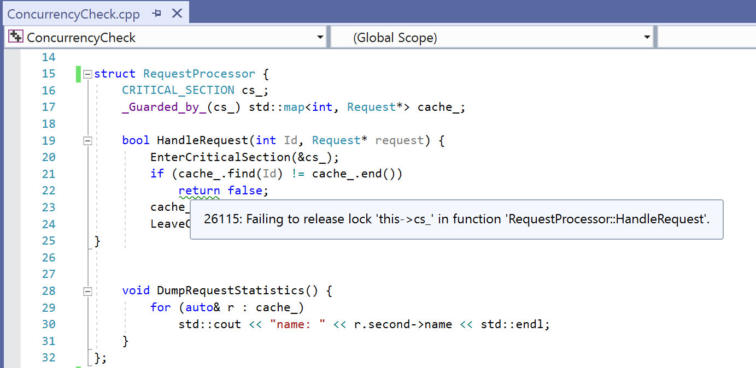
Concurrency Checkers

Slide 12
Concurrency Checkers

Slide 13
In-Editor Code Analysis Warnings
Code analysis is run in the background
Warnings are displayed as green squiggles

Slide 14
Quick Fix for Uninitialized Variables
New quick fixes for:
C6001: using uninitialized memory <variable> (Microsoft Native Minimum ruleset)
C26494 VAR_USE_BEFORE_INIT (C++ Core Check Type ruleset)

Slide 15
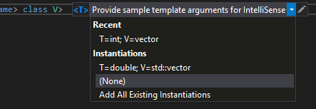
Template Bar
Specify template type parameter examples
Gives suggestions based on instantiations in the code

Slide 16
Template Bar
Lightens up IntelliSense in template code

Slide 17
Template Bar Demo

Slide 18
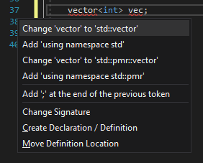
Resolve Missing Namespace Scope
Options to resolve a missing namespace scope:
Fully qualify the name
Add “using namespace …”

Slide 19
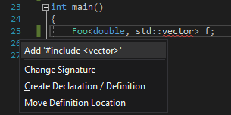
Add Missing #includes
Lightbulb for missing #includes

Slide 20
Missing #include Demo

Slide 21
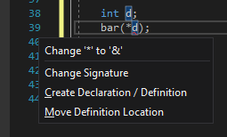
Fix Bad Indirection (* and &)
Replaces * with & and & with * if used wrong
Example
void bar(int* p) {}
int d;
bar(*d);

Slide 22
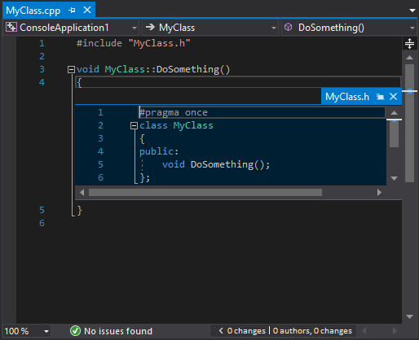
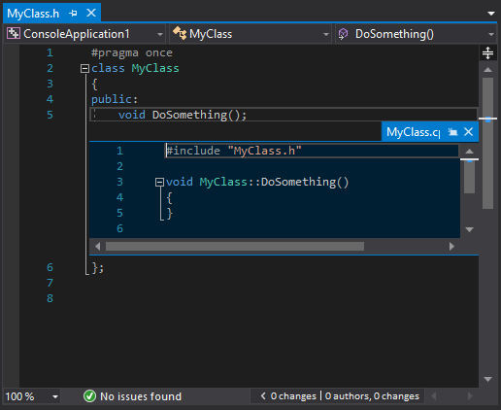
Peek at Header/Code File
Ctrl+K/Ctrl+J: peek at header from code file, or peek at code file from header

Slide 23
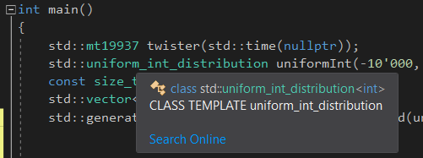
Quick Info Colorization
Semantic colorization of Quick Info tooltips
2017
2019

Slide 24
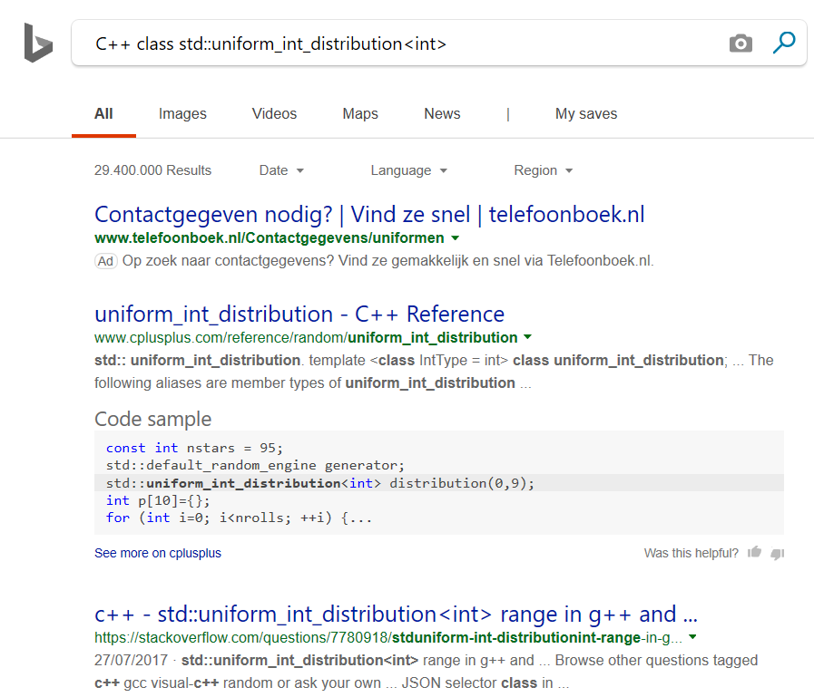
Quick Info Search Online
“Search Online” link in Quick Info tooltips
Customize Provider: Tools > Options > Text Editor > C++ > View

Slide 25
Linker Throughput Improvements
Link improvements up to 2x thanks to
smart debug info pruning
Type and global symbol hash improvements (using xxhash)
AAA Game Title
Link time (seconds) | VS 2017 15.9 Update (base) | VS 2019 Preview 2 (diff) | base/diff (higher is better)
/DEBUG:full | 392.1 | 163.3 | 2.4
/DEBUG:fastlink | 72.3 | 31.2 | 2.32
Input size (bytes) | 12,882,624,412 | 8,131,565,290 | 1.58

Slide 26
Linker Throughput Improvements
Google Chrome (x64 release build)
Link time (seconds) | VS 2017 15.9 Update (base) | VS 2019 Preview 2 (diff) | base/diff (higher is better)
/DEBUG:full | 126.8 | 71.9 | 1.76
/DEBUG:fastlink | 30.3 | 21.5 | 1.41
Input size (bytes) | 5,858,077,238 | 5,442,644,550 | 1.08
Google Chrome (x86 debug build)
Link time (seconds) | VS 2017 15.9 Update (base) | VS 2019 Preview 2 (diff) | base/diff (higher is better)
/DEBUG:full | 232.6 | 106.9 | 2.18
/DEBUG:fastlink | 43.8 | 38.8 | 1.13
Input size (bytes) | 8,384,258,922 | 7,962,819,862 | 1.05

Slide 27
SIMD Expression Optimizations
Pre-2019: no optimizations of vector intrinsics operations
2019: optimizations include:
constant folding
arithmetic simplifications, including reassociation
handling of cmp, min/max, abs, extract operations
converting vector to scalar operations if profitable
patterns for shuffle and pack operations

Slide 28
SIMD Expression Optimizations
Example:
__m128 test(float a, float b) { __m128 va = _mm_set1_ps(a); __m128 vb = _mm_set1_ps(b); __m128 vd = _mm_set1_ps(-b);
// Computes (va * vb) + (va * -vb) return _mm_add_ps(_mm_mul_ps(va, vb),_mm_mul_ps(va, vd)); }
VS 2017 /arch:AVX2 /fp:fast vmovaps xmm3, xmm0 vbroadcastss xmm3, xmm0 vxorps xmm0, xmm1, DWORD PTR __xmm@80000000800000008000000080000000 vbroadcastss xmm0, xmm0 vmulps xmm2, xmm0, xmm3 vbroadcastss xmm1, xmm1 vmulps xmm0, xmm1, xmm3 vaddps xmm0, xmm2, xmm0 ret 0
VS 2019 /arch:AVX2 /fp:fast
vxorps xmm0, xmm0, xmm0 ret 0

Slide 29
Out-of-Process Debugger
Visual Studio is 32 bit
Debugging large applications might cause VS to run out of memory
2019: Debugger now runs out of process in a 64 bit process
No more out-of-memory

Slide 30
Live Share
Real-time collaborative development
Available by default in 2019
Available as extension for 2017 and Visual Studio Code

Slide 31
Live Share
Supports:
Co-editing & Co-debugging
Sharing audio, terminals, …
Use-case:
Pair programming
Code review
Teaching
…
When connecting to a live share session, you don’t need to entire codebase locally checked out

Slide 32
Live Share
Build output messages are shared in real-time
Terminal sharing
Read-only, or read/write
Co-debugging:
Inspect variables, call stack, threads, …
Allow stepping, step into, …

Slide 33
Live Share Demo

Slide 34
Native Support for WSL
Use local Windows Subsystem for Linux (WSL) with C++ natively without additional configuration or SSH connection
How to?
Install WSL support in Windows 10 (admin powershell): Enable-WindowsOptionalFeature -Online -FeatureName Microsoft-Windows-Subsystem-Linux
Install favorite Linux distro from Windows Store, e.g. Ubuntu
Install gcc, gdb, make, rsync, and zip tools: sudo apt install g++ gdb make rsync zip
Done
Support for CMake and MSBuild

Slide 35
CMake & WSL Demo

Slide 36
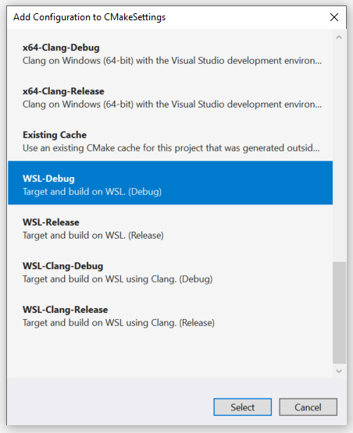
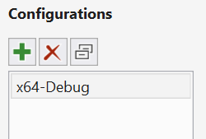
Native Support for WSL
Visual C++ + CMake + WSL procedure:
Add WSL-Debug or WSL-Release configuration

Slide 37
MSBuild & WSL Demo

Slide 38
Native Support for WSL
Visual C++ + MSBuild + WSL procedure:
Use WSL platform toolset

Slide 39
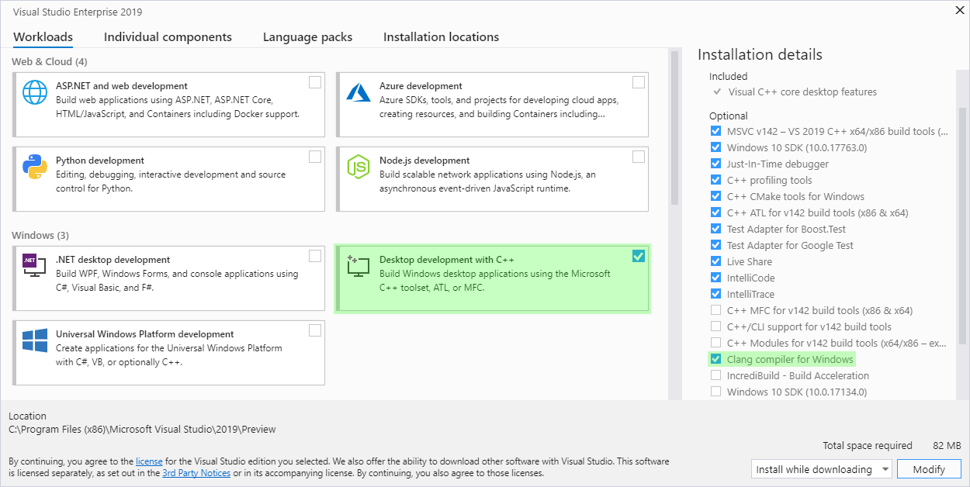
Clang/LLVM Support
Visual C++ 2019 supports Clang/LLVM for CMake projects
Target both Windows and Linux
Supports full IntelliSense

Slide 40
Clang Demo

Slide 41
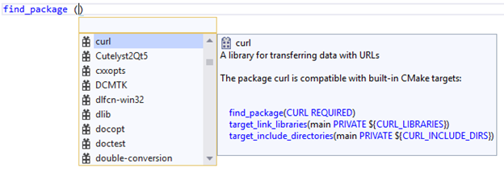
CMake IntelliSense
In-editor documentation for commands, variables, and properties
Quick info tooltips and autocompletion
Example:

Slide 42
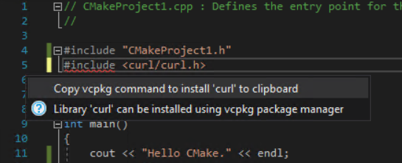
vcpkg IntelliSense
IntelliSense can give suggestions to install missing packages using vcpkg

Slide 43
CMake & vcpkg IntelliSense Demo

Slide 44
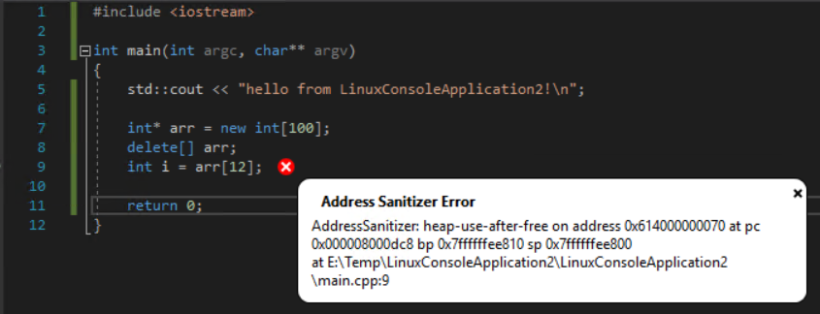
Address Sanitizer Support
Visual C++ 2019 supports ASAN: Address Sanitizer for Linux builds
Works with remote Linux machines and WSL
Needs libasan-dbg: sudo apt-get install libasanX-dbg
For MSBuild/CMake: enable ASAN in project properties
Recompile required
Run in debugger:

Slide 45
ASAN Demo

Slide 46
C++20
Visual C++ 2019 supports a number of:
C++20 language features
C++20 Standard Library features
Requires /std:c++latest

Slide 47
C++20 Language Features
Designated initialization
struct Data {
int anInt = 0;
std::string aString;
};
Data d{ .aString = "Hello" };

Slide 48
C++20 Spaceship Operator <=>
Official name: three-way comparison operator
Three-way: comparing 2 objects and then comparing result with 0
(a <=> b) < 0 // true if a < b
(a <=> b) > 0 // true if a > b
(a <=> b) == 0 // true if a is equal/equivalent to b
A bit like C strcmp() returning -1, 0, or 1

Slide 49
C++20 Spaceship Operator <=>
Common case: automatically write all comparison operators to compare X with Y (memberwise):
auto X::operator<=>(const Y&) = default;
Advanced: specific return type: (support all 6 operators)
 |  | a < b supported
 |  | Yes | No
a==b implies f(a) == f(b)? | Yes | strong_ordering | strong_equality
 | No | weak_ordering or partial_ordering | weak_equality
partial_ordering: allows incomparable values, i.e. x < y, x > y, and x == y could all be false.

Slide 50
C++20 Spaceship Operator <=>
class Point {
int x; int y;
public:
friend bool operator==(const Point& a, const Point& b){ return a.x==b.x && a.y==b.y; }
friend bool operator< (const Point& a, const Point& b){ return a.x < b.x ||
(a.x == b.x && a.y < b.y); }
friend bool operator!=(const Point& a, const Point& b) { return !(a==b); }
friend bool operator<=(const Point& a, const Point& b) { return !(b<a); }
friend bool operator> (const Point& a, const Point& b) { return b<a; }
friend bool operator>=(const Point& a, const Point& b) { return !(a<b); }
// ... non-comparison functions ...
};
#include <compare>
class Point {
int x; int y;
public:
auto operator<=>(const Point&) const = default;
// ... non-comparison functions ...
};
C++17
C++19
Notes:
= default generates memberwise comparison for Point.

Slide 51
C++20 Spaceship Operator <=>
Currently, Standard Library types don’t support <=> yet (e.g. std::string, …) ☹

Slide 52
C++20 Standard Library Features
starts_with() and ends_with() for basic_string/basic_string_view.
std::string str = "Hello world!";
bool b = str.starts_with("Hello");
contains() for associative containers.
std::map myMap{ std::pair{1, "one"s}, {2, "two"s}, {3, "three"s} };
bool result = myMap.contains(2);
remove(), remove_if(), and unique() for list and forward_list now return size_type instead of void, the number of removed elements
shift_left() and shift_right() added to <algorithm>, shifts elements in a range

Slide 53
C++20 Standard Library Features
Parallel versions of:
is_sorted(), is_sorted_until()
is_partitioned()
set_difference(), set_intersection()
is_heap(), is_heap_until()
Only useful if using large data set (profile!)

Slide 54
C++20 Standard Library Features
Example:
// Generate data
mt19937 twister(time(nullptr));
uniform_int_distribution uniformInt(-10'000, 10'000);
const size_t count = 10;
vector<int> data(count);
generate(begin(data), end(data), bind(uniformInt, twister));
// Print data
for (const auto& e : data) { cout << e << "\n"; }
cout << "Is sorted: "
<< is_sorted(execution::par, begin(data), end(data)) << "\n";
// Sort data and print again
sort(begin(data), end(data));
for (const auto& e : data) { cout << e << "\n"; }
cout << "Is sorted: "
<< is_sorted(execution::par, begin(data), end(data)) << "\n";

Slide 55
C++20 Standard Library Features
Example:
Data set of 10.000.000 points
Sorting 10.000 times
Non-parallel: ~64 sec
Parallel: ~25 sec

Slide 56
Agenda
Lifetime Profile Checker
Use-After-Move
Concurrency Checkers
Quick Fix for Uninitialized Variables
In-Editor Code Analysis Warnings
Template Bar
Resolve Missing Namespace Scope
Add Missing #includes
Fix Bad Indirection (* and &)
Peek at Header/Code File
Quick Info Colorization
Quick Info Search Online
Linker Throughput Improvements
SIMD Expression Optimizations
Compatibility
Out-of-Process Debugger
Live Share
Native Support for WSL
Clang/LLVM Support
CMake IntelliSense
vcpkg IntelliSense
Address Sanitizer Support
C++20 Features

Slide 57
Questions
?

Slide 58
Widescreen Test Pattern (16:9)
Aspect Ratio Test
(Should appear circular)
4x3
16x9

