Slide 1
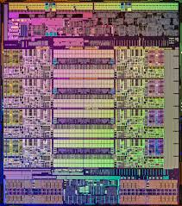
OMP
What are you caching about?
CPPBe
Barry Van Landeghem

Slide 3
Studied mathematics and computer science at the University of Antwerp
Work for OM Partners (https://ompartners.com/)
Senior Manager Of Technology
Who Am I?

Slide 4
Investigations were done by OMP R&I department
Davy Van Nieuwenborgh, Bart Tanghe, Patrick Van Cauteren
Credits

Slide 5
This is not a pure C++ presentation
We’ll see how current memory hardware architecture might impact how you want to write algorithms
Basic goal is to bring some more awareness
Presented material is not new and well-known in certain industries (e.g. Gaming industries)
What will I present?

Slide 6
A silver bullet to tackle all your performance problems
Fully detailed coding examples
What not to expect!

Slide 7
Mental model developers often use when writing algorithms

Slide 8
Memory
int
CPU
Big O complexity of algorithm

Slide 9
However reality is different

Slide 10
Modern Computer Architecture: Single Socket
Socket with 4 cores
CPU1
registers
CPU2
registers
CPU3
registers
CPU4
registers
L1 I
L1 D
L1 I
L1 D
L1 I
L1 D
L1 I
L1 D
L2 Cache
L2 Cache
L2 Cache
L2 Cache
L3 Cache
DataBus
Main Memory

Slide 11
Modern Computer Architecture: Cache Size
Your cache is …
never big enough!

Slide 12
Modern Computer Architecture: Cache Size
Caches are small compared to the vast amounts of RAM
Caches don’t cache bytes, but lines of bytes (LineSize)
So reading one byte that is not in cache will trigger a read of LineSize bytes from memory! Same for writing!
Everything in L1 is also in L2, and everything in L2 is also in L3

Slide 13
Modern Computer Architecture: Cache Size
Using CoreInfo.exe from SysInternals you can get info
Level 1 of 32KB with a 64-bytes line size ➔512 lines of 64-bytes
Level 2 of 256KB with a 64-bytes line size ➔4096 lines of 64-bytes, but only 3072 different from L1
Level 3 of 40MB with a 64-bytes line size ➔655360 lines of 64-bytes, only 589824 different from L1/L2

Slide 14
Modern Computer Architecture: Cache Speed
L1
Rule-of-thumb: every cache level is +/- 3 times slower
Register: 1
L1: 3
L2: 9
L3: 27
Main memory: 81
CPU
L2
L3
Memory

Slide 15
Modern Computer Architecture: Conclusion
Not thinking about caches and cache-lines …
can hurt your algorithm runtime performance significant!

Slide 16
Let’s investigate

Slide 17
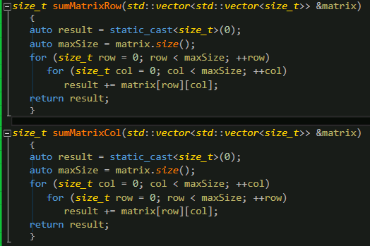
Sum of matrix elements

Slide 18
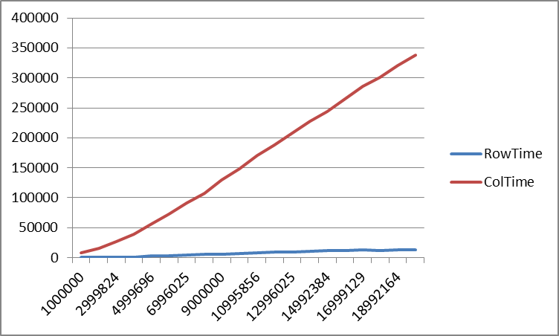
Summing a matrix: Results for big matrices
Note that
8MB does not fit in L1 and L2 cache
> 100MB does not fit in L3 cache either
Number of elements

Slide 19
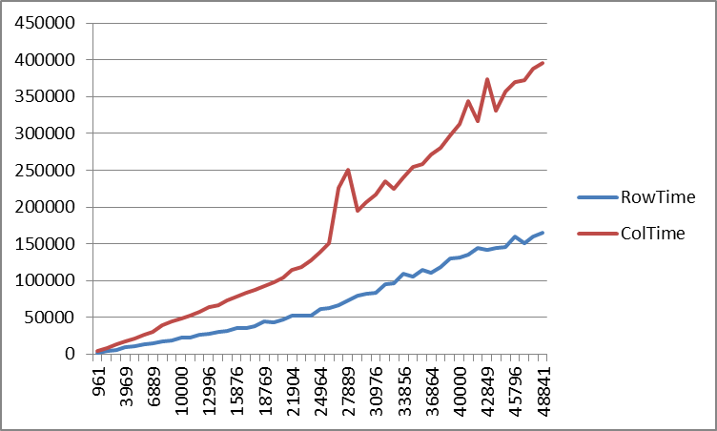
Summing a matrix: Results for small matrices
For small matrices that fit in L1 (or even L2) you would expect no difference in performance?
Number of elements

Slide 20
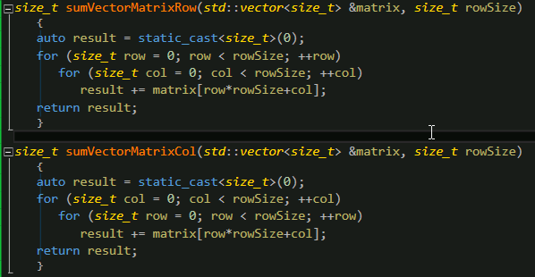
Matrices revised

Slide 21
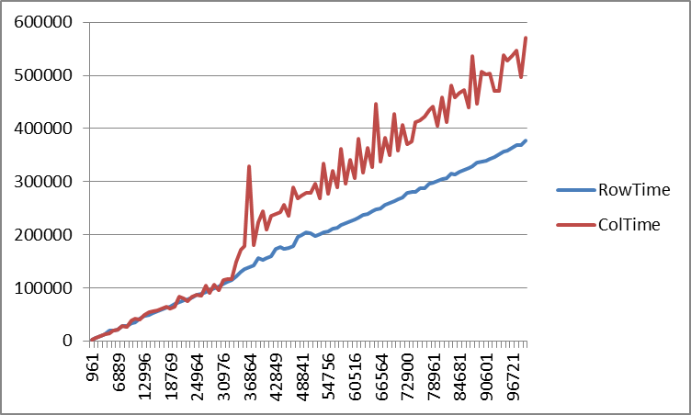
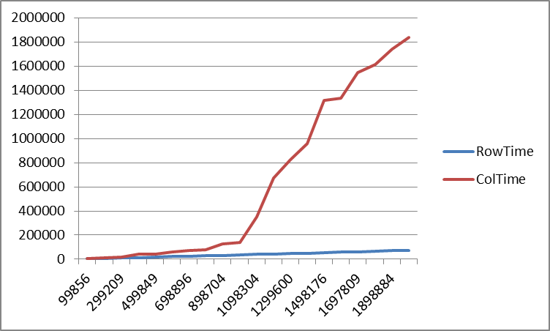
The results!
L2-Cache size
Number of elements

Slide 22
Why? Prefetching
Processors try to predict the memory you will read in future.
By the time you actually read it, the data is already in the cache
2 simple algorithms
Forward/backward consecutive reading
Probably also some more complex ones!
Good to know
No hardware prefetching over page boundaries (Apple filed a patent although) ➔ Locality is VERY important!
Page is typically 4KB, but you can go bigger, e.g. 2MB and 4MB
_mm_prefetch can be used to hint on prefetching yourself ➔ know what you are doing, it can work against you!

Slide 23
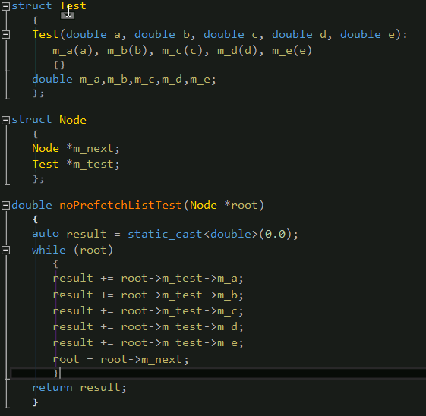
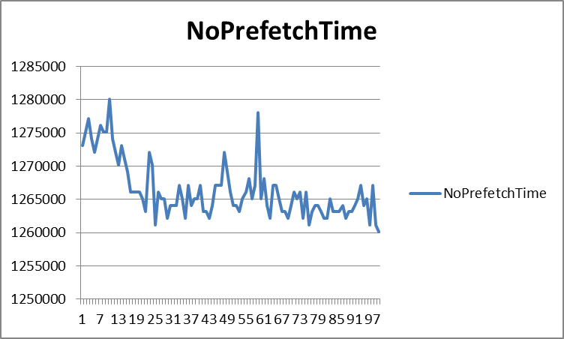
__mm_prefetch: a simple linked list example
Consider a simple linked list concept

Slide 24
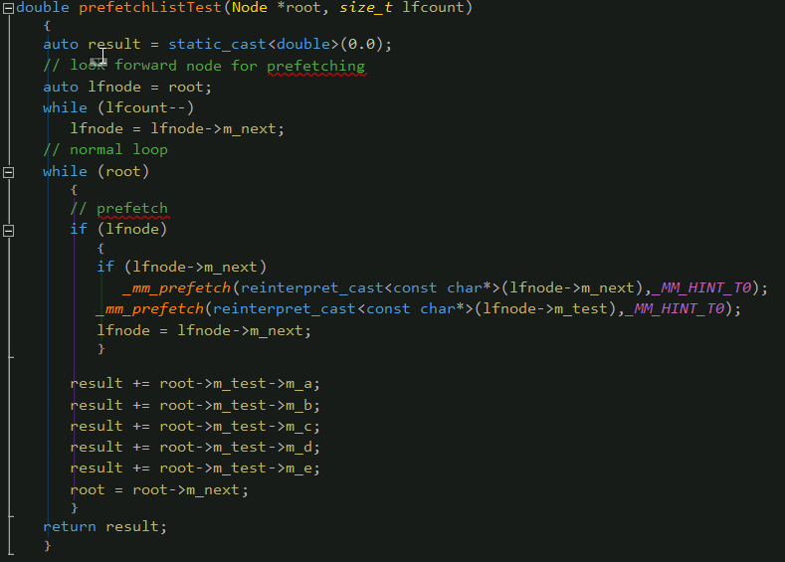
__mm_prefetch: let’s jump forward

Slide 25
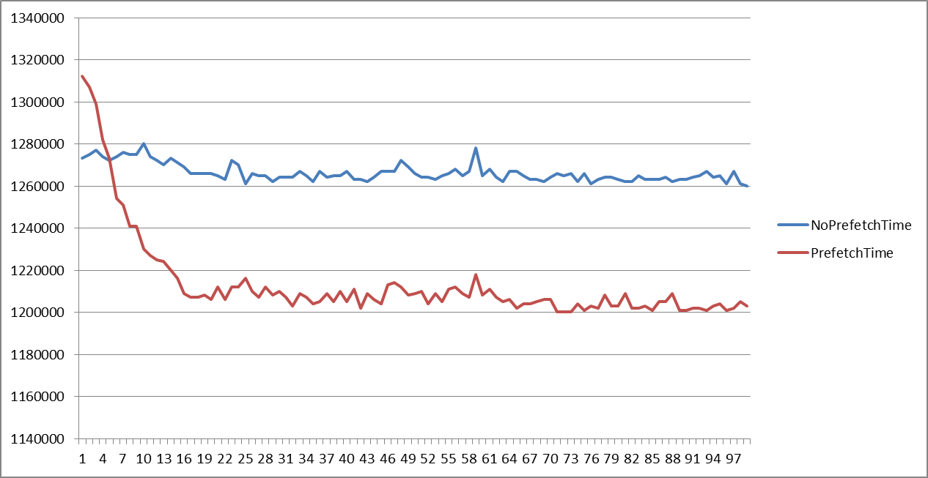
__mm_prefetch: the results
A nice 5% improvement, if you jump far enough
Prefetch Look Forward Count

Slide 26
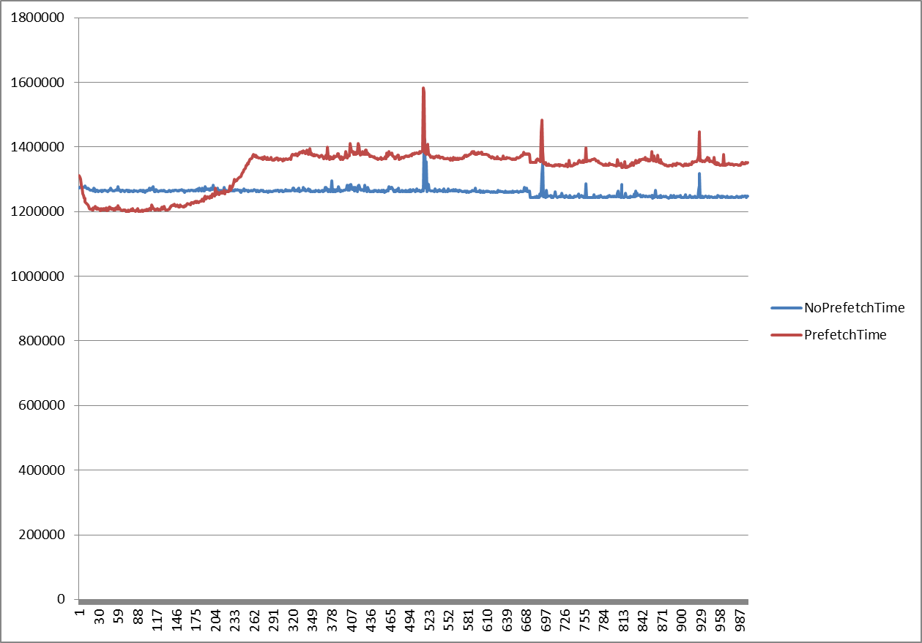
__mm_prefetch: but don’t jump to far!
Prefetch Look Forward Count

Slide 27
Cache Oblivious
Cache-Oblivious Algorithm:
An algorithm designed to take advantage of a CPU cache without having the size of the cache as an explicit parameter

Slide 28
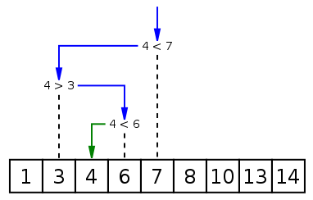
Binary Search Revisited
Binary Search Basics:
sorted collection
divide remaining search space by 2 each loop
complexity: O(Log2(n))
Is this a cache friendly algorithm?

Slide 29
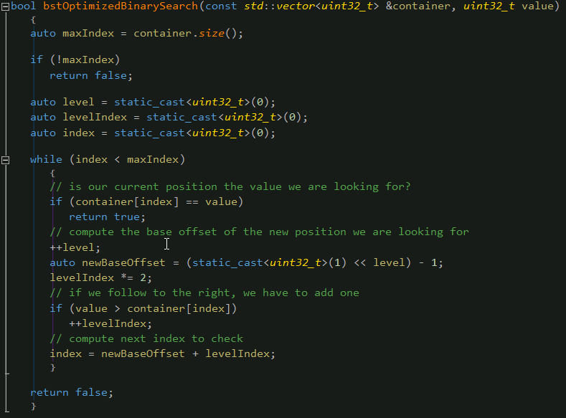
Cache-oblivious thinking: Binary Search Revisited
Can we improve ➔ Sort the vector as if it was a tree
8 | 4 | 12 | 2 | 6 | 10 | 14 | 1 | 3 | 5 | 7 | 9 | 11 | 13 | 15
8
1
4
12
2
3
2
6
10
14
4
5
6
7
1
3
5
7
9
11
13
15
8
9
10
11
12
13
14
15
In Order
BFS

Slide 30
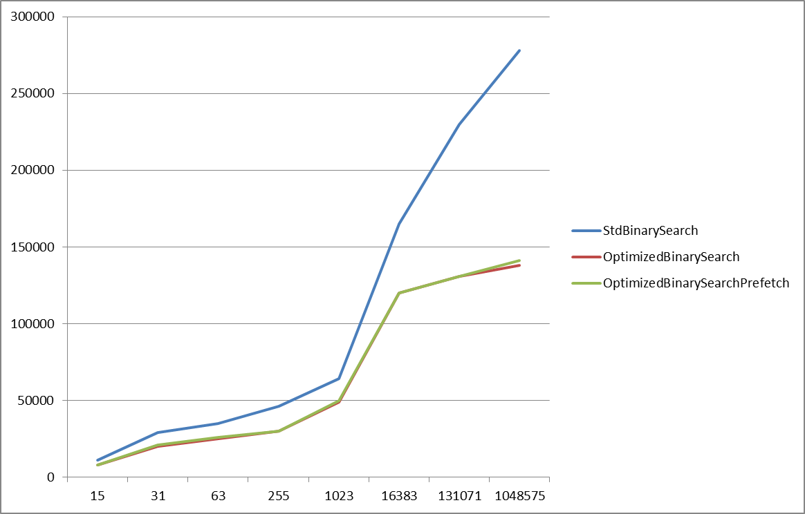
Binary Search Revisited: The Results
Number of elements

Slide 31
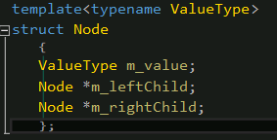
(Binary) Efficient Tree/Graphs: Alternatives
Previous binary search encoding is good for problems where the data does not change much
If you also want to insert, remove and maintain balanced trees, we typically switch to the following presentation
To maintain a balanced property in the tree, we typically introduce rotations (with red/black coloring)

Slide 32
(Binary) Efficient Tree/Graphs: Alternatives
Most common implementations are a horror for the cache as you jump around in memory like hell.
Can we fix that?
Definitely, both cache-oblivious and not cache-oblivious
Let’s explore a non cache-oblivious approach
Suppose
ValueType == uint32_t
Max number of elements < 2^(sizeof(uint32_t)*8)
In a 64-bytes cache line, we can fit 16 uint32_t

Slide 33
A more efficient binary tree
Recall that the above presentation was especially efficient in the beginning of the search
Can we exploit this better?
Some observations
The first tree levels of a binary tree fit in 7 positions of the 16
The fourth level has at most 8 elements
Thus, in a cache line we store
3 levels of the tree using the special encoding
8 references to the next lines containing the rest of the tree
And in the remaining free space, we can store a reference to the parent
8 | 4 | 12 | 2 | 6 | 10 | 14 | 1 | 3 | 5 | 7 | 9 | 11 | 13 | 15
8 | 4 | 12 | 2 | 6 | 10 | 14 | L1 | L2 | L3 | L4 | L5 | L6 | L7 | L8
1 |  |  |  |  |  |  |  |  |  |  |  |  |  |  | P

Slide 34
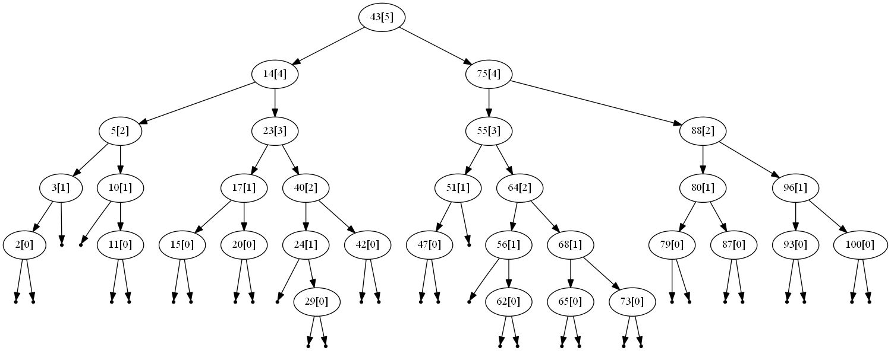
The van Emde Boas layout for binary trees
Clearly not cache-oblivious as we exploit our knowledge of the hardware
The representation is a bit more complex to understand
Rotations and so on to rebalance will be a bit more cumbersome, but it is possible

Slide 35
The van Emde Boas layout for binary trees
You can also implement it cache oblivious
Instead of optimizing on cache-line size, you could optimize on page size
Fit 9 levels of a binary tree in the first 511 elements
Level 10 contains 512 references to the continuation pages
But!
you need to know/understand the problem you want to fix
E.g. amount of searches vs inserts vs deletes
Only parallel searching, or also parallel modifications
…
you need to test and measure, but also try to explain the results

Slide 36
Some results: cache-line optimized version
10% slower w.r.t. our OptimizedBinarySearch for smaller amounts of elements
The data-structure uses 50% more memory for storing the references
In a 4KB page we can fit 1024 elements for the first representation, but we need 1024/7*16*4 = +/-9KB for the BST representation
7 ➔ useful elements that fit in 1 cache line
16 ➔ available elements in cache line
4 ➔ bytes per element
No prefetching over page boundaries
But we have of course increased functionality as we can also insert/delete and keep the thing balanced
The added complexity (extra function calls) also add some extra time
The gap decreases when the amount of elements grows

Slide 37
Good old B-Trees
Remember the B-Trees used in databases to overcome the slow hard-drives vs RAM memory?
➔ replace “hard-drives” with RAM and “RAM” with cache
Suppose we store uint32_t, i.e. 4 bytes
So, in 64-bytes, we can fit 16 elements
➔ Let’s create a 16-ary tree

Slide 38
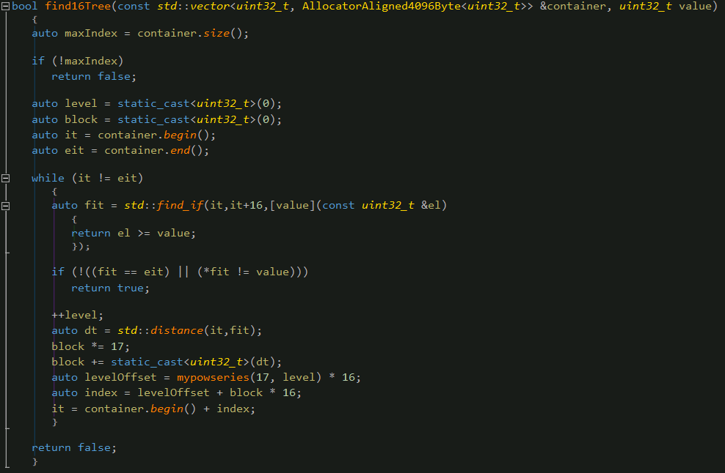
16-ary tree search

Slide 39
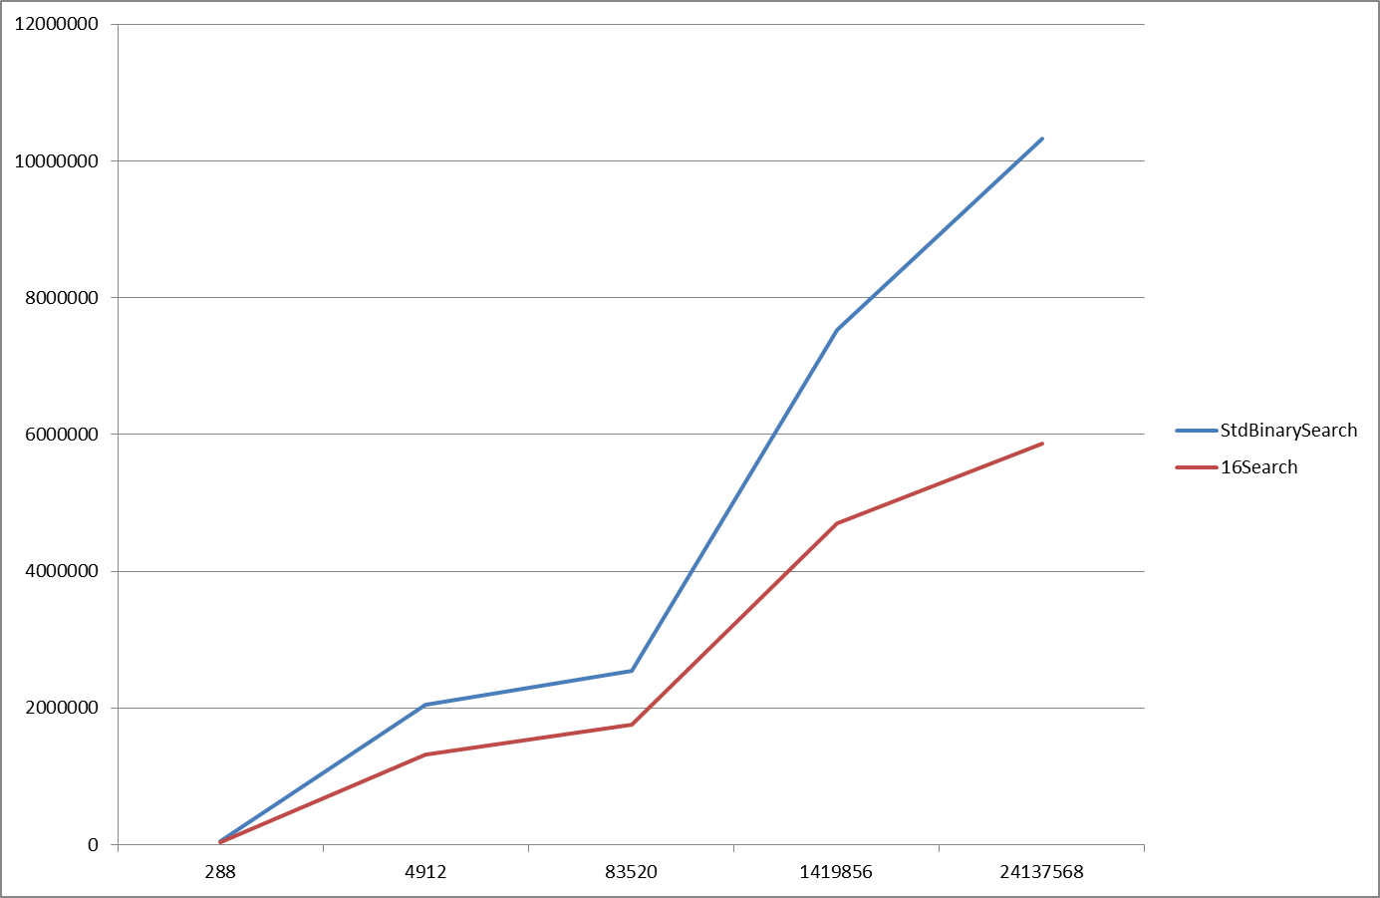
16-ary tree search: the results

Slide 40
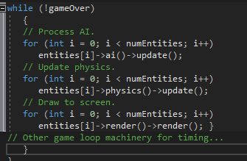
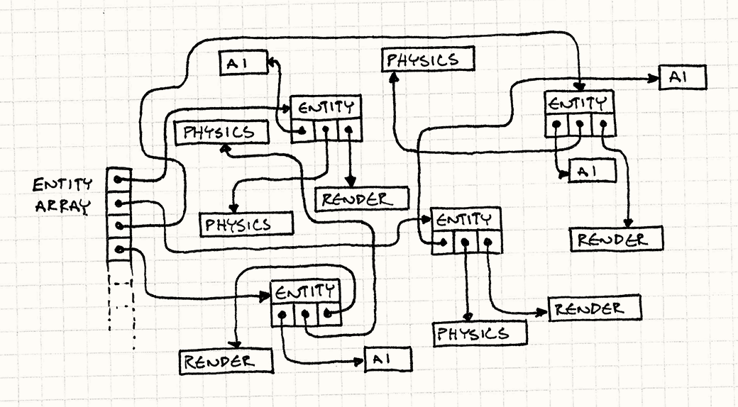
An example from the game industry
http://gameprogrammingpatterns.com/data-locality.html
When I got some stuff working, I was surprised. I knew it was a big deal, but there’s nothing quite like seeing it with your own eyes. I wrote two programs that did the exact same computation. The only difference was how many cache misses they caused. The slow one was fifty times slower than the other.

Slide 41
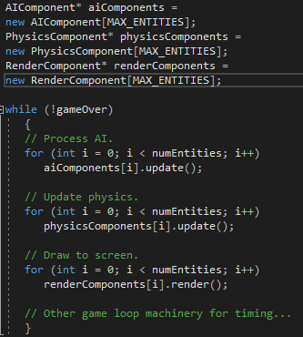
An example from the game industry

Slide 42
A word on alignment
Alignment is important
If your structure is less then 64-bytes, make sure it is not spread over a cache line, i.e. align on 64-bytes if needed!
When your structure is bigger then 64-bytes, make sure to align it on 64-bytes!
Hot/cold splitting if needed
Reduce amounts of padding bytes

Slide 43
Things to remember

Slide 44
Things to remember
Think about how and where you store your data
Think about how you use your data
Remember: forward/backward traversal triggers prefetching!
Try to use as much of a cache line as possible
Don’t neglect alignment
Data oriented over object oriented programming
Sometimes you need to give in on inheritance, virtual functions,…
Measure ,Measure and Measure!

Slide 45
Let’s put some threads to the equation

Slide 46
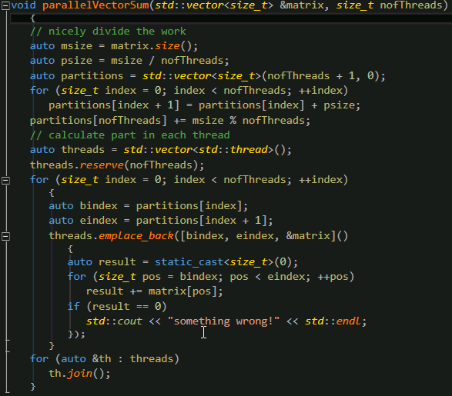
Parallel (partial) summation of vector

Slide 47
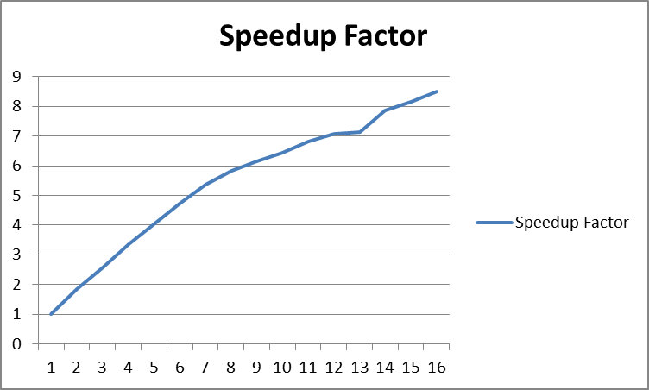
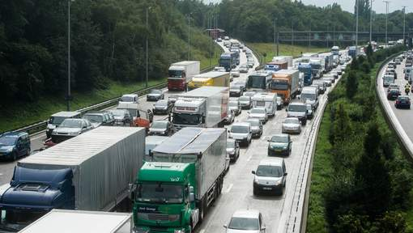
Parallel summation of vector: results
Only 8 times faster for 16 cores!
What is going on?
Remember the databus?

Slide 48
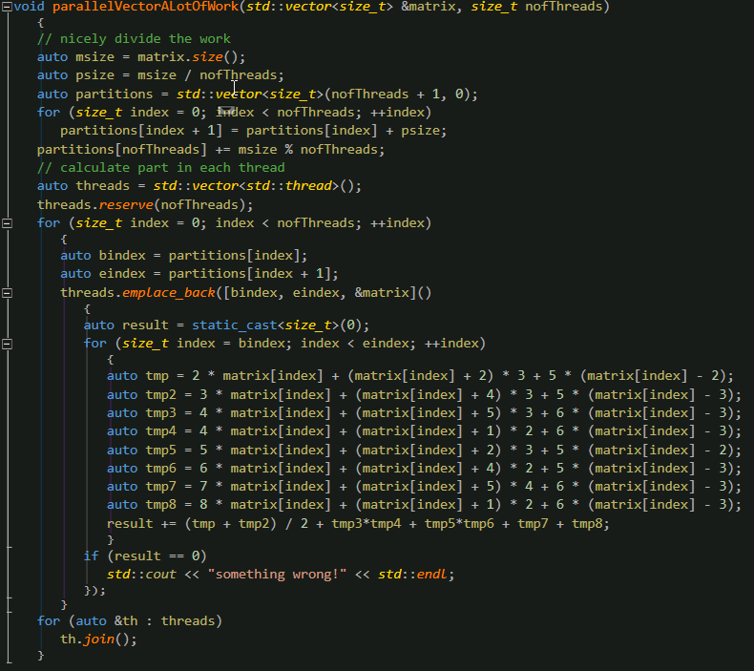
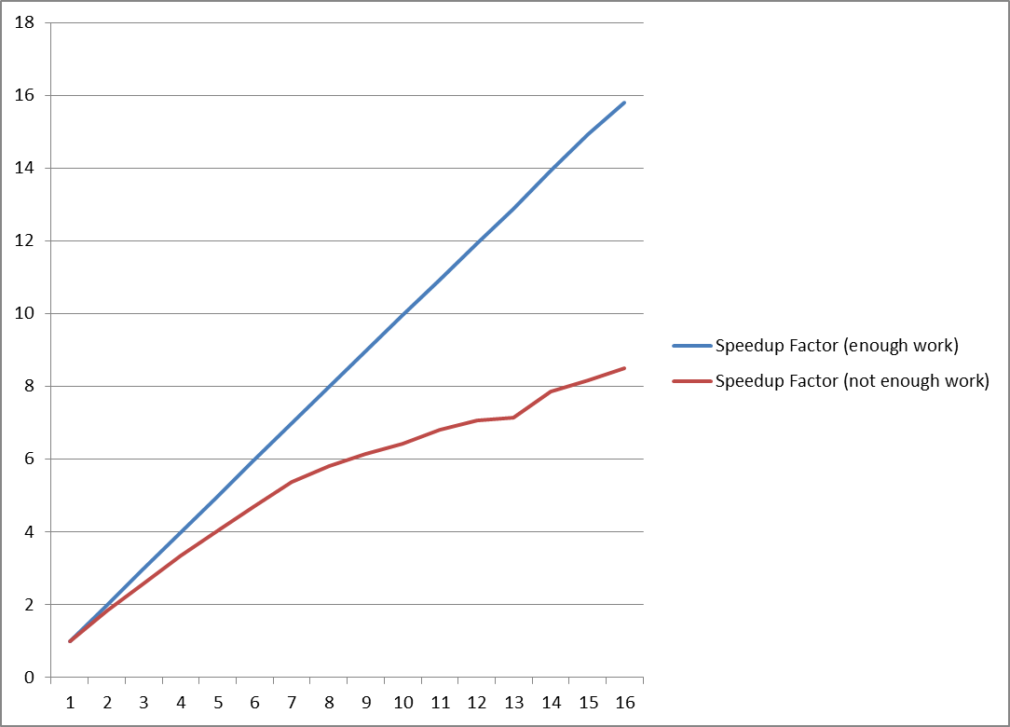
Make sure you have work to do!

Slide 49
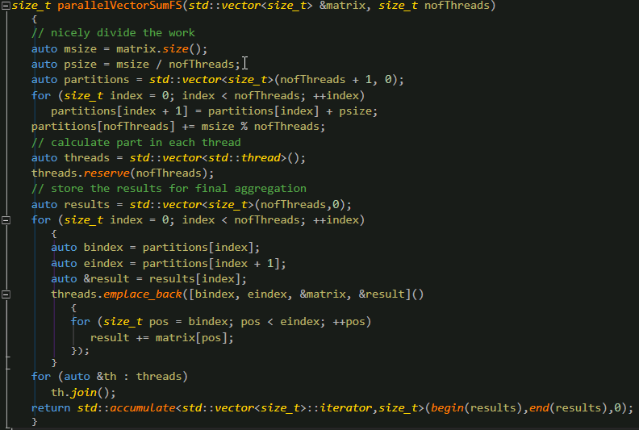
Real Parallel summation

Slide 50
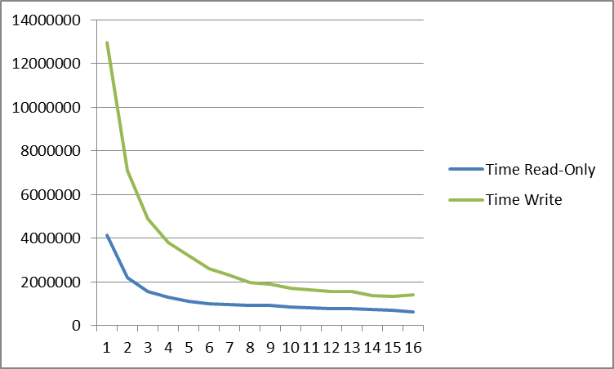
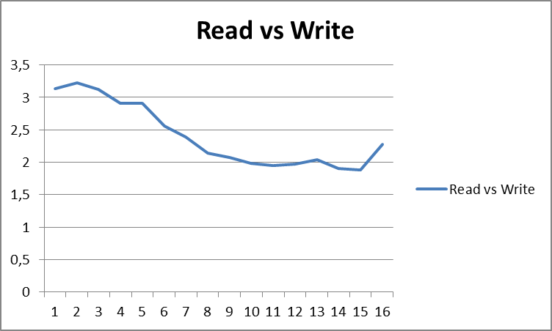
Real Parallel summation: performance?

Slide 51
What is going on? Cache Coherency
Socket with 4 cores
CPU1
registers
CPU2
registers
CPU3
registers
CPU4
registers
Each CPU has the same value x at address y in its cache
Suppose CPU1 writes a new value x’ at y
What do CPU2, CPU3 and CPU4 read?
L1 I
L1 D
L1 I
L1 D
L1 I
L1 D
L1 I
L1 D
L2 Cache
L2 Cache
L2 Cache
L2 Cache
L3 Cache

Slide 52
What is going on? Cache Coherency
Socket with 4 cores
Caches are introduced to reduce the latency involved when reading main memory
It should be transparent to the user
There is only one memory location corresponding with y!
Thus CPU1 will invalidate y in CPU2, CPU3 and CPU4 caches
CPU2, CPU3 and CPU4 will read the new values ➔ Takes time!!!
CPU1
registers
CPU2
registers
CPU3
registers
CPU4
registers
L1 I
L1 D
L1 I
L1 D
L1 I
L1 D
L1 I
L1 D
L2 Cache
L2 Cache
L2 Cache
L2 Cache
L3 Cache

Slide 53
What is going on? Cache Coherency
Socket with 4 cores
Reminder, caches are read/written per line, not per element
So a write invalidates a complete cache-line and forces a completely reread of the line!
CPU1
registers
CPU2
registers
CPU3
registers
CPU4
registers
L1 I
L1 D
L1 I
L1 D
L1 I
L1 D
L1 I
L1 D
L2 Cache
L2 Cache
L2 Cache
L2 Cache
L3 Cache

Slide 54
What is going on? False sharing!
Logically different memory locations sharing the same cache line
So each time a CPU writes in his result, the cache line is invalidated and the others have to reread!
Socket with 4 cores
CPU1
registers
CPU2
registers
CPU3
registers
CPU4
registers
L1 I
L1 D
L1 I
L1 D
L1 I
L1 D
L1 I
L1 D
L2 Cache
L2 Cache
L2 Cache
L2 Cache
L3 Cache

Slide 55
What is going on? False sharing!
As a summary, false sharing only happens when the following conditions are all satisfied
Access to memory that is located in the same cache line
The cache line is accessed concurrently from different threads
The access to the cache line has a high frequency
One of the threads is writing in the cache line
Note that any type of data can suffer from false sharing, both on heap, stack and statics!
However, if you don’t pass reference/pointer to local variables (stack) to other threads, these variables typically don’t suffer from false sharing. Hence the solution in our case …

Slide 56
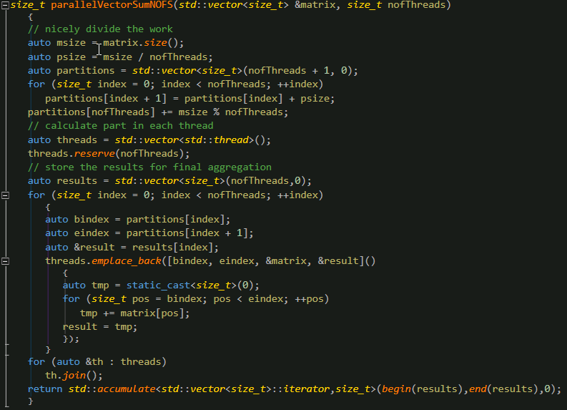
The art of removing false sharing

Slide 57
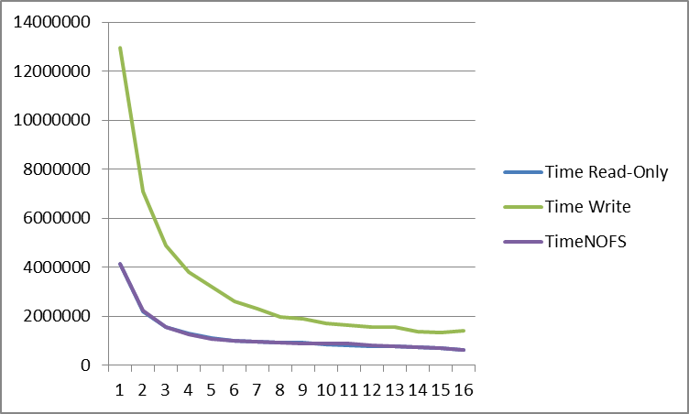
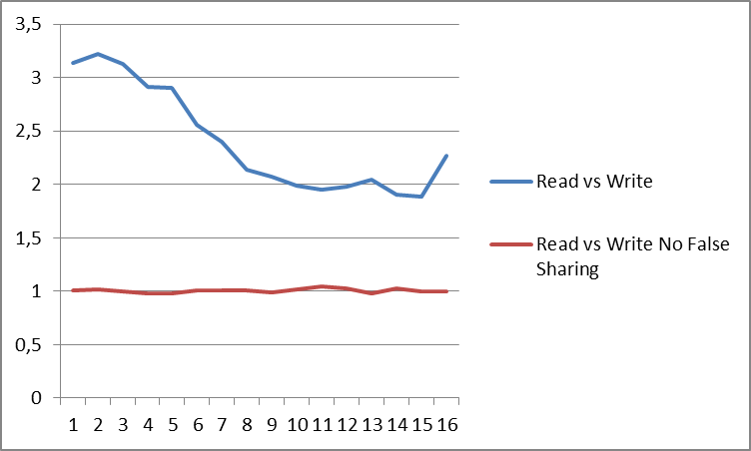
The results

Slide 59
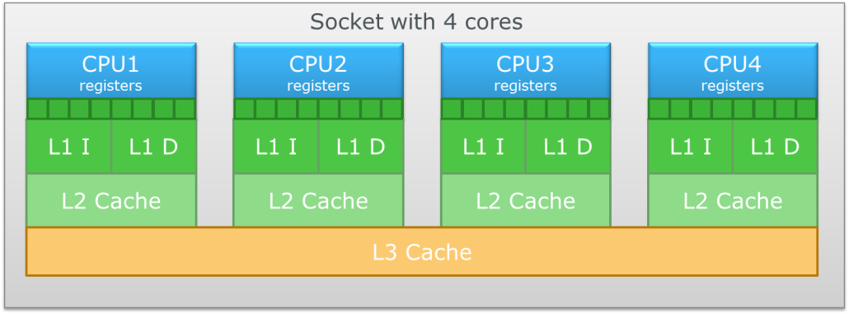
Modern Computer Architecture: Multi Socket
NUMA: Non-Uniform Memory Access
DataBus
DataBus
Main Memory
Main Memory

Slide 60
Modern Computer Architecture: Impact?
Use CoreInfo to see the impact ➔ 30% slow down if memory is located on another node seems to be the minimum (confirmed by own experiments) ➔ The cost is a dynamic number, so depending on load it can be worse!

Slide 61
Modern Computer Architecture: Impact?
Do we need to care?
It makes everything we discussed in this presentation worse with at least 30% if the memory is located on another node
There is not that much you can do as a developer on a local data and algorithmic level
In contrast to optimization for cache behavior, the NUMA story is something we have to tackle on a higher level in tools!
Does it make sense to use all cores in a multi-socket system if you know that at least half of the work runs at least 30% slower?
Pinning a process on a certain NUMA node and make sure it only runs on the corresponding socket (processor affinity) seems an important improvement!

Slide 63
References
http://gameprogrammingpatterns.com/data-locality.html
http://igoro.com/archive/gallery-of-processor-cache-effects/
http://www.aristeia.com/TalkNotes/ACCU2011_CPUCaches.pdf
https://www.akkadia.org/drepper/cpumemory.pdf
https://en.wikipedia.org/wiki/CPU_cache
http://erikdemaine.org/papers/BRICS2002/paper.pdf
http://quick-bench.com/xYfOs9oIKKqW-ujk743NBH9X2Ak
Matrix examples

Slide 64
Questions?

Slide 65
Optional Comment
Quote

